Slide 1

POWERING TOMORROW: AI-Driven Transformer Maintenance and Smart Metering for a Resilient and Just South African Energy Future
Presented by Goodness Maziya, Metering Manager &
Wesley Vorster, Digital Solutions Manager
ACTOM Smart Technologies (Pty) Ltd

Slide 2
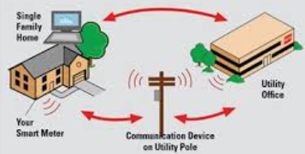


Introduction: The Case for Smart Metering
But smart meters alone are not enough. AI (Artificial Intelligence) is the key to unlocking the full value of this data — enabling us to detect tampering, forecast load, and make smarter, faster decisions
Smart metering is more than just a new technology trend, it’s a critical enabler for revenue protection, energy efficiency, and grid reliability, for suppliers and distributers of electricity, especially municipalities facing mounting financial and operational pressure.

Slide 3
Current Status of Smart Metering in South Africa
Municipalities
Leading:
Metros have begun implementing smart metering, particularly for commercial and industrial customers. Increasingly metering their distribution feeders, particularly at secondary substations.
Mid-Tier
Medium-sized towns and cities have partial rollouts, often focused on revenue protection in high-loss areas or major feeders. However, these deployments may lack full back-end integration or AI-based analytics. Distribution feeder metering is minimal.
Under-Resourced or Rural Municipalities:
Many municipalities, especially in rural or peri-urban areas, are still reliant on manual meter reading, often paper-based or legacy prepayment systems. Distribution feeder metering is minimal or non-existent
Eskom:
  Actively rolling out smart meters, with a target of replacing over 6 million meters by 2029 as part of load management and revenue protection strategy. Deployments full back-end integration. A portion of distribution feeders metered, especially secondary & higher-voltage points.

Slide 4

Challenges for Sectors Without Smart Metering
But why haven’t all sectors adopted smart meters?
High upfront costs, especially for communication infrastructure and software.
Connectivity gaps - poor mobile signal in rural and peri-urban areas.
Staff shortages - many municipalities lack the technical expertise to operate and manage smart meter platforms.
Widespread theft - meters and SIM cards are often stolen or tampered with.
Perhaps the most critical issue is that, without smart meters and AI agents, municipalities lack visibility, with no way to detect theft, balance loads, or improve revenue collection.
Without smart metering, there are negative impacts: Revenue loss, unpaid bulk accounts, delays/ difficulty in connecting to the grid.

Slide 5
Communication Pathways: Should Meters Talk to AI Directly?
The answer lies in structured, scalable architecture:
Not Ideal: It is not advisable for smart meters and feeder meters to communicate directly with AI agents due to huge volume of data.
Best Practice:
  Meters should first transmit data to a metering management system or unified data layer (e.g. via MCP over MQTT).
  This system organizes, validates, and contextualizes the data — creating semantic consistency across millions of data points.
  Once standardized, the data is then passed to AI agents for Anomaly detection, Load forecasting, Predictive maintenance and Revenue loss analysis.
✅ This ensures data quality, interoperability, and allows AI to function effectively with confidence scores and traceable decisions.

Slide 6
The Need for AI in Smart Metering
Capability | Smart Metering Systems -Measurement & Billing) | SCADA Systems - Real-time Grid Monitoring & Control | DMS - Grid Operations & Optimization | AI-Enabled Analytics - Insight, Prediction & Optimization
Theft Detection | ✅ Detects tamper events and reverse flow ⚠️ Rule-based alerts only | ⚠️ Detects energy losses at system level ⚠️ Cannot pinpoint customer-level theft | ⚠️ Tracks loss patterns ⚠️ Limited behavioral insight | ✅ Learns patterns, detects subtle anomalies, adapts over time
Load Forecasting | ❌ Raw data only; no forecasting capability | ✅ Short-term forecasting ⚠️ Limited to system/substation level | ✅ Feeder-level forecasting ⚠️ Based on static models | ✅ Real-time, adaptive, localized forecasting using weather, DER, behavior
DER Support | ✅ Measures net metering (import/export) ⚠️ No optimization | ⚠️ Manages voltage/reactive power⚠️ Not designed for high DER variability | ⚠️ Handles balancing/load control ⚠️ DER integration limited | ✅ Predicts DER impact, manages reverse flows, supports optimization strategies
Dynamic Pricing | ✅ Supports TOU and real-time pricing ⚠️ No demand response insight | ❌ Not pricing-related | ❌ Not applicable | ✅ Enables behavioral pricing, load shifting, demand forecasting

Slide 7
Roadmap for AI & Smart Metering Rollout — Who Needs to Do What
Phase
What gets done
Who is responsible
Readiness
Audit existing metering infrastructure; assess data flows; identify high‑loss feeders
Municipal technical depts; Eskom (where it supplies); IPPs/DER connected customers; NERSA set requirements
Infrastructure & Data Layer
Rollout of smart meters in pilot zones; feeder metering; establish unified data layers / MDM; ensure connectivity
Municipalities; Eskom; communications firms; IoT / meter vendors
Phase 3 (AI/Analytics Deployment)
Deploy AI for theft detection, load forecasting, DER impact modeling, demand response
Analytics firms; municipalities; Eskom; IPPs; policy/regulation enabling environment
Phase 4 (Scaling & Regulation)
Expand coverage; ensure legal / regulatory frameworks support trading, wheeling, pricing innovation; ensure cost recovery; integrate dynamic pricing / TOU tariffs
NERSA; Ministry of Energy / Electricity; SALGA / AMEU; Municipalities; Eskom; IPPs; energy traders
1
2
3
4
Emphasize collaboration: no one player can do this alone. Need coordinated action between Eskom, municipalities, IPPs, traders, regulators, and communities.

Slide 8
AI in Smart Metering – Real Examples in South Africa
Entity / Municipality | What’s Happening | AI / Analytics Component
Tshwane Municipality | Implemented smart meter integration, digital mobile apps for meter reading, and back‑end systems (AMI / MDMS) | Already in operation; large scale within the city. Read accuracy improved dramatically (from ~27% up to 80‑90+%) after integration.
Plentify | Intelligent home energy management | Load forecasting & behaviour modelling
Eskom | System optimisation | Eskom is using big data & AI to monitor the national grid & optimize system performance.
Sol Plaatje Municipality | Accurate billing & real-time monitoring | Predictive maintenance potential
RT29 Contract (MTN, Vodacom, etc.) | National smart metering procurement | TOU & load analytics enablement
Academic Experts (e.g. Prof. Vally Padayachee) | Advocating AI for tariff modeling and demand forecasting | Influencing policy and regulatory reform

Slide 9
Connect
Collect
Store
Analyse
Visualize
Improve
How AI Agents Works
Notes:
"Now let’s talk about the AI agents — and I want to emphasize, these are not just dashboards. They are digital co-workers, capable of making sense of vast, real-time data flows.
Here’s what they do:
They continuously monitor transformer metrics and analyze them against international standards like IEC 60076.
When something abnormal is detected — like overheating, high harmonics, or a gas spike — they automatically create a maintenance ticket, complete with a suggested root cause and a priority level.
These agents learn from experience — every time an engineer accepts, modifies, or closes a ticket, the AI adjusts its models.
Crucially, they also correlate external data — like smart meter consumption spikes — with transformer stress levels, allowing for holistic diagnostics that traditional systems can’t match.
So rather than waiting for equipment to fail, municipalities now have a system that helps predict failures and guide interventions intelligently — even with limited staff capacity.

Slide 10
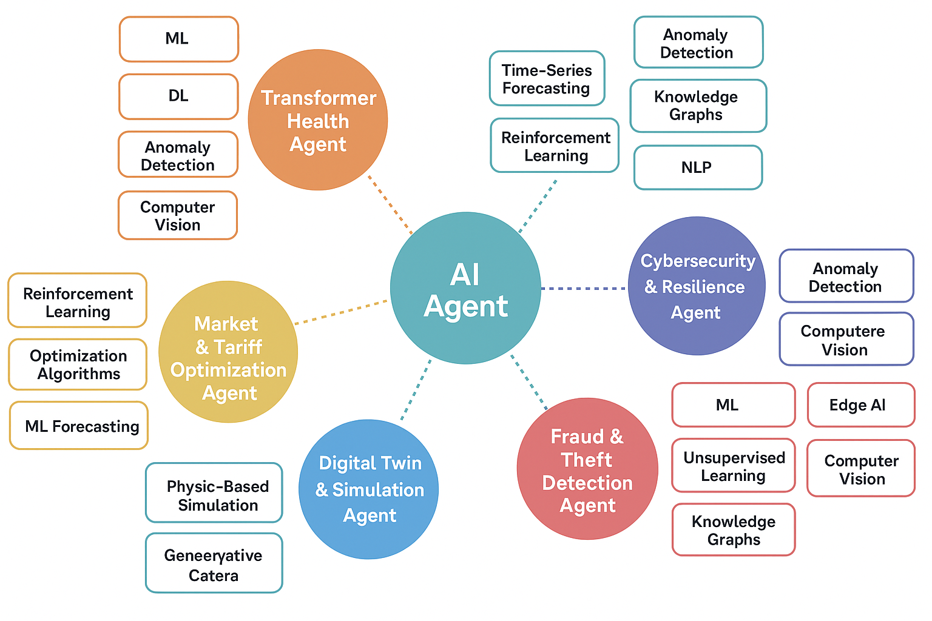
How AI Agents Works
Notes:
"Now let’s talk about the AI agents — and I want to emphasize, these are not just dashboards. They are digital co-workers, capable of making sense of vast, real-time data flows.
Here’s what they do:
They continuously monitor transformer metrics and analyze them against international standards like IEC 60076.
When something abnormal is detected — like overheating, high harmonics, or a gas spike — they automatically create a maintenance ticket, complete with a suggested root cause and a priority level.
These agents learn from experience — every time an engineer accepts, modifies, or closes a ticket, the AI adjusts its models.
Crucially, they also correlate external data — like smart meter consumption spikes — with transformer stress levels, allowing for holistic diagnostics that traditional systems can’t match.
So rather than waiting for equipment to fail, municipalities now have a system that helps predict failures and guide interventions intelligently — even with limited staff capacity.

Slide 11
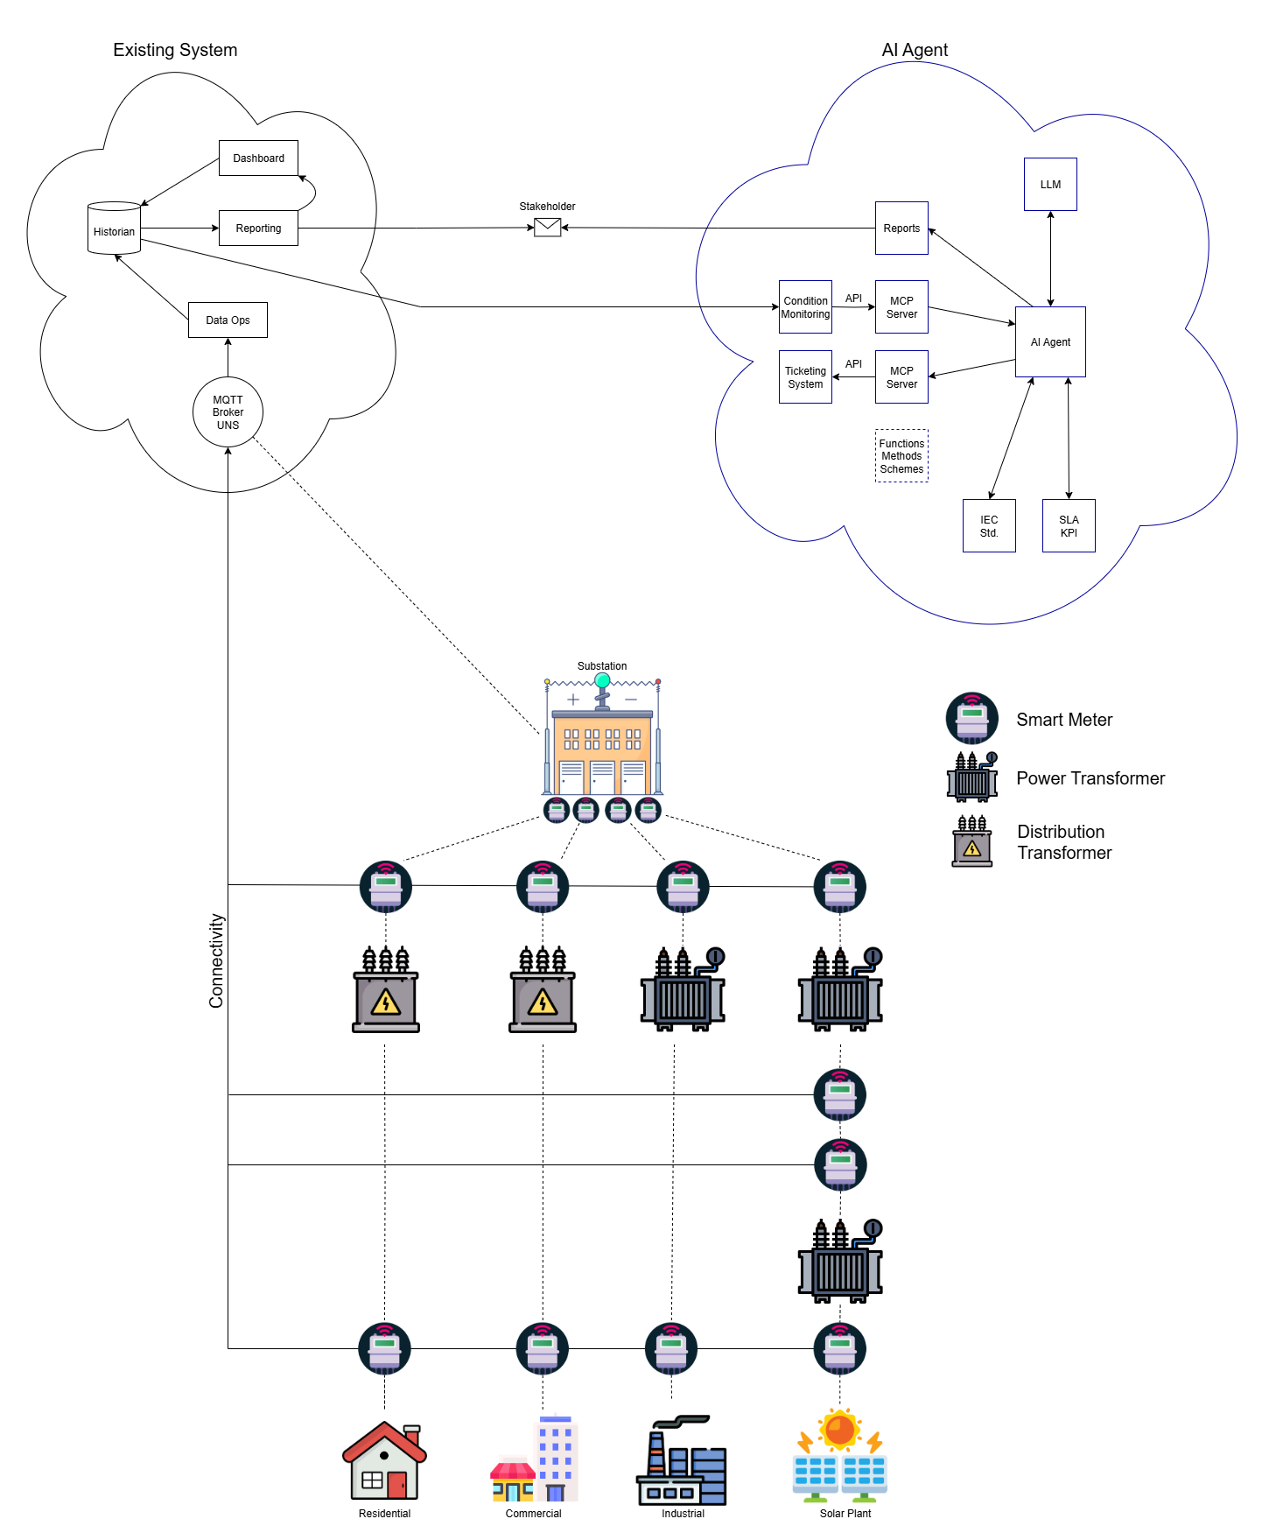
Architecture of AI-Powered Condition Monitoring
Notes:
At the device level, we use sensors that measure temperature, current, harmonics, and even dissolved gases in oil — all key indicators of transformer health.
These sensors feed data into edge devices — microcontrollers or industrial gateways — which perform light processing and anomaly detection onsite.
We use standard protocols like Modbus, MQTT, and MCP to transmit data efficiently and securely across networks.

Slide 12
Architecture of AI-Powered Condition Monitoring
Notes:
All data is then organized into a Unified Namespace — or UNS — which gives the system a consistent structure and makes it easy to find and correlate data from different sources.
A time-series database stores all this historical data with millisecond precision, which is vital for diagnostics and predictive analysis.
And finally, at the top of the stack, we deploy AI agents — the real brains of the system — that interpret the data, detect patterns, and trigger actions.“
This architecture isn’t theoretical — it’s already in use, and it’s designed for both large municipalities and smaller towns, with flexibility to scale based on available infrastructure.

Slide 13
Cybersecurity & AI Trust
Now — as we move toward AI-driven infrastructure, cybersecurity and trust become non-negotiable.
Architecture must comply with IEC 62443 for industrial cybersecurity
All data traffic must be encrypted, SIM cards should be embedded or tamper-protected, and systems are geofenced
AI decisions are explainable — using tools like SHAP and LIME, which show exactly why a model made a specific recommendation
And most importantly, we maintain a human-in-the-loop model. Engineers are always in control, with the AI offering insights, not mandates.
In this way, we ensure that trust is built through transparency, repeatability, and alignment with human expertise.

Slide 14
Conclusion
This isn’t just about hardware or AI. It’s about creating a resilient, intelligent, and inclusive energy system that can respond to local needs in real time — whether that’s fixing a failing transformer before it trips, detecting illegal connections, or helping a low-income household manage their electricity better.
With AI, we’re no longer just reacting to problems — we’re anticipating them, responding faster, and serving communities more equitably.
Together, smart metering and AI condition monitoring can help South Africa build a grid that’s not only smarter — but also fairer, cleaner, and future-ready.

Slide 15

Thank you

