Slide 1

Innovative Business Models for Scalable Smart Metering Implementation in Emerging Markets
Authored & Presented by Maruthi Mallepalli
Regional Manager (MEA – Smart Grids),
Wirepas

Slide 2


About the author & the company
Postgraduate degree in Power Systems
Extensive background in distribution network planning and implementation of T&D loss reduction programs
Led a software development team for designing and deploying utility billing systems
Served as Chief Operating Officer at a leading utility in Nigeria for five years
Currently Regional Head – Middle East & Africa (MEA) at Wirepas
About the Author & Presenter
  Wirepas is a Finnish technology company and a leading provider of Advanced Metering Infrastructure (AMI) communication solutions. With over 13 million smart meters deployed using Wirepas RF Mesh, the company has established a strong presence across Europe and India, delivering scalable, reliable, and cost-efficient connectivity for smart metering and IoT networks.

Slide 3
Contents
Introduction
The Energy Trilemma
Typical AMI system and its role in addressing Trilemma
  Smart meter communications role in AMI’s success
Various business models used by utilities
Recommended model for AMI in South Africa
Business Model demonstration – A sample case

Slide 4
Introduction
Smart metering is central to addressing the Energy Trilemma — balancing sustainability, affordability, and reliability.
The success of AMI (Advanced Metering Infrastructure) depends on the right mix of technology, business models, and regulatory alignment.
Communication technology choice (RF Mesh, Cellular, PLC) plays a critical role in determining OPEX, scalability, and system reliability.
Different business models suit utilities based on financial capacity, risk profile, and operational strategy.
In South Africa, a hybrid “Modified Off-Balance Sheet” model with Escrow can help bridge financing gaps and ensure sustainable AMI deployment.

Slide 5
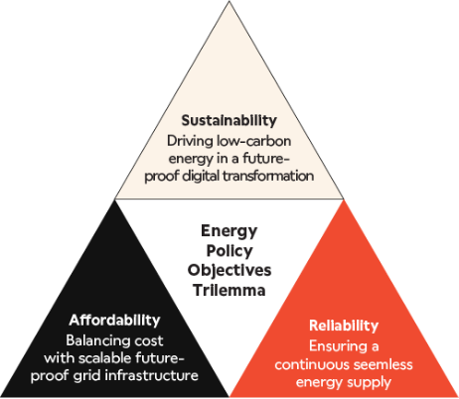
The Energy Trilemma

Slide 6
The Energy Quadrilemma – South African Perspective
South Africa’s Energy Future: A Quadrilemma Perspective
Traditional Energy Trilemma to a Quadrilemma, adding socio-economic development as a fourth pillar.
This shift, championed by Minister Dr. Ramokgopa, recognizes that energy policy must not only deliver clean and reliable power but also drive economic growth, create jobs, and address energy poverty.
Economic Development

Slide 7
Role of AMI
Heavy reliance on coal
Energy Transition
Decentralization leading to complicated grid management.
Smart grid integration of decentralized renewables with real-time data.
Supports demand response to align load with renewable availability.
Provides consumption insights for carbon reduction strategies.
Sustainability
Tariff Increases
Arrears and non-payment culture
Cost recovery for utility sustainability vs. consumer ability to pay.
Granular consumption data to help consumers budget
Enabling time-of-use tariffs
Reduces utility costs
Affordability
Load shedding
Impact of grid stability, power theft, losses, and outages.
Maintain power quality while managing outages.
outage detection and fault localization.
Helps in assessing non-technical losses
Helps in Demand side Management
Reliability

Slide 8
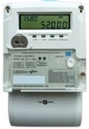

A typical AMI System in a distribution utility
Billing
Meter Data Management system (MDM)
Legacy Systems
Value Added Services
Head End System (HES)
Consumer & Utility Interface
Smart Meters
Communication
HES & MDM
Other IT/ OT systems
Automatic recording of meter data
Real-time communication
Installed at consumer, DT & feeder level
RF
PLC
Cellular
Any combination
Facilitate configuration of meter parameters
Ensure 2-way communication b/w meter & MDM
Can be cloud hosted or on-premise
Processes, cleans and validates data
Report generation and system analytics
Integrated with other utility IT-OT systems such as billing system, consumer portal, etc.

Slide 9
Smart metering communication – A critical element in AMI
Smart metering communication technology choice is critical for AMI success.
The technology must ensure:
  Low Operational Expenditure (OPEX)
  High reliability
  Scalability
No single technology fits all — selection depends on:
  Local network topology
  Population density
  Telecom infrastructure availability
RF Mesh significantly reduces OPEX since:
  No recurring subscription cost
  One cellular subscription can serve ~500 meters

Slide 10
Meter Communications
Access Technology | Sustainability (Longevity) | Affordability (Cost) | Reliability (Performance)
Cellular | Vulnerable to network shutdowns and spectrum repurposing | Relatively High maintenance cost; subject to operator fees and licensing. | Good coverage, reliability varies, additional costs for high reliability.
PLC | Utility-managed private network | Need maintenance; DCU installations required. | Time tested, dependency on distribution n/w infrastructure; suitable mostly for AMI.
RF Mesh (DECT NR+) | Utility-managed private network | GW infrastructure (In meter GW), low TCO. | Unlicensed dedicated spectrum ensures good performance.

Slide 11
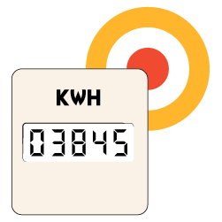
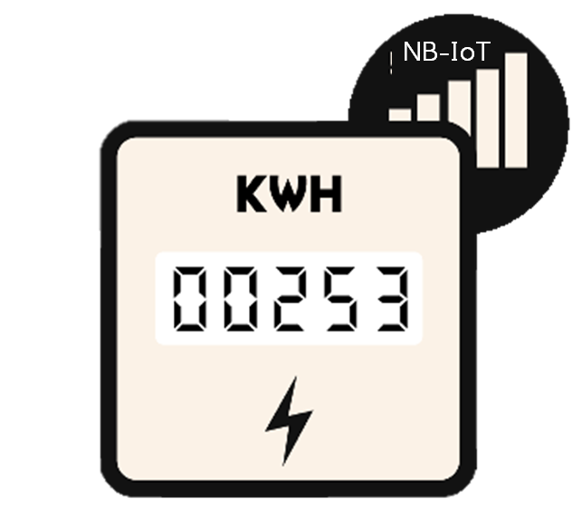

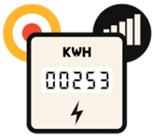


OpEx: Cellular backhaul (embedded) for NR+ vs. Cellular default
200 NR+ Meters
Cellular cost per
metering point
4 EUR / 200 = 0.02 EUR
Lifetime 2.40 EUR
NR+ / RF Mesh
Gateway
1 cellular connection
Cellular cost per
Month (200 MB)
4 EUR
200 Cellular connections
Cellular cost per
Month
16.67 EUR
200 Cellular Meters
Cellular cost per
metering point
0.083 EUR
Lifetime 10 EUR
11

Slide 12
Business Models adopted in AMI project implementation

Slide 13
Business Models for AMI Implementation in South Asia
Utility Procurement Model (CAPEX)
OPEX Model
TOTEX model
Utility directly procures individual AMI components from vendors.
Up to 10 % payment upon signing of the contract.
50 – 60 % of contract value paid upon completion of testing and installation.
Remaining amount paid in annual instalments at the end of each year - during service period (3 – 5 years).
Utility nominates a Concessionaire (AMI Solution Provider)
AMISP is paid on monthly basis by utility with no upfront capex investment
AMISP procures AMI components from own subsidiaries or buy from vendors.
AMISP will be paid on monthly basis through concession period.
Utility pays upfront up to 22.5% of smart metering meter cost (capped at certain amount) upon installation and operationalization of meters
Remaining cost is paid on monthly basis as annuity payments upon meeting of SLAs for a period ranging from 7 to 8 years

Slide 14
Comparison of Business Models for AMI Implementation
Parameters
Initial Investment
Ease of Implementation
System Integration
Cyber Security Risk
Private Sector Participation
CAPEX (On Balance Sheet)
High (Less Preferred) Utility bears all costs upfront
Low (Less Preferred) Requires rigorous capacity building at utility end
Low (Less Preferred) Requires coordination between multiple vendors
Low (Most Preferred) Utilities have entire control over data
Low (Less Preferred) Low investor confidence
OPEX ( Off Balance Sheet)
Low (Most Preferred) PMA is paid on monthly basis - no upfront CAPEX
Medium (Preferred) PMA manages end–to–end operations
Medium (Preferred) May lack flexibility for future utility needs
Medium (Preferred) Certain extent of control of data by third parties
Medium (Preferred) Order accumulation amongst few vendors
TOTEX
Medium (Preferred) Utility funds a portion - rest managed via OPEX
High (Most Preferred) AMISP does all the heavy lifting for implementation
High (Most Preferred) Provides seamless system integration
Medium (Preferred) Control and ownership of data lies with the AMISP
High (Most Preferred) Highest private sector participation

Slide 15
Case study for the business Model: AMI project in India
RDSS project aims to reduce the AT&C losses to pan-India levels of 12-15% and ACS-ARR Gap to zero by 2024-25 by improving the operational efficiency and financial sustainability of all DISCOMs.
Smart Metering Progress in India (as of Sep 2025)
  Installations: 42 million smart consumer meters installed
  Sanctions: 224 million consumer meters, 5.3 million DT meters, and 2.05 million feeder meters sanctioned.
  Target: Complete replacement of 250 million meters in 2 years.

Slide 16
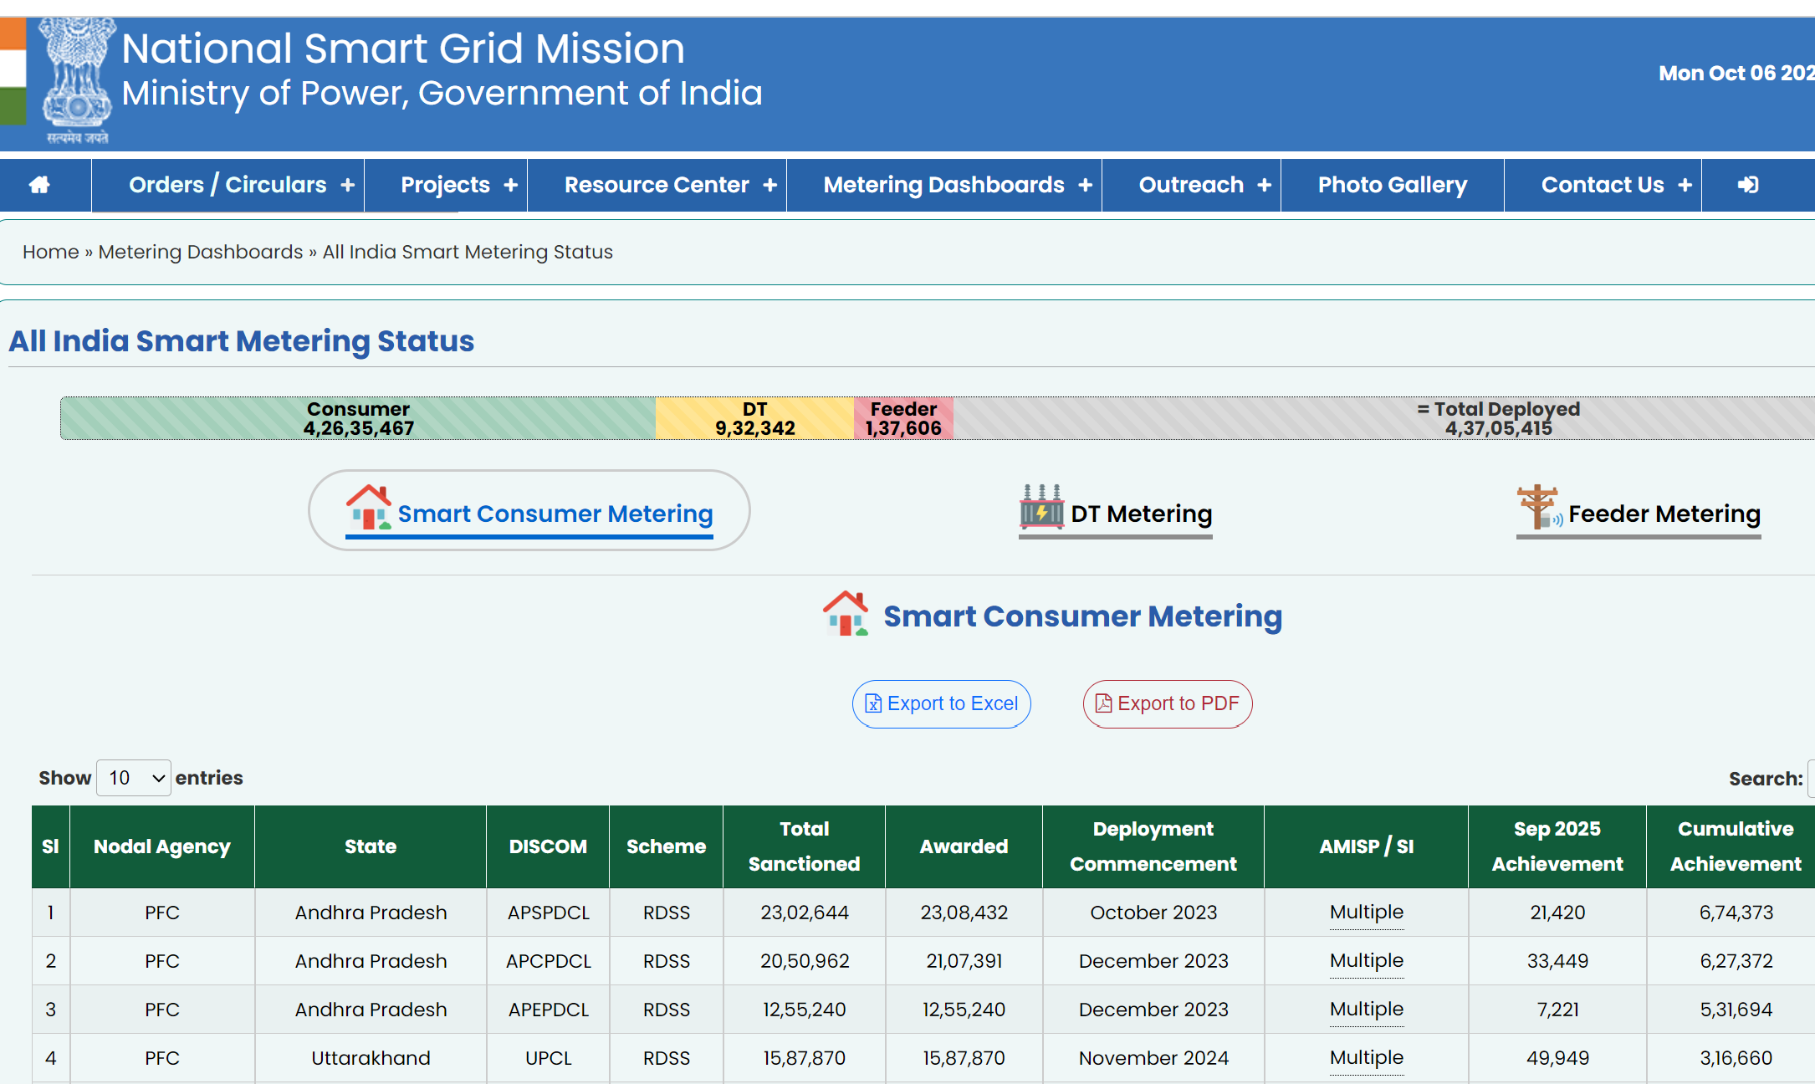
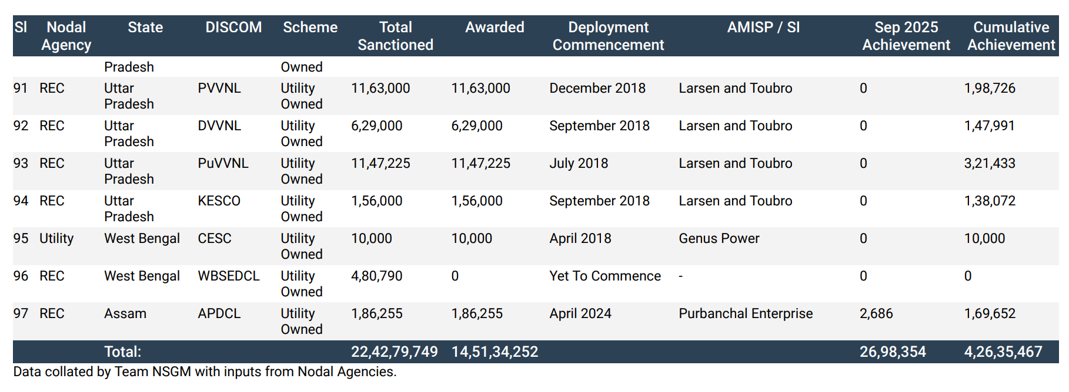
Case study for the business Model: AMI project in India

Slide 17
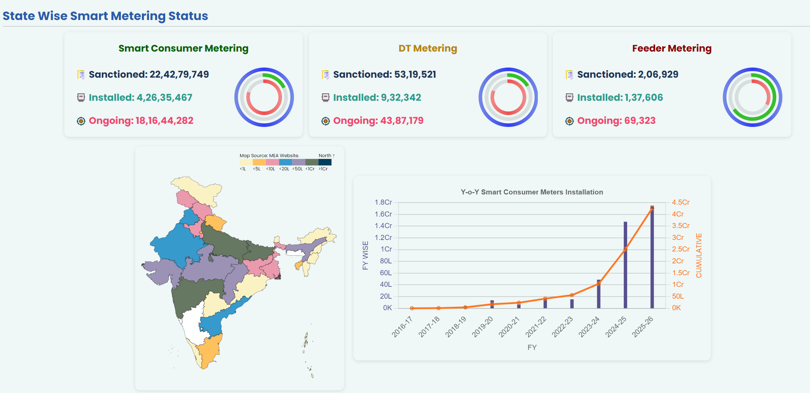
Case study for the business Model: AMI project in India

Slide 18
AMI project in India - RDSS 2.0 Vision
Modernisation of substations, transmission lines, and underground cabling.
Integration of AI/ML for load forecasting and demand management.
Promotion of smart homes, efficient appliances, and peer-to-peer energy trading.
Support for renewable integration, EV adoption, and sector automation, ensuring long-term resilience.

Slide 19
Recommended Business Model for South African context
Given the weak financial condition of many municipalities and distribution utilities, a conventional CAPEX-driven AMI rollout is often not feasible.
To overcome this barrier, a “modified off-balance sheet model with an Escrow arrangement” can provide a viable solution.

Slide 20
Hybrid “Modified Off-Balance Sheet Model” with Escrow Arrangement
Features
Reducing upfront capital requirements
Securing payments through an Escrow mechanism
Linking payments to performance via SLA-based annuities
Benefits
Financial sustainability
Operational reliability
Investor confidence

Slide 21
Business Model demonstration – A sample case
Assumptions & Estimations
No of Customers | Nos | 100,000
Project Concession period | years | 5
Total Estimated Project cost | Million USD | 13.8
Project Funding by Implementation Agency ( Concessionnnaire) | % | 100%
Loan taken by Implementation Agency ( Concessionnnaire) | % | 90%
Finance Charges | % | 9%
Single Phase meters |  | 75%
Three Phase meters |  | 25%

Slide 22
Business Model Demonstration – Projected / Estimated performances

Slide 23
Business Model Demonstration – Utility Cashflows for AMI project
IRR (Pre Tax) -16%

Slide 24
Key Takeaways on the Model
This model demonstrates how an off-balance sheet financing structure can enable utilities to implement AMI without upfront capex, while still achieving:
Positive IRR for both the operator and the utility
It is a win-win structure where the utility avoids heavy debt burdens, and the implementation agency secures predictable annuity-based returns.
Detailed business model can be shared and happy to discuss further – email id: Maruthi.Mallepalli@wirepas.com

Slide 25

Thank you

