Slide 1

Collaborative Digital Innovation Ecosystems for a Just Energy Transition
Presented by Phatudi P Malepe
PhD Candidate
Wits Business School [University of the Witwatersrand]

Slide 2

PRESENTATION OUTLINE
Background
Current research focus
Problem statement
Digital Innovation Ecosystem
Role of digitalization
Methodology
The Framework

Slide 3
BACKGROUND
Multifaceted challenge of climate change.
Energy sector as a significant contributor.
Decentralization of energy systems.
Twin transition [Digital Transformation and Sustainability].

Slide 4
CURRENT RESEARCH FOCUS
Current research on digitalization and sustainability tends to focus predominantly on the “what” (technological applications) and the “where” (sectoral or geographic impact). However, there remains a notable gap in understanding the “how” (the mechanisms, processes, and governance models through which digital innovations shape sustainable outcomes) and the “why” (the underlying values, motivations, and systemic drivers that inform these transitions).

Slide 5
PROBLEM STATEMENT
There is a lack of a comprehensive and unified theoretical framework that explains how digitalisation can be effectively implemented and managed within the digital innovation ecosystem for significant social transformation.

Slide 6

Digital Innovation Ecosystems
“a loosely coupled set of independent actors involved in the development and implementation of innovations enabled by digital technologies.”

Slide 7
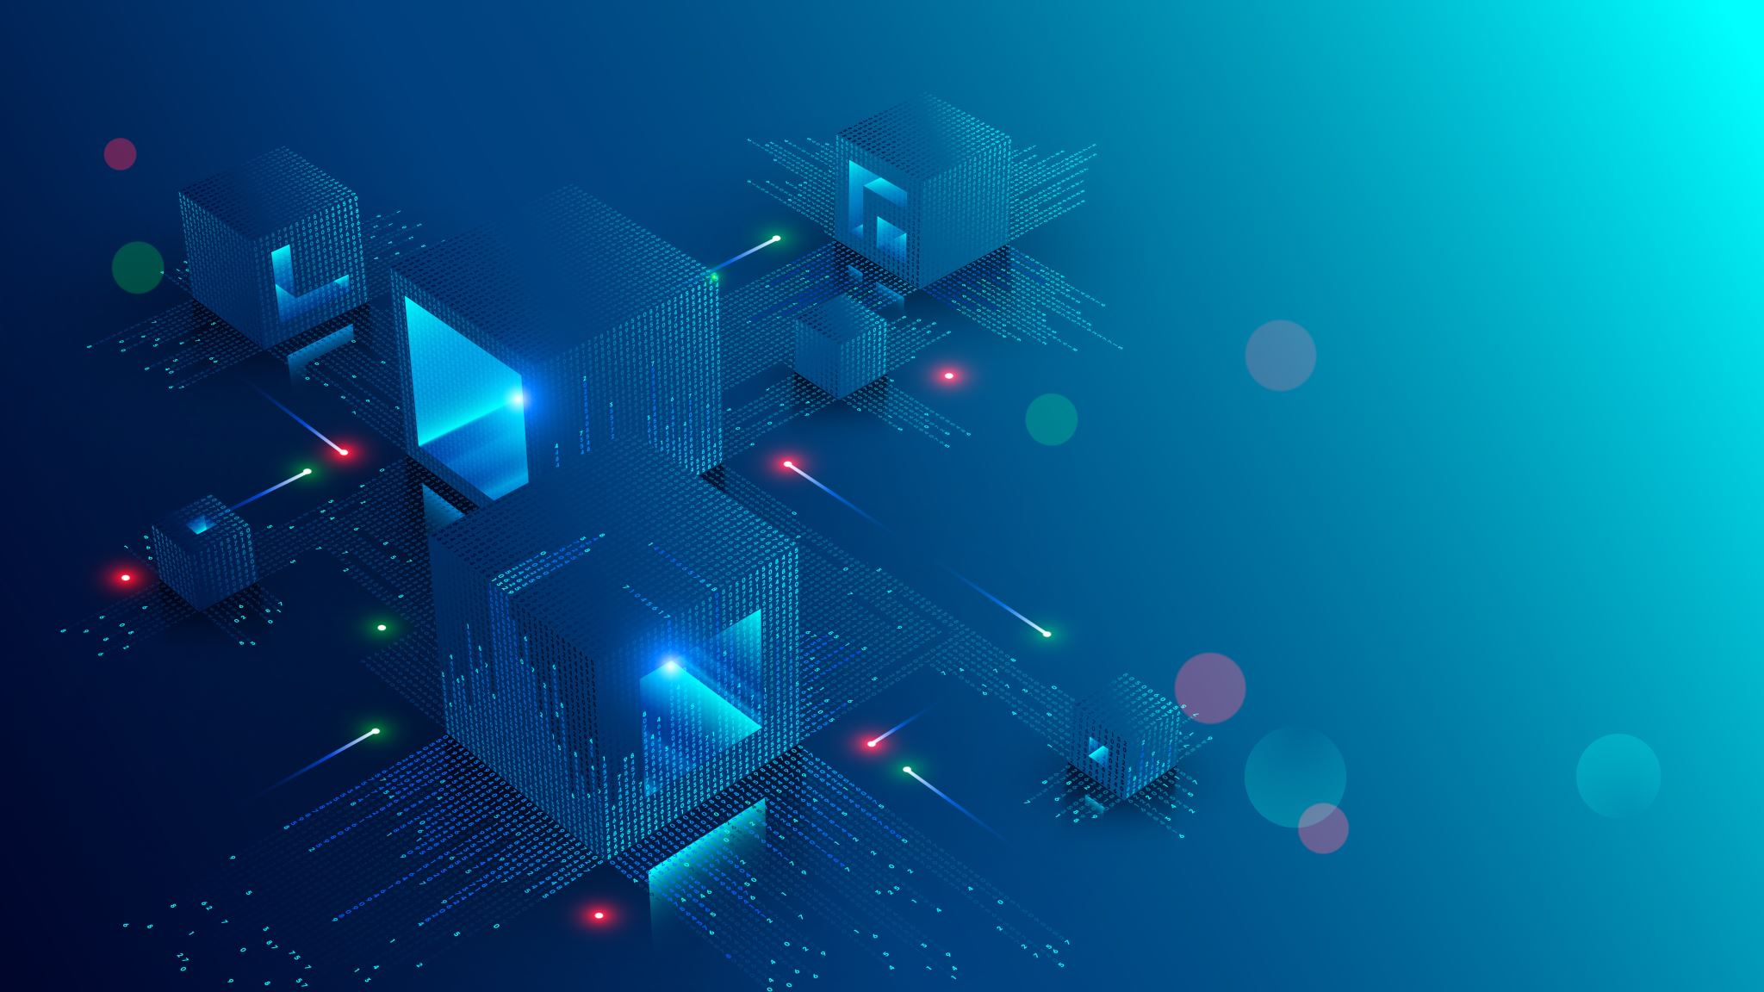
ROLE OF DIGITALIZATION
Enhanced efficiency
Improved coordination
Development of new business models
Improved governance and transparency

Slide 8
METHODOLODY
METHODOLOGICAL APPROACH
Critical Realism [empirical, actual, real]
Actor-Network Theory
Systems Thinking

Slide 9
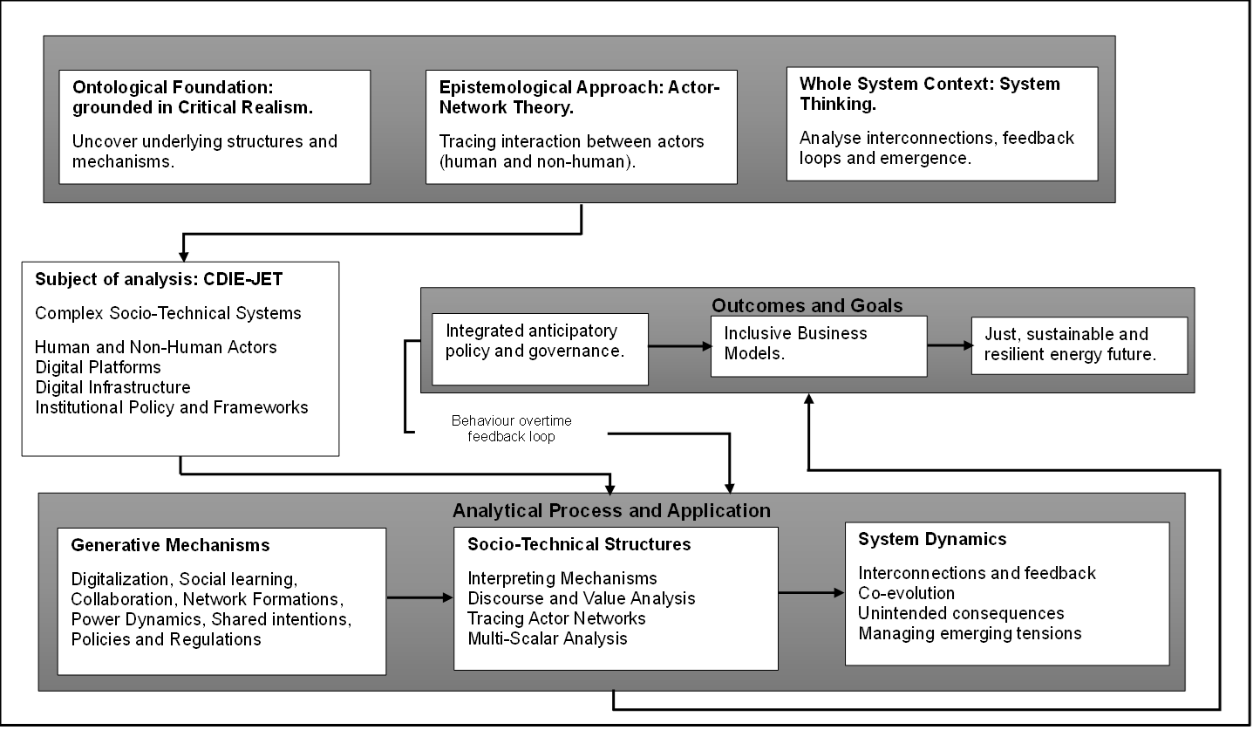

Slide 10
CONCLUSION
The framework provides holistic view.
Acknowledges that ecosystems are not merely technical but embedded in social, cultural and political.
[What works for Who in What circumstances?].
Context-Mechanism-Outcome [CMO].
Moves beyond the “what” and “which”, to the “how” and “why”.
Future validation of the framework.

Slide 11
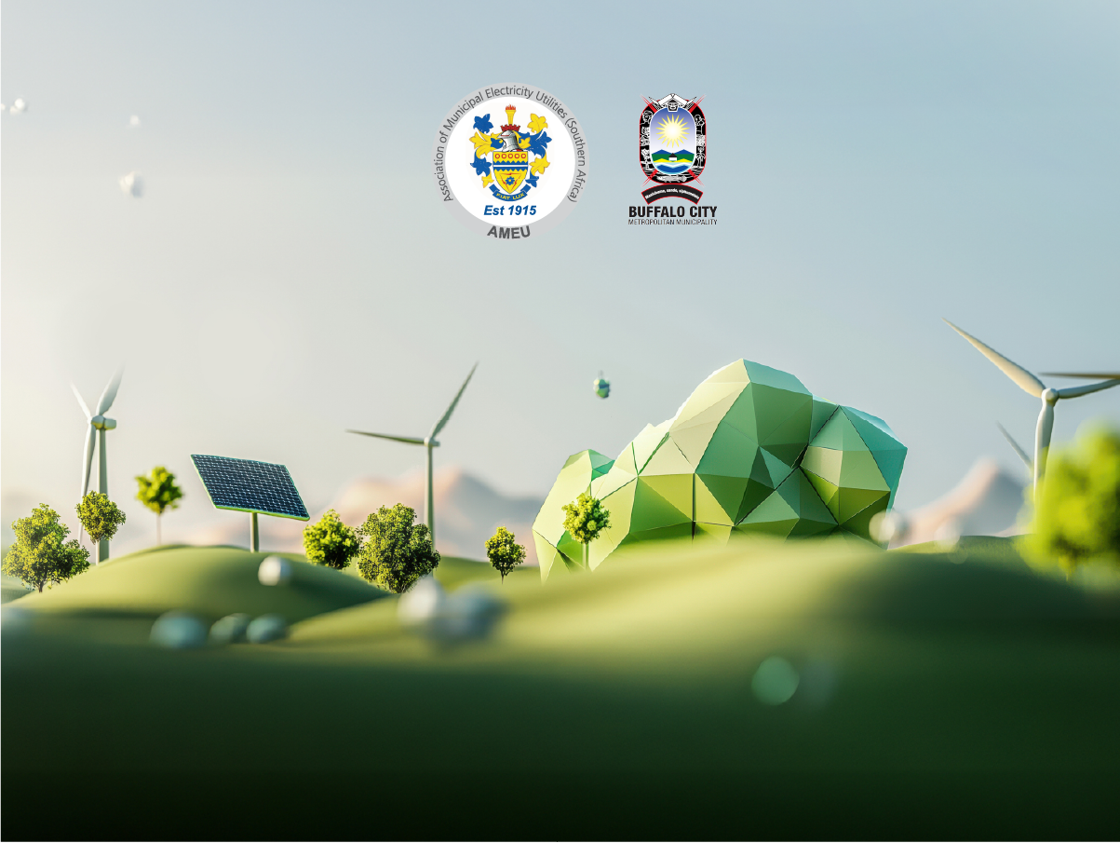
Thank you

