Slide 1

THE ESKOM DISTRIBUTION AGENCY AGREEMENT (DAA)
AMEU Convention 2025
Presented by Mpumelelo Mnyani
Senior Manager Retail
Eskom Distribution

Slide 2
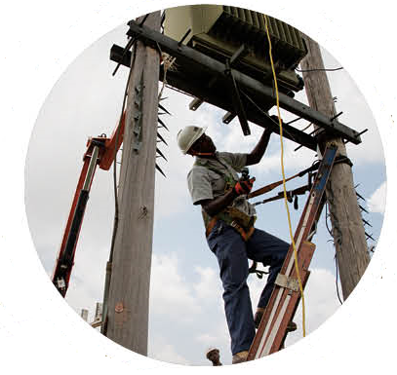


Contents
The key challenge
Introduction
Municipality debt overview
Eskom as a Reticulation and Distribution agent
Municipal electricity priority focus area
Mitigating the impact of high electricity tariffs on municipalities & households
Potential key benefits to be derived by the key role players in the EDI
Benefits derived from and during the implementation of the DAA
Support required

Slide 3

The key challenge
Municipality Debt
Municipal Arrear debt as at end of August 2025 is R 103.5 Billion 2025 and growing monthly by R2 billion due to systemic challenges in the Electricity Distribution Industry (EDI).
Municipalities are unable and, in some instances, refuse to pay utilities for the services they receive.
Addressing these systemic issues within municipalities will lead to improved municipal electricity operations and a more efficient EDI
Advocacy for municipalities to pay for services rendered and embrace partnerships (Active Partnering Program) that includes the DAA.
Debt monster

Slide 4


Introduction
DAA
  The presentation provides background to the Distribution Agency Agreement with a focus on highlights and achievements.
  The focus of the DAA is to assist municipalities with their electricity business, enabling them to pay their bulk accounts in full to Eskom and prevent the growth of the municipality debt.
The DAA process deals with municipalities in crisis on a wholistic, one-by-one basis
  The DAA will realize benefits for the sustainability of the entire Electricity Distribution Industry.
  The DAA entails partnering with municipalities with their reticulation and distribution of electricity business; revenue collection and retail services.
  The DAA supports municipalities to provide sustainable local services whilst also contributing to the sustainability of South Africa as a whole.
  The DAA is not meant to be a permanent solution but a transition for municipalities to better their operations, collect revenue to enable them to pay for electricity.

Slide 5
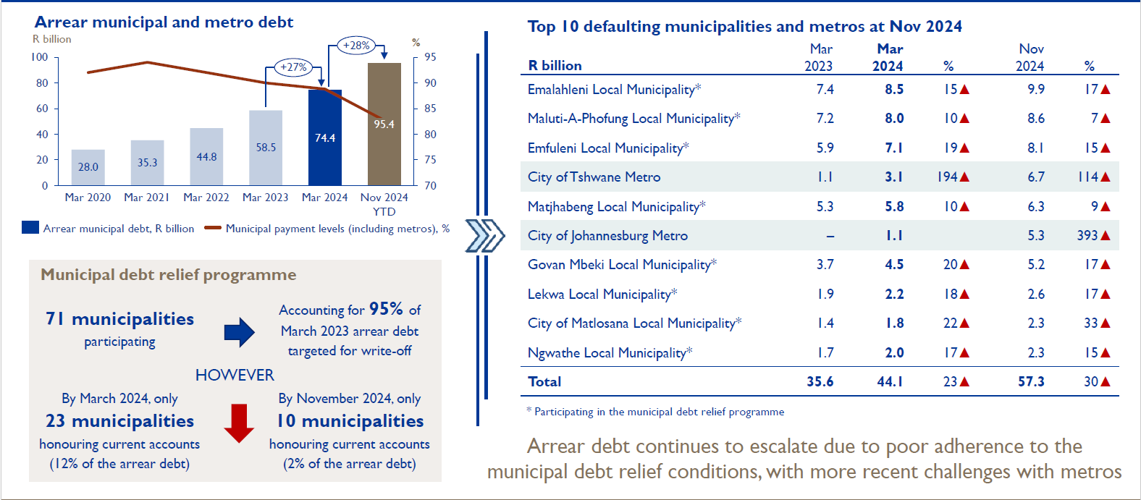
Municipality debt overview

Slide 6
Eskom as a Reticulation and Distribution agent
Eskom as a Reticulation and Distribution agent
Principles
Roles and responsibilities
The municipality retains its license to reticulate and distribute.
Customers remain at municipal tariffs.
Eskom partners & assists with the distribution and reticulation service.
The electricity business is fully ring-fenced.
Billing and revenue collection for electricity is done by Eskom.
Customers pay directly into a controlled bank account.
FBE grant and provision directly via Eskom to ensure disbursement to indigents – the importance of an updated indigent register by the municipality.
Capital investment is provided via municipal funding mechanisms.
Manage reticulation and distribution network.
Collect all electricity related revenue directly from customers
Effect credit control where required jointly with the municipality
Reconcile collections vs bulk purchases
Strengthen network and connect new customers
Eskom
Conduct public participative processes as per MSA
Obtain infrastructure funding via MIG or other sources
Promote payment for services
Manage customer/public interface
Set cost reflective tariffs and apply to NERSA
Maintain licensee obligations with NERSA
Accountable for FBE provision and funding
Municipality

Slide 7

Municipal electricity priority focus area
Need for planned maintenance and refurbishment of networks
  Lack of optimal system capabilities to operate, maintain the network and service customers
  Shortage of facilities to service their customers and the network
  Some electricity departments operate on a low level of maintenance maturity in terms of their practices.
  Municipalities offer a base set of electricity delivery services, but gaps exist leading to inequitable customer experience across segments
  Inconsistent municipal surcharge applied lead to tariff discrepancies across the municipalities
Disparate tariffs & customer services inconsistencies
  High levels of staff attrition within the industry
  Low levels of investment in training of staff on critical
  technical & financial skills
  Lack of standardisation on staff compensation arrangements and stabilisation of labour-related issues
Lack of professional skills, availability and retention
  There is an increased electricity demand at the municipalities
  Increased distribution losses- technical and non-technical
  Ageing assets
High level of outages

Slide 8

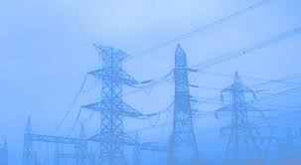
Understanding the impact of electricity tariffs on municipalities and households
It is critical to understand the cost of supply of municipalities to determine their cost base.
1
Installation of smart meters to enable the measurement, management & recovery of revenue.
2
Focusing on the efficient operation of their own networks to reduce overall supply costs
3
Managing of technical & non-technical losses
4
Stakeholder buy in and meaningful interactions engagements
5

Slide 9
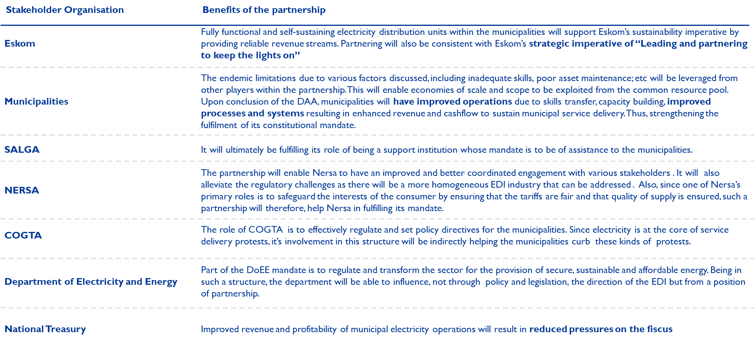
Potential key benefits to be derived by the key role players in the EDI

Slide 10
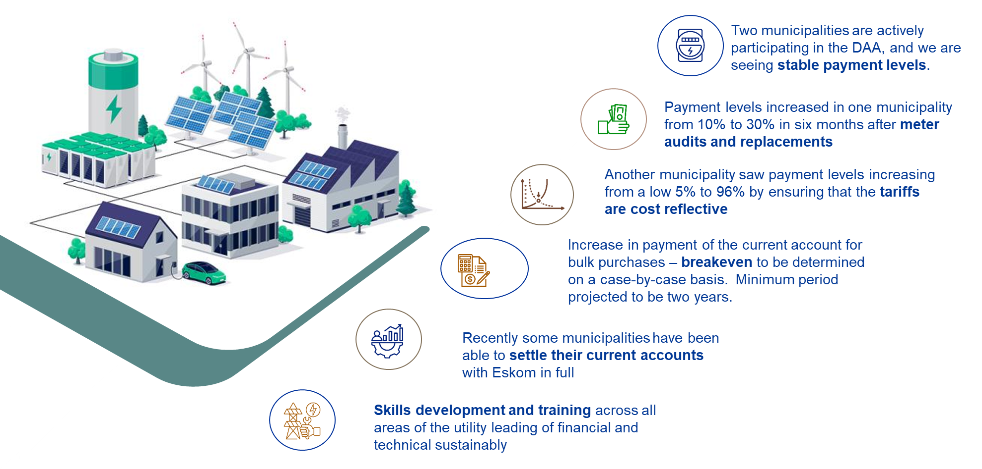
Benefits derived from and during the implementation of the DAA

Slide 11
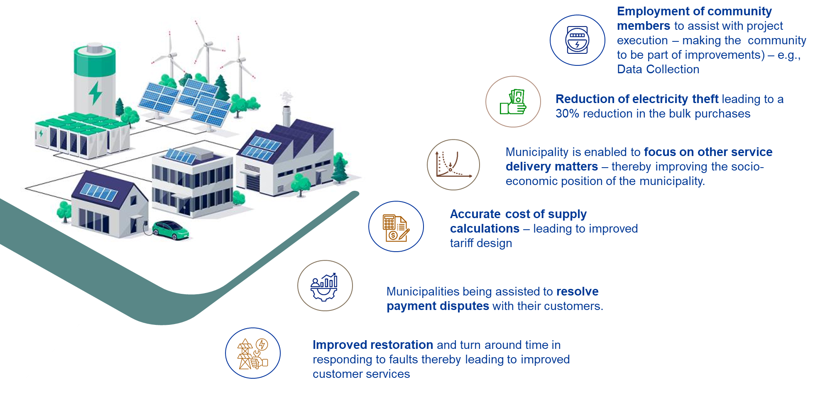
Benefits derived from and during the implementation of the DAA

Slide 12

Support required
Government departments and municipality council support to resolve metro and municipality debt challenges within short periods, to prevent escalation to PAJA/legal actions.
Enforcement of compliance to payment agreement conditions.
Continued support for municipalities that are compliant to current account payments.
Resolutions regarding municipalities that are not compliant to NT Debt Relief effort
  Adoption of Eskom Distribution Agency Agreement
  Direct Payment from Municipality customers to Eskom bank account.
Assist municipalities to account in terms of:
  Payment for bulk services (MFMA compliance)
  Ringfencing of electricity service
Increase of the FBE kwh from 50 to 200 kwh with payment to be made directly to Eskom.

Slide 13

Thank you

