Slide 1

Mitigating Cybersecurity Threats in Smart Metering Infrastructure Through Standard Security Frameworks
Presented by Shawn Papi,
Senior Advisor
Eskom Research, Testing & Development Business Unit

Slide 2
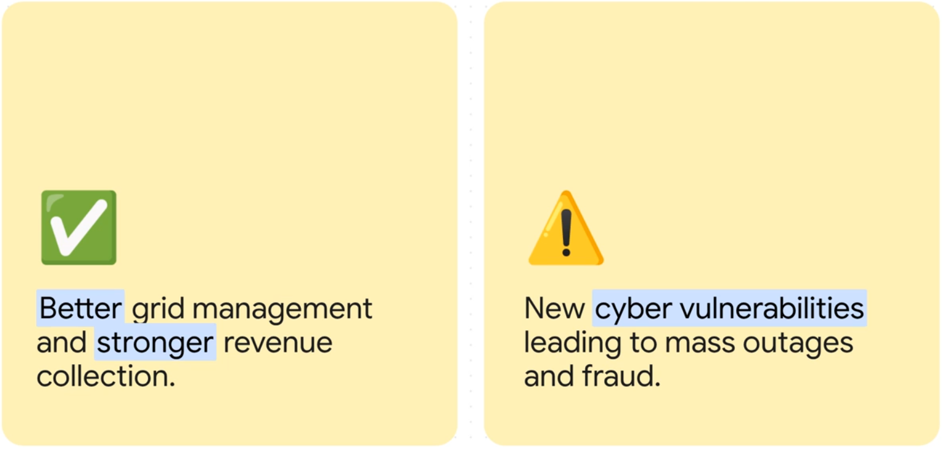
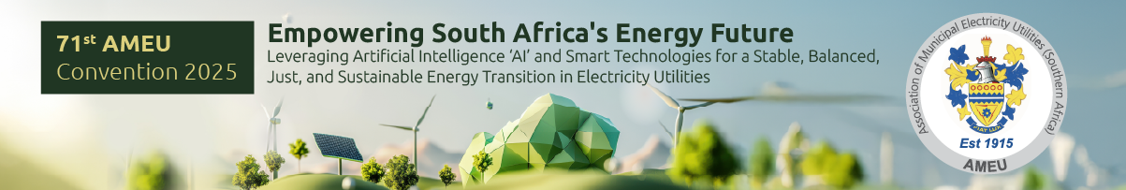
Introduction
Rapid Expansion: Smart electricity metering is expanding rapidly in South Africa to strengthen revenue collection and grid management.
Fragmented Landscape: The national distribution network is supplied by Eskom alongside approximately 100s of municipal distributors.
The Cyber Risk: While smart metering enhances efficiency, it creates new cyber risks!

Slide 3
The Cybersecurity Threat Landscape
Triggering mass remote disconnections.
Altering meter settings or injecting false data.
Manipulating prepaid tokens or token hijacking.
“Smart meters are inherently vulnerable to cyber threats, serving as potential targets for malicious actors because of their close proximity to end users.”

Slide 4
Advantage of Standard Security Frameworks
Challenges of Fragmentation
Proprietary systems often lock municipalities into a single vendor and complicate inter-agency data sharing.
Benefits of Open, Consensus-Driven Standards
Interoperability: Open standards provide a vendor-neutral secure data exchange across diverse devices and systems.
Shared Infrastructure: A common standard allows Eskom and all municipal utilities to potentially share a unified security backbone.
Cost Reduction & Efficiency: Utilities can pool resources such as Certificate Authorities (CA), revocation lists, and training across the country. This reduces duplication of effort and cost (e.g., fewer separate license fees) and allows economies of scale.

Slide 5
DLMS/COSEM – Standard for Smart Meter Data Exchange
DATA MODELLING
IEC 62056-6-1 (OBIS Codes), IEC 62056-6-2 (Interface classes)
MESSAGING
IEC 62056-5-3 (Application layer incl. information security)
TRANSPORT
Power Line Communication, RF, Serial, Ethernet, GSM, etc.

Slide 6
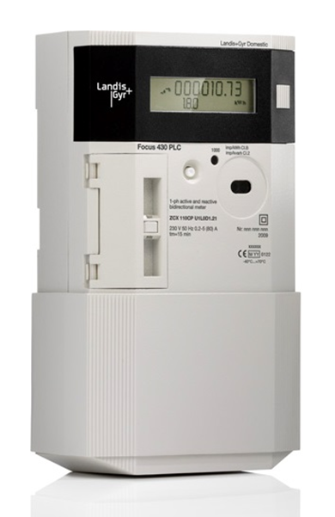
DLMS/COSEM – Standard for Smart Meter Data Exchange
DLMS Client
(Head End System, Hand Held Unit, Laptop, etc.)
Transport (GSM, PLC, RF, Serial, etc.)
Token Gateway - 115
[0000010900FF]
Register - 3
[0000010800FF]
DLMS Message
Smart meter data
Account - 110
[0000010A00FF]

Slide 7
DLMS/COSEM – Standard Security Framework
SOURCE: Security in DLMS – A white paper by the DLMS User Association.

Slide 8
DLMS/COSEM – Standard Security Framework
Plain DLMS Message
DLMS Message
Authenticated DLMS Message
DLMS Message
Authentication Code
(SHA-256/384)
Encrypted DLMS Message
Encrypted DLMS Message
(AES-GCM-128/256)
Authenticated + Encrypted DLMS Message
Encrypted DLMS Message
(AES-GCM-128/256)
Authentication Code
(SHA-256/384)
Digitally Signed DLMS Message
DLMS Message
Digital Signature
(ECDSA)

Slide 9
DLMS/COSEM – Standard Security Framework
Threat | DLMS/COSEM security | What it does
Unauthorized commands (e.g., remote disconnect) | Authenticated encryption | Ensures meter only processes authenticated commands (e.g., from utility systems)
Malicious firmware updates | Secure image transfer | Verifies digital signatures on all firmware images
Modification of energy readings, configuration changes. | Authenticated encryption | Ensures meter only processes authenticated commands (e.g., from utility systems)

Slide 10
Regulatory Integration – Global Precedent
Jurisdiction | Regulation / Standard | Requirement
European Union | European Parliament, “EU Cyber Resilience Act,” 2024 | Classifies smart meters as critical products requiring certified security.
European Union | DIRECTIVE (EU) 2022/2555 OF THE EUROPEAN PARLIAMENT AND OF THE COUNCIL (NIS2) | Obliges utilities to report incidents and implement risk management.
United States of America | NISTIR 7628 Guidelines for Smart Grid Cybersecurity | Sets comparable standards requiring robust privacy and security controls for smart meters

Slide 11

Thank you

