Slide 1

Data Farming in a Smart Low Voltage Distribution System
Presented by Noah Fakude
Electrical Engineer
City of Tshwane

Slide 2

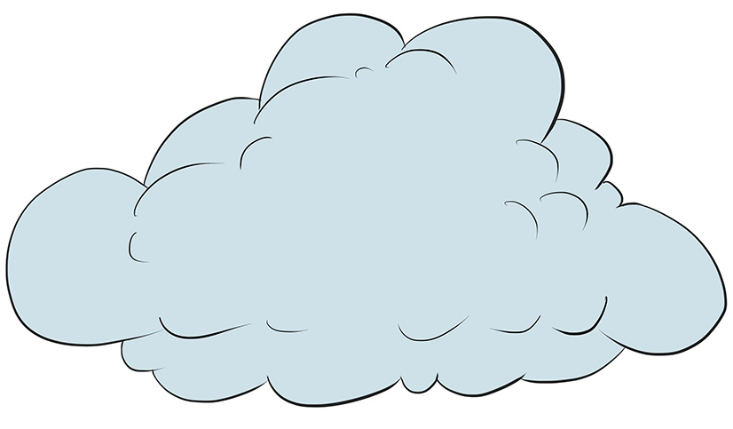

Power Grid Revolution architecture
Open Loop
Gx
Tx
Dx
Load
Gx
Tx
Dx
Load
Control
Tx
Dx
SM
Closed Loop
Feedback
Notes:
The power grid has always been generators and the

Slide 3
Farming in the Context of Data
1st IR 1800s
Paper Chart recorders
4th IR 2000s to Present
Cyber-physical systems, IoT, AI, Big Data
IoT sensors in grids, cloud computing for grid analytics.
2nd IR early 1900s
3rd IR (2000s)
Manual logging, Paper-based, Human-readable
Telephone-based telemetry (early 1900s) for sending data from substations to control centers.
Local measurement, slow/limited communication to operators.
SCADA (Supervisory Control and Data Acquisition) systems.
Digital data, centralized monitoring, and automation begin.
Coding and programmable systems to analyze and automate data.
Cloud computing introduced
Server network computing and server data storages were introduced
Archives thrived
Fiber technology 3G,4G,5G introduction
AI, ML, and blockchain in energy trading and predictive maintenance.
MACHINE LEARNING
Real-time, high-resolution, big data, predictive and prescriptive analytics.

Slide 4
Introduction of Data Farming
INTRODUCTION: This topic centers on two fundamental concepts: Data and Farming. These terms demonstrate how accessible, high-quality data powers utilities seeking to modernize their infrastructure. The study emphasizes that data acts as a catalyst driving grid modernization, automation initiatives, and the advancement of power grid technologies
PROBLEM STATEMENT: Traditional power grids operate primarily on human-expertise, inherited-practices, legacy-topologies, and established-standards, rather than leveraging real-time data for decision-making and system optimization..

Slide 5
What Data is, and What it is not?
Data is a value or set of values (numeric, letters/characters) that represent a specific concept. Data can also be words, and all these are characterized and classified by timestamp, units, and definition in formats such as CSV, TSV, XLM, and other data protocols. Data should not have any meaning unless it is analyzed.
Information is processed data. During analysis, the information inherits a minimum level of subjectivity, especially during the narrating phase, which is processed and analyzed to convey meaning. This means that if the same data were given to a different analyst, a different outcome would occur.

Slide 6



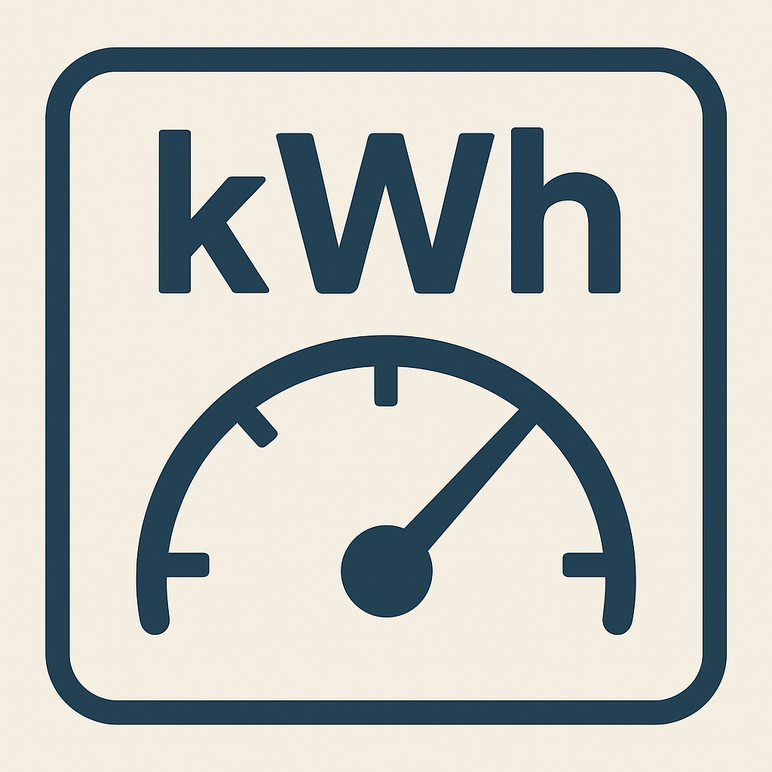
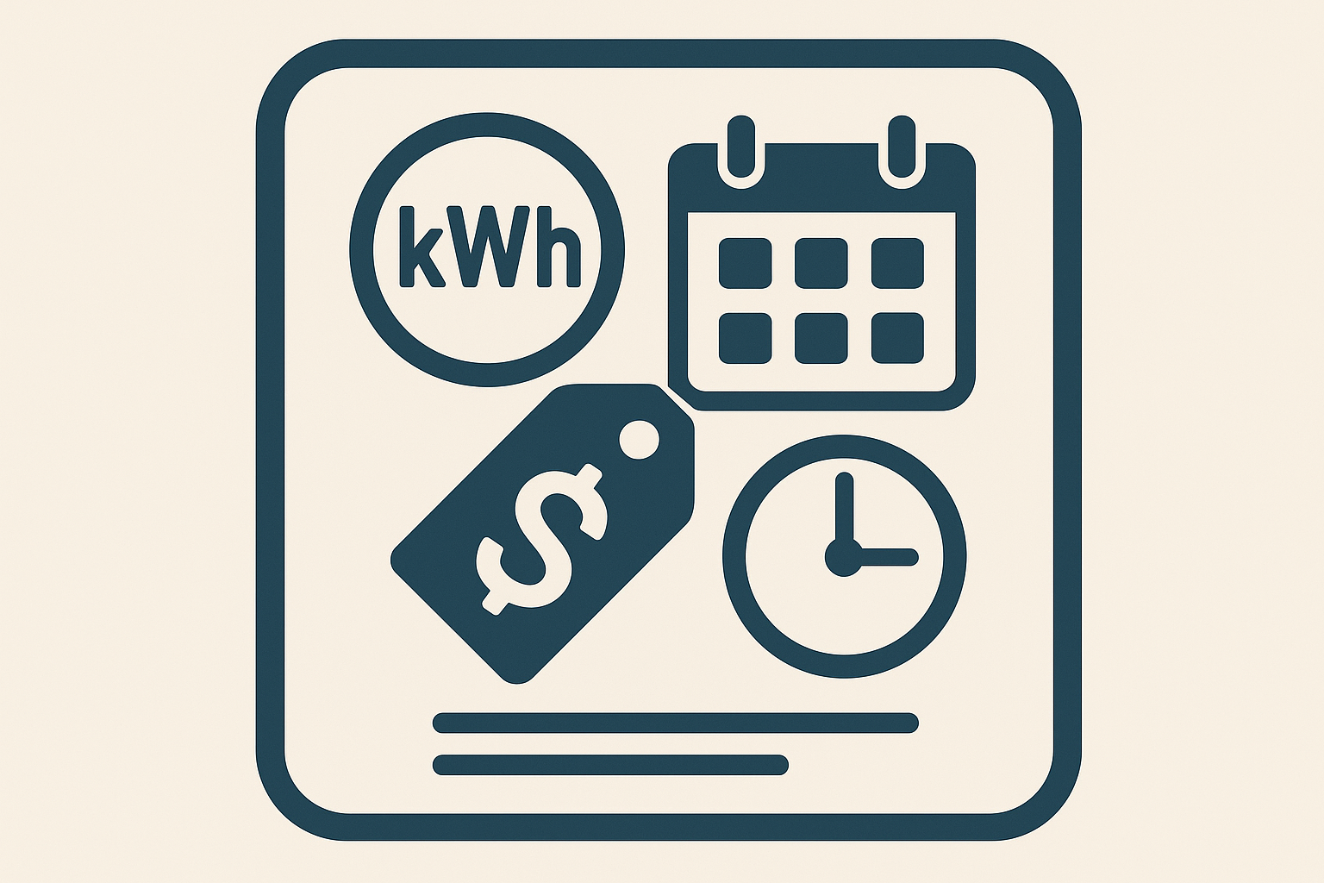



Data and Information Distinction
Information
Tariff-structure
Total Bill
Data
$$\int_{0}^{T}{\operatorname{VIcos}\left(wt\right)dt}$$
TOU

Slide 7
Agriculture/Engineering-Data Correlation
Cultivation / Data-acquisition process
Growing-crops /Data-augmentation (adding data sample, real or synthetic
Weed-Control/ Data Cleaning, removing noise & Gaps
Harvesting/ Data-acquisition for analyses, Billing,etc
Storage/ Data Repositories and Inventories
Market/ Data sharing to partners, Planning, AI, Billing, Analyses, Reports to Stakeholders

Slide 8
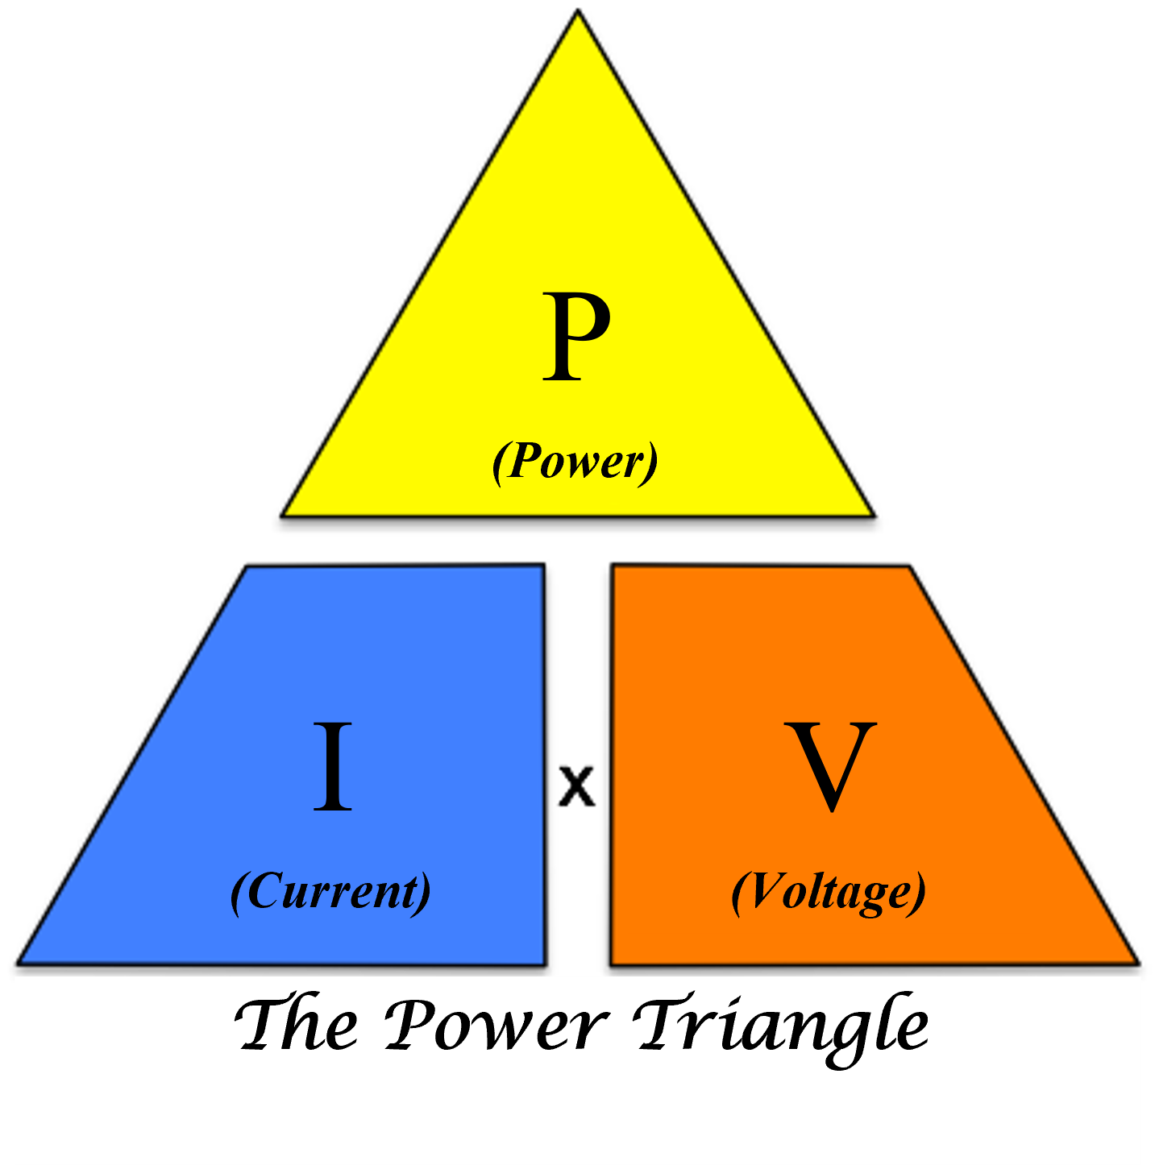
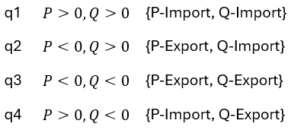
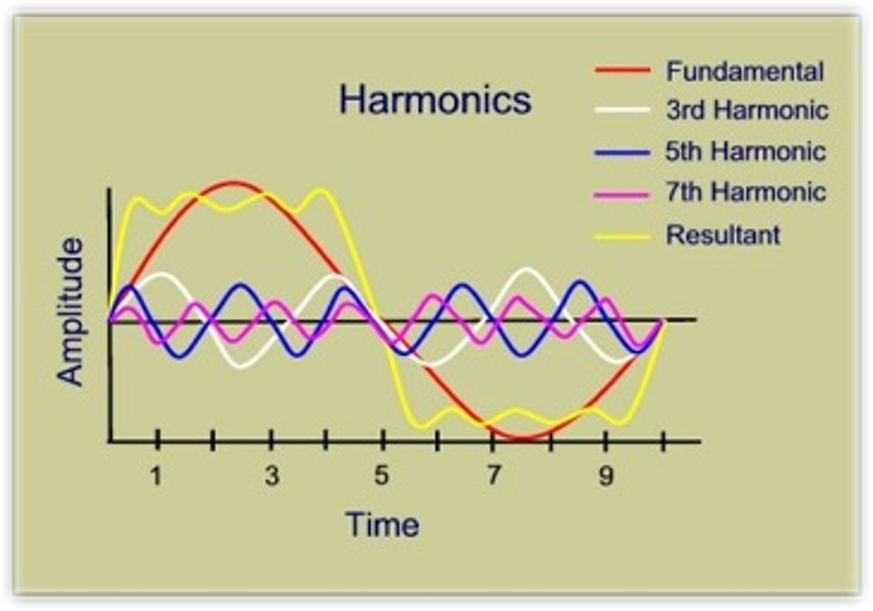

Data Grow in Power Utility
Fundamental Registers, DC/Act_L Unidirectional, Linear Loads
Bi-directional 4 quadrants
Non-Linear Load, Transformer, Sat
$$\cos\left(θ+wt\right)$$
S
Q

Slide 9
Data Farming - Channels
Data-Captured
Data captured manually (logbooks & Records)
Data measured and stored temporarily by analog & digital measuring equipment (Less frequent)
Realtime-acquisition
Data measured with calibrated devices at short time intervals
Automated data transferred as per set time intervals
Data interpolation- Extrapolation
Data prediction using algorithms such as Linear, polynomial, Spline, and others by looking at existing patterns
Data-Mining
Extracting data from existing information, missing information may be estimated using patterns and aggregation

Slide 10
Data-Farming Process Flow
Data Capture & Collection
• Assert registers, ageing of equipment (Physical files)
• Frequent recordings of grid instruments
• Digitization of grid measuring Devices
Data Sorting & Standardization
• Standardize formats (dates, coordinates, capacity sizes, import & export on embedded generation.
• Classify files and remove duplicates & errors
Data Mapping
• All data sets must be mapped to coordinates
• Data must be mapped according to their classification and categories
• Format into CSV (UTF-8, delimiter, etc.)
Storage & Accessibility
• Central repository
• Version control
• Backup & recovery
Data Usage & Sharing
• Data analyses, Billing, Planning
• Data sharing with stakeholders
• Data transfer to contracted third parties
Data Governance, Security & Management
• Assign responsibility
• Define update frequency
• Maintain audit trails
• Apply policies & compliance

Slide 11
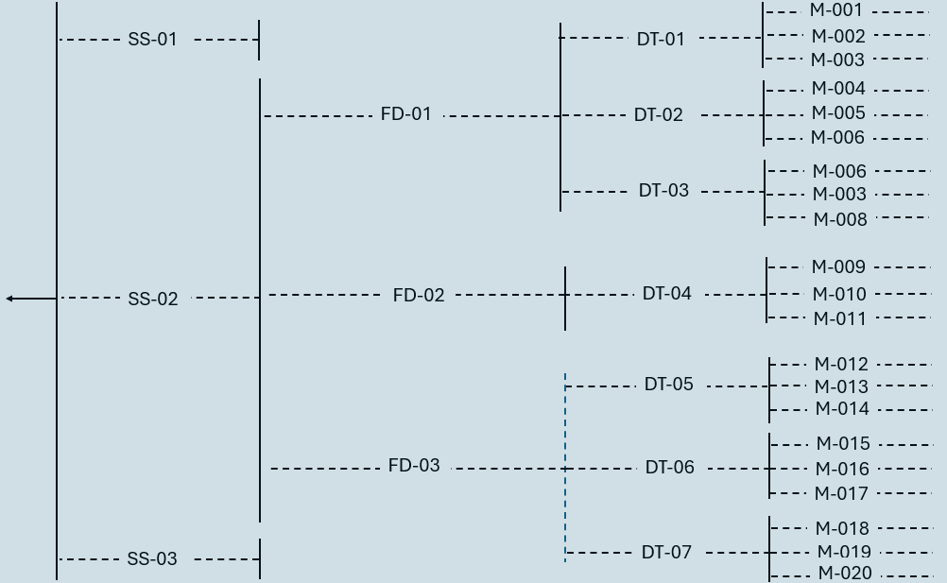
Load-Flow Data Profiling Tree

Slide 12
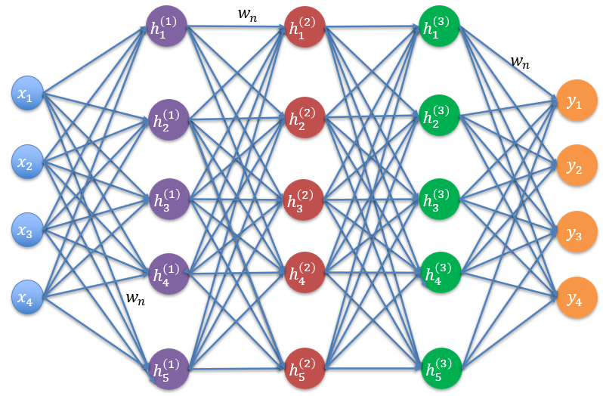
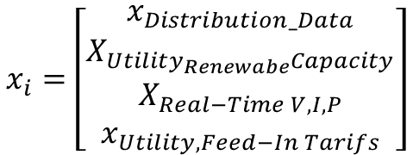
Data used to train Neural Networks
$$x_{i}=\left[\begin{matrix}x_{Distribution_Data} \\ X_{Utility_{Renewabe}Capacity} \\ X_{Real−Time V,I,P} \\ x_{Utility,Feed−In Tarifs}\end{matrix}\right]$$
Fixed (PEM) - Power grid Data
Variables - Power grid Data
Variables – Load-Flow Data
Fixed (EIF) – Ext effect Data
Performance
Revenue Output
Losses
ROI

Slide 13
Pathways for Data Farming in Utilities
Intentional Data Strategy – Data must be treated as a deliberate asset, not an accident, ensuring it is available when needed for decision-making.
Robust Data Collection Systems – Utilities should deploy technologies (e.g., smart meters, SCADA, protection relays with data logging) for continuous and reliable data capture.
Centralized Repositories & Inventories – Establish structured data inventories and repositories to store, organize, and retrieve information efficiently.
Human Capital Investment – Develop skilled teams for data management, analysis, protection, and knowledge sharing across the utility.
Data Sharing & Collaboration – Promote secure data exchange between municipalities, third-party suppliers, and prosumers to enable better forecasting, planning, and renewable integration.

Slide 14
Available Legislation for electronics data control in SA
Protection of Personal Information Act (POPIA) (Act 4 of 2013)
Electronic Communications and Transactions Act (ECT Act) [No. 25 of 2002]
Promotion of Access to Information Act (PAIA) 2000
General Data Protection Regulation (GDPR)
Grid Connection Code For Renewable Power Plants (RPPs) Connected To The Electricity Transmission System (Ts) Or The Distribution System (Ds) In South Africa, Appendix 12 - Provision of Technical Network / Grid Data to RPP Generators

Slide 15

Thank you

