Slide 1


Smart Substations for Smart Grids:
Pioneering Digital Protection in Namibia
Presented by Herman Mare, BEng Electrical
General Manager
ACTOM Protection and Control

Slide 2
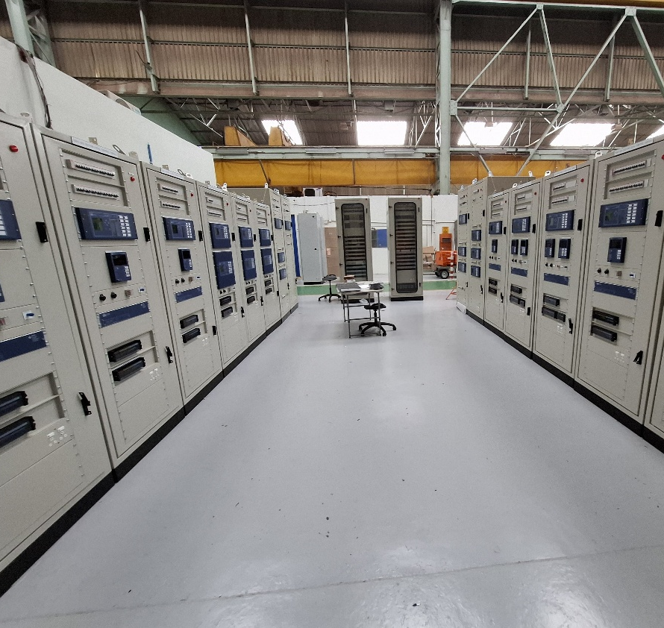

Abstract / Context
An African Success Story
Namibia’s first fully digital substation (Sekelduin).
Hybrid architecture: conventional + IEC 61850 process bus.
Sets benchmark for Africa, a transition towards intelligent grid systems
Notes:
Sekelduin sets a benchmark for transition toward intelligent grid systems.

Slide 3
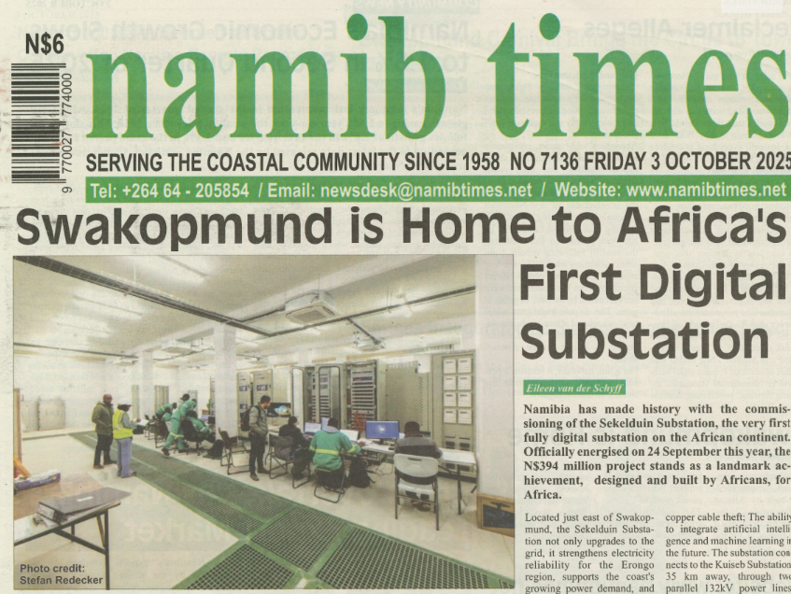
Let us take some time to reflect on success and let it inspire us to create more engineering dreams.
Notes:
As engineers, project managers, Fiananciers, we tend to jump from one project to the next, Let us take some time to reflect on a success and let it enspire us to create more engineering dreams.
Should have used a digital newspaper to boast a about a digital sub, not a paper based edition

Slide 4

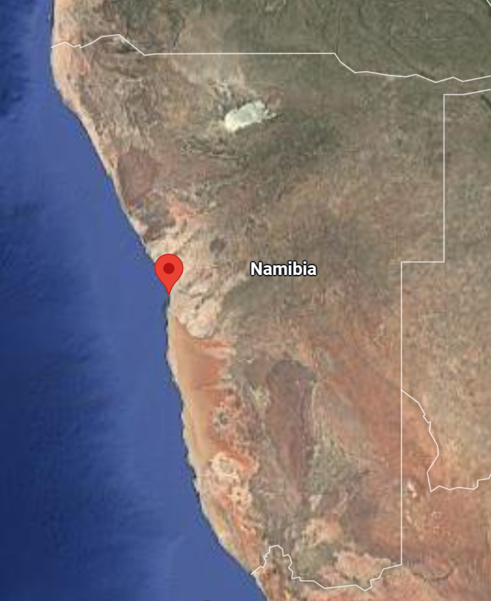
Introduction: Digital Transformation
Sekelduin near Swakopmund.
African utilities: pressure to modernize, manage aging assets.
Benefits: interoperability, predictive maintenance, cybersecurity.
Namibia bold step:
  Dream
  Specification
  Reality
Notes:
Sekelkduin is near Swakopmund in the Erongo region of Namibia
As a system integrator, we work with many utilities across Africa…
African utilities are under increasing pressure to improve efficiency, reliability, and sustainability while managing aging assets
Nampower took a bold step when they dreamt of Sekelduin, they took that dream and converted it to a spec and that gave the guidelines to bring this dream to reality.

Slide 5
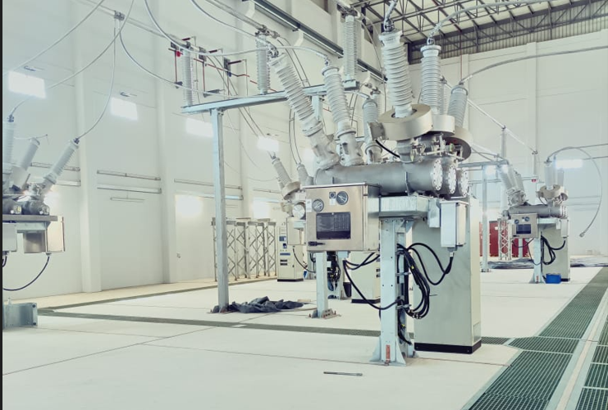
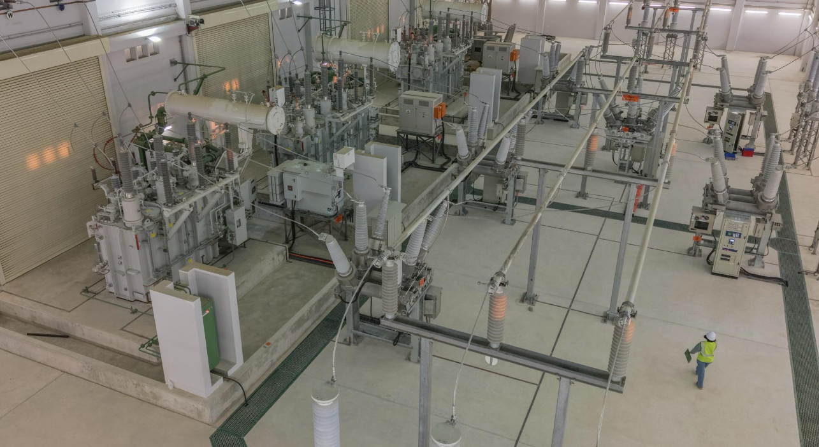
Project Overview
132/66/33 kV indoor substation.
Supports mining, industry, tourism, and residential demand.
Key assets:
  60 MVA & 20 MVA transformers.
  Mixed Technology Switchgear (132 & 66 kV).
  Indoor design for coastal/desert resilience.
Strategic objectives: grid reliability, renewable integration, digital diagnostics, copper theft prevention.
Notes:
Let us look at some of the technical details that this project consists off.

Slide 6
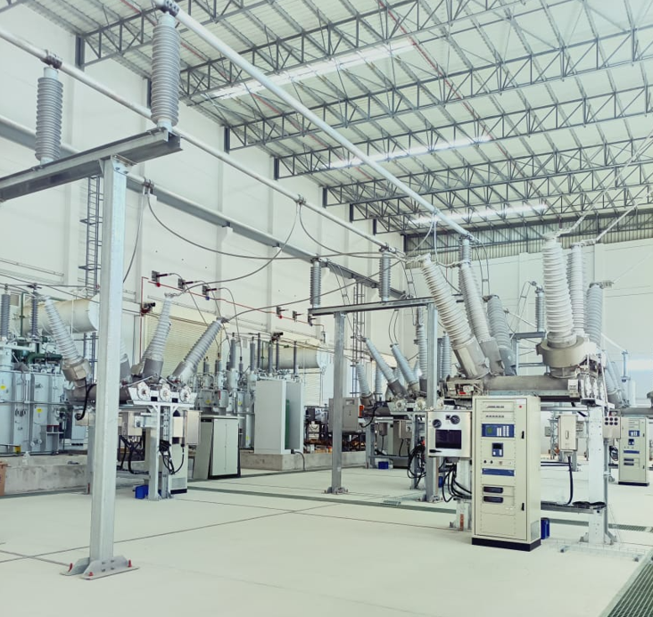
Design Philosophy
IEC 61850, then and now
Hybrid protection:
Main: fully digital IEC 61850 (process bus, SV, GOOSE).
Backup: hybrid with hardwired CT/VT + GOOSE.
Redundancy: dual PRP fibre LANs (A & B).
Compatibility with legacy Siemens relays.
Notes:
Here is where I get a bit passionate: the secondary side…
Substation has main and Backup prot
Over the years we have implemented many IEC61850 substations, but they were all on station bus, this was the first one with process bus.

Slide 7
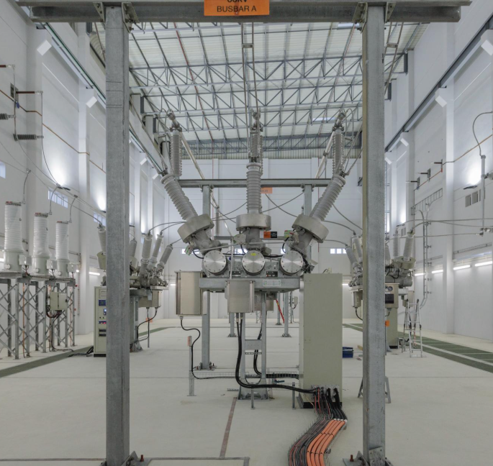
PAC System Implementation
Components: IEDs, PIUs, IMUs, relay panels.
Schemes:
  HV Feeder Protection.
  MV Feeder Protection.
  Transformer Protection.
  Busbar Protection.
Bay Control: interlocking, command sequencing, HMI.
Substation Automation: dual networks, SCADA, inter-centre comms.
Notes:
If we dive a little deeper…
Although we did the scheme designs ,we had the privilege to work with an amazing OEM on the protection and Automation side who was deeply involved in the configuration of the complete system.
Digital substations is nothing without an HMI

Slide 8
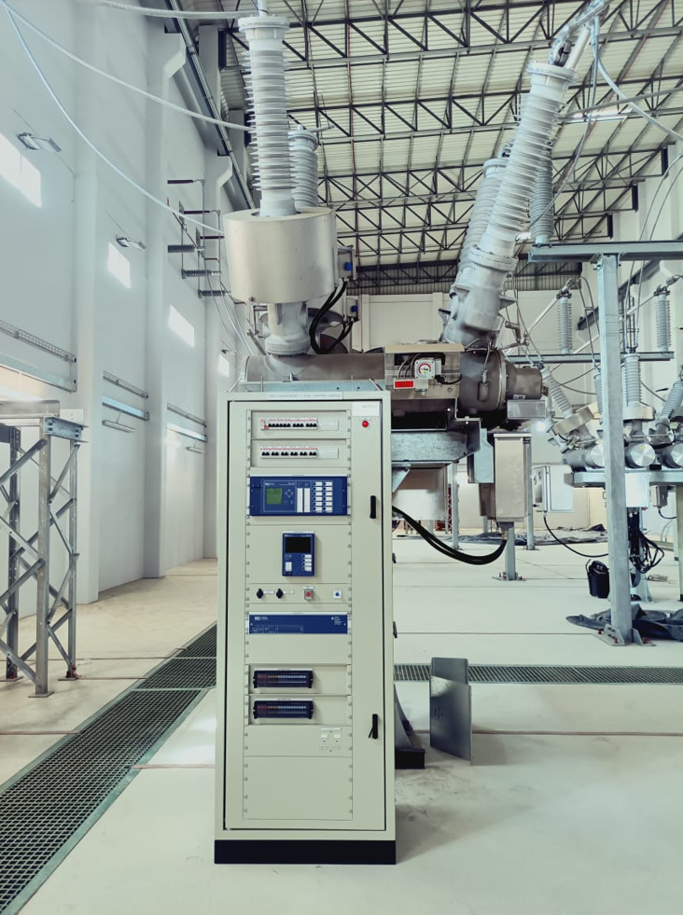
Infrastructure & Technology
Relay panels: Main and Centralised BB IED’s
LCCs: at switchgear, housing backup IEDs
Process Bus: digitizes CT/VT signals for protection and control
Dual auxiliary supplies (AC/DC).
Fibre-optics (secure, theft-proof, no interference).
Notes:
In terms of the hardware and technology in the secondary plant there was:

Slide 9
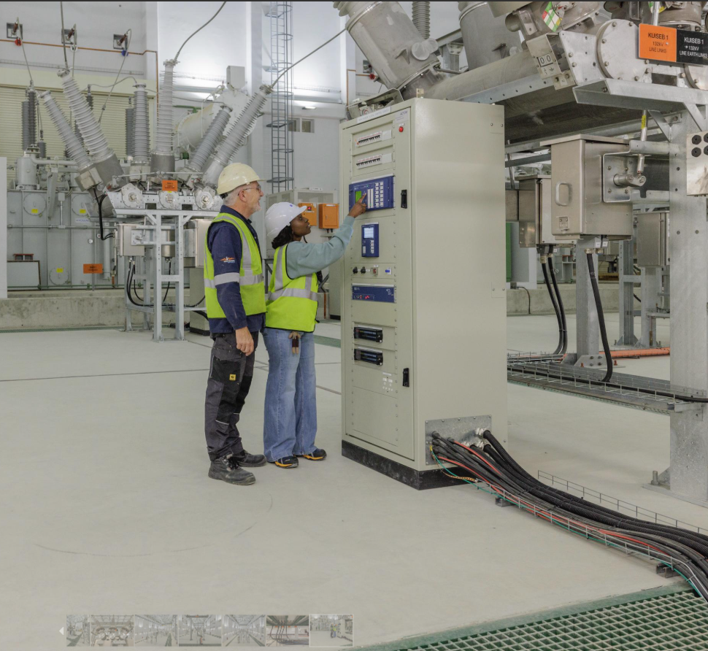
Operational Advantages
Condition-based monitoring.
Remote diagnostics (SIHMI + SMC).
Event Correlation - Time synchronization (IEEE 1588 PTP)

Slide 10
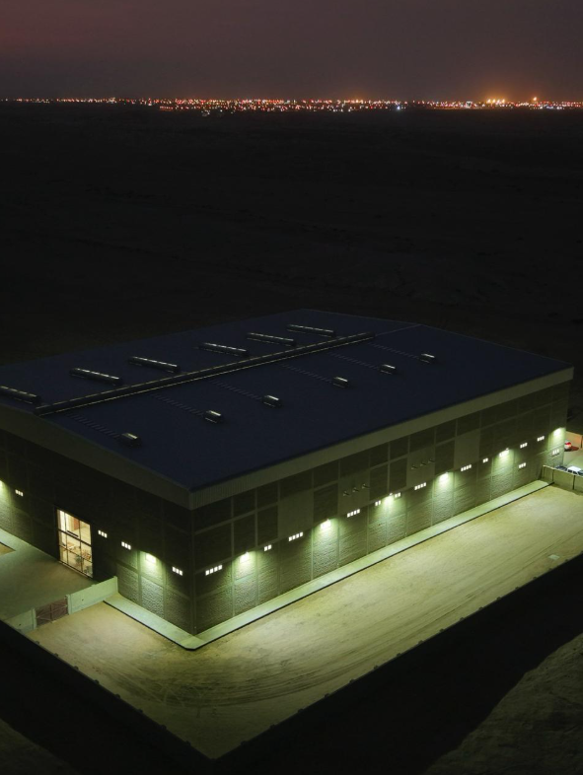
System Redundancy & Legacy Compatibility
Dual Protection Systems, Main and Backup.
Digital sampled values + hardwired CT/VT.
Dual redundant LANs A/B.

Slide 11
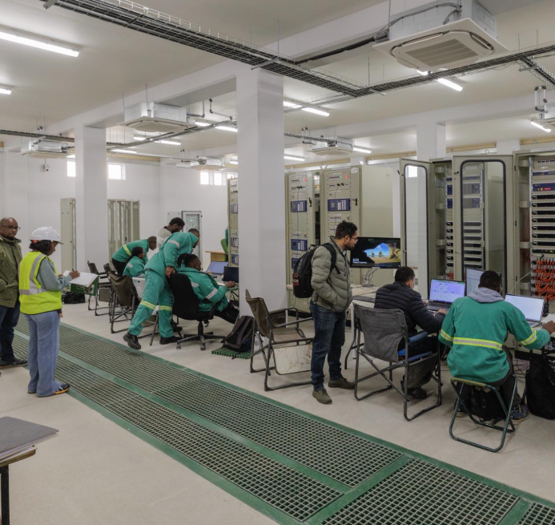
Lessons Learned/ Challenges faced
Incorrect Network configurations caused congestion.
Also identified network hardware oversight- blessing in disguise.
Engineers are ready for Digital Substations: End customers, OEM and contractors.
Could have better designs by fully embracing technology.
Technology to try: Software defined Networks
Future paper on Redundancy and reliability
Notes:
This is the slide we need to stand still perhaps.
As with any project there are always some challenges, some you only discover during commisioning

Slide 12
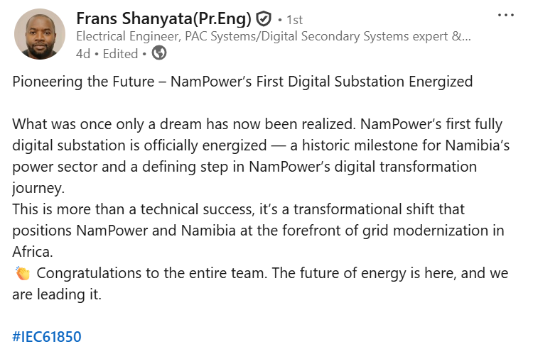
Conclusion
Namibia’s step into intelligent grids.
Model for African utilities.
Cannot be said better than this:

Slide 13

Be inspired:
Dream Big

