Slide 1

Equitable Energy Access in Grid Modernization
Frameworks for Justice-Centered Utility Transformation
Presented by Sindisiwe Shozi (Chief Engineer),
Bhekani Hadebe (Senior Manager)
eThekwini Municipality

Slide 2

Presentation overview
Africa equitable energy access challenges
Africa electricity access
South Africa energy landscape
Energy justice pillars
South Africa’s case study
Ethiopia’s case study
Intervention for justice centered energy transformation
Path forward
Notes:
Despite some progress, close to 700 million Africans still lack reliable electricity access with rural and vulnerable populations most affected.
Ntabankulu, or Nguza Hill

Slide 3
Africa equitable energy access challenges
Low participation of rural area stakeholders in the energy transition limits inclusive development and local engagement.
Deepening inequality in energy access perpetuates socio-economic divides between urban and rural populations.
Skill gaps and workforce transitions challenge local economies shifting from fossil fuels to renewables
Financial constraints limit investment in rural renewable energy projects.
The implementation of policies that promote equitable energy access and foster innovation in rural energy systems remains limited.

Slide 4
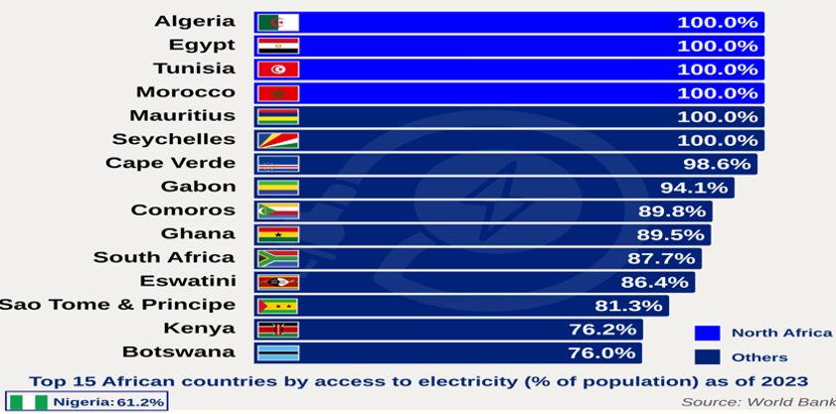
Africa’s electricity access

Slide 5
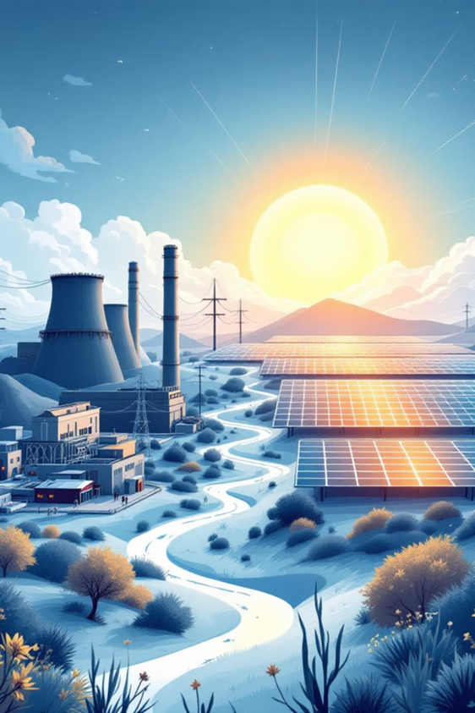
South Africa’s energy landscape
80%
45%
15 GW
Coal Dominance
Energy Poverty
Current Renewables
Coal still powers 80% of generation despite transition efforts
Households affected by energy poverty nationwide
Renewable capacity as of September 2025
32 GW
2030 Target
Projected renewable capacity by 2030
South Africa's unique position as a coal-reliant economy pursuing a Just Energy Transition Partnership (JETP) underscores the urgency of justice-centered approaches to avoid locking in fossil dependencies.
Notes:
Urban access – 91 %
Rural access – 26%
15 % renewable energy , 5 % nuclear

Slide 6
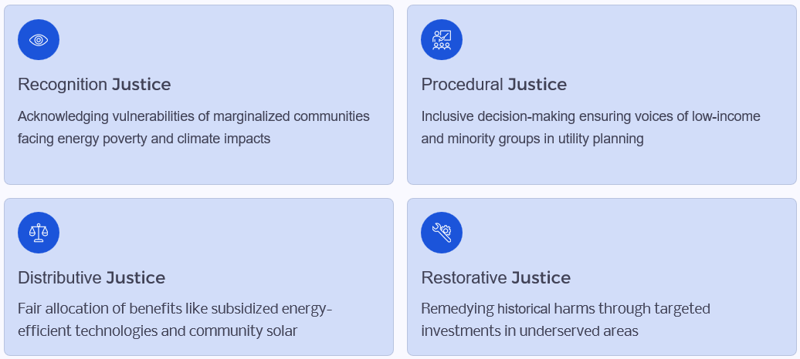
Energy justice pillars
Notes:
Grid modernization through clean energy offers sustainability opportunities but risks deepening inequities without energy justice principles. This study bridges theoretical justice with practical utility transformation, addressing gaps in affordability, reliability, and participation.

Slide 7


South Africa's REIPPPP case study
Justice Opportunity
Overview
The Renewable Energy Independent Power Producer Procurement Programme integrates wind and solar, generating 26,000 GWh annually and creating jobs. However, low community ownership (under 5%) hinders equity.
Community trusts could advance restorative justice, though sustainability issues remain.
Recommendations emphasize transparent consultations and equitable benefit-sharing models.
Challenges
Lack of equity policy enforcement
Urban focus exclude rural communities
Procedural gaps in decision-making processes

Slide 8



Ethiopia's GERD case study
Opportunity
Grand Ethiopian Renaissance Dam aims to triple Ethiopia's electricity access (currently 45%), enhancing grid modernization via hydropower with $800M export potential.
Challenge
Raises distributive justice issues with downstream Egypt and Sudan over water allocation, risking 25% flow reduction and regional tensions from historical treaties.
Solution
Cooperative frameworks for equitable transboundary benefits, supporting SDG 7 while addressing climate vulnerability through basin-wide agreements.

Slide 9
Interventions for justice centered energy transformation
Mandate community committees
Implement equity-weighted investment
Require transparent consultations and community impact assessments in regulatory filings, tracking participation rates in public hearings.
Score grid projects on justice metrics using vulnerability mapping and data-driven tools for resilience planning.
Subsidize energy-efficient technologies
Deploy hybrid mini-grids
Scale rural mini-grids with AI forecasting for
reliability, subsidies, and capacity building
to address affordability and maintenance
challenges.
Target low-income households with financial support for EET adoption, reducing energy burden to below 6% of income.

Slide 10
Path Forward
Key findings
Equitable energy access demands frameworks operationalizing all four justice pillars/principles. Utilities must embed metrics like energy poverty reduction and community engagement to align with SDGs 7 and 13.
Policymakers
Mandate equity assessments in regulations
Prioritize targeted investments in historically underserved areas
Balance techno-economic and socio-political constraints
Scale successful models using AI for equity analytics
Future research should explore use of AI technology for continuous monitoring and reporting of equitable energy projects rollout throughout the county

Slide 11

Thank you

