Slide 1


MUNICIPAL NETWORKS
Presented by Geeven V Moodley
Managing Director
DIgSILENT Buyisa (Pty) Ltd

Slide 2
Project Objectives
The project objective is to undertake a grid impact/network modelling assessments to understand the implications and limitations in the municipal distributors network, identifying future network constraints and challenges under a range of scenarios.
The future grid studies will work with the actual municipal distributor network, to explore the implications on a future grid.
The years of study considered for the future grid was 2030 & 2040. For purposes of presentation only 2040 are shown.
  NOTE: 2023 was studied to provide a basis for comparison

Slide 3
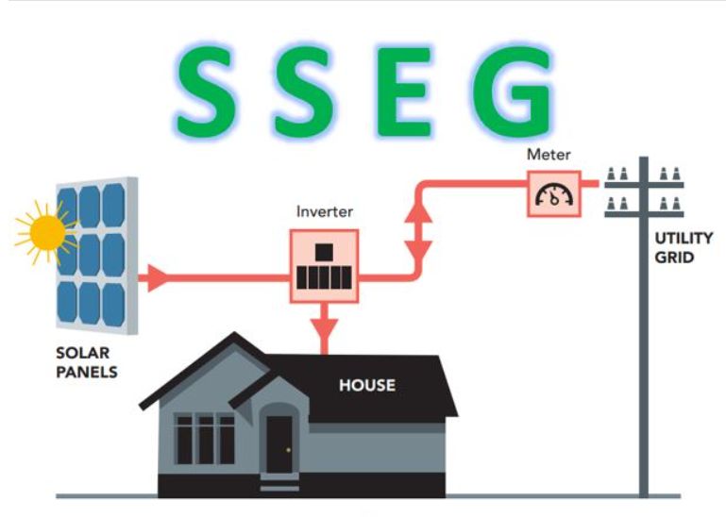
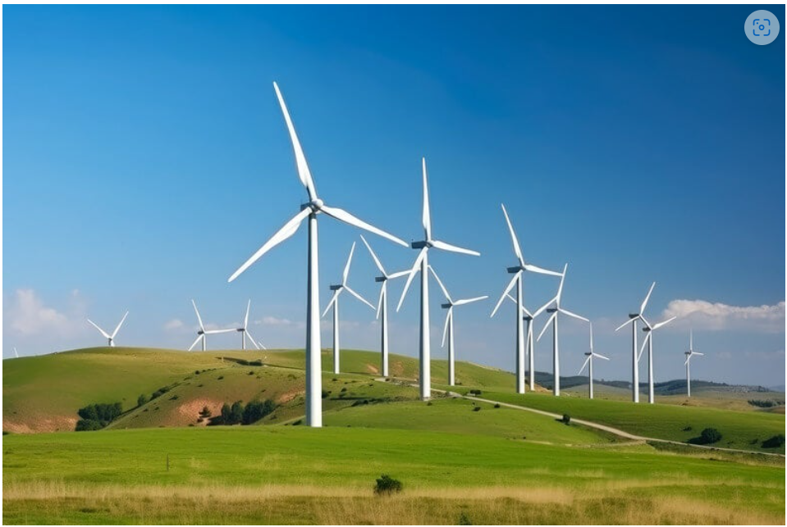
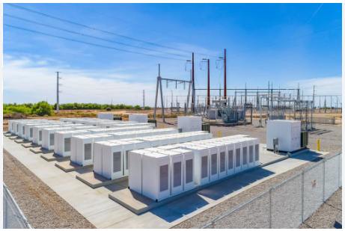
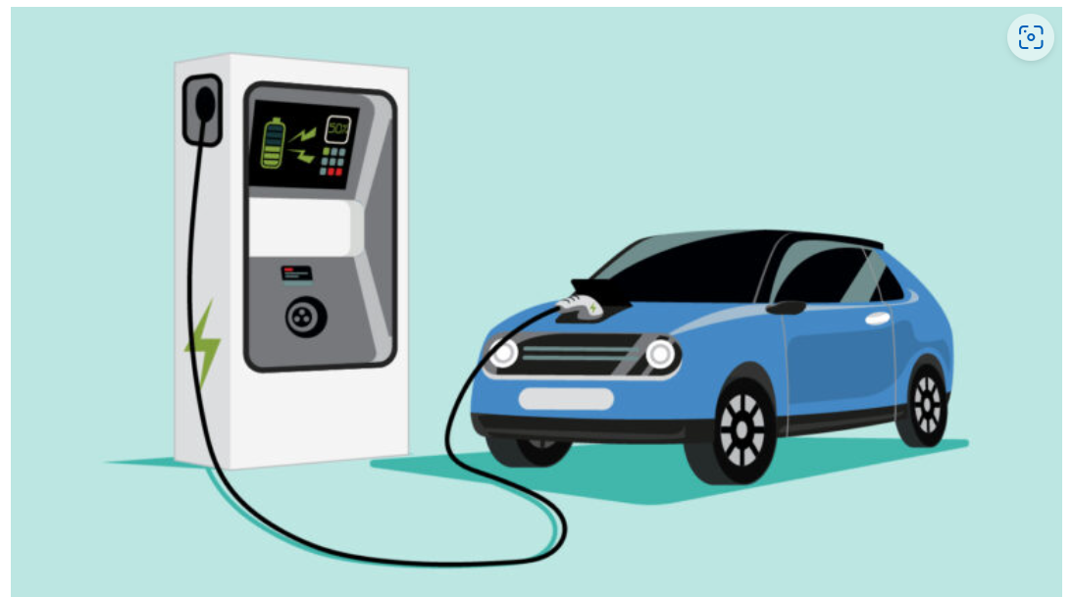
Project Objectives
The following potential ‘future grid’ scenarios that will be considered in these studies:
  Small scale embedded generation (EG)
  Larger generation (Large Power Producers)
  Storage (in particular battery storage systems - BESS)
  Electrical vehicles (EVs)
  Energy efficiency initiatives

Slide 4
Methodology
A present network municipal model will be received from a selected municipality (real network)
The load forecast for the future years will be added to this model to create a base network model.
  NOTE: No future planning studies are undertaken. The network topology is kept the same and the capacity of the network increased to handle the future load
Each of these ‘future technology’ will be added to the network as an independent object
Studies are then undertaken to consider only one future technology at a time, on the base network, in order to quantify the impact of that technology only on the network.
Finally studies are undertaken considering all technologies on.
Notes:
State actual municipal network was used for the basis of the study

Slide 5
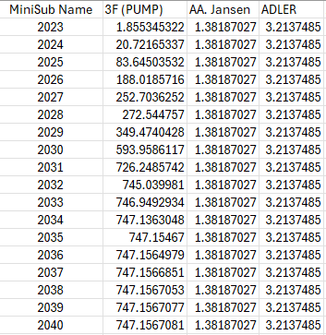
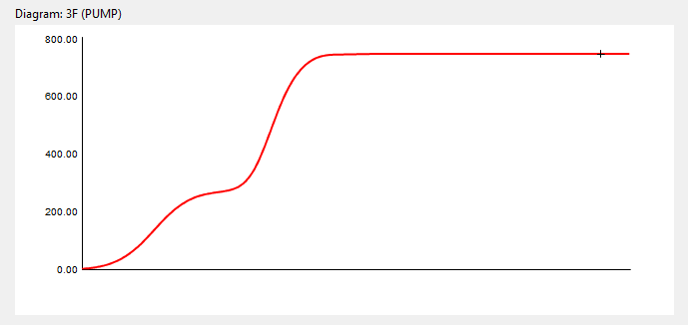
Load forecast and Load characteristics
A file characteristic was provided which includes yearly forecasts for MV loads within the Municipality.
These forecasted values represent a single maximum expected load at MV substation (2023 – 2040)

Slide 6
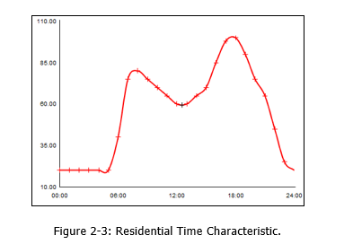
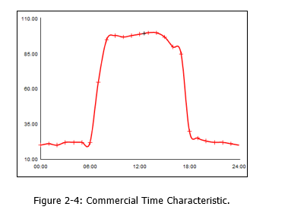
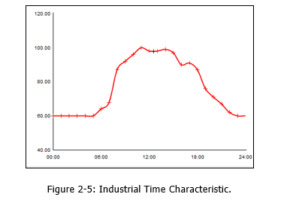
Load forecast and Load characteristics
Typical daily load profiles were created for the loads in the municipal network to represent:
  Residential customers
  Commercial customers
  Industrial customers

Slide 7
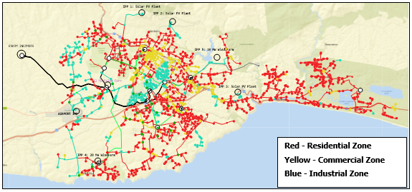
Load forecast and Load characteristics

Slide 8
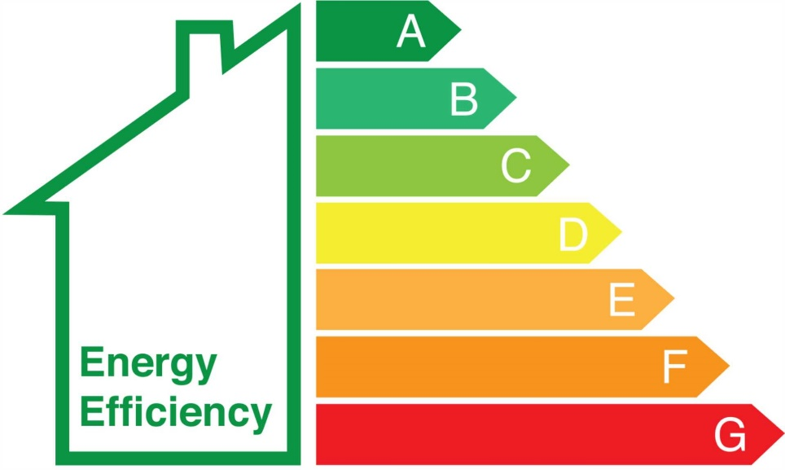
Energy Efficiency
The consideration of energy efficiency strategies was also considered.
The overall finding was that these strategies will lead to a reduction in demand
Since is it very difficult to predict which customers will implement energy efficiency strategies, an overall 2% reduction in load per year was considered to account for energy efficiency strategies from different customers.

Slide 9
STUDY RESULTS

Slide 10
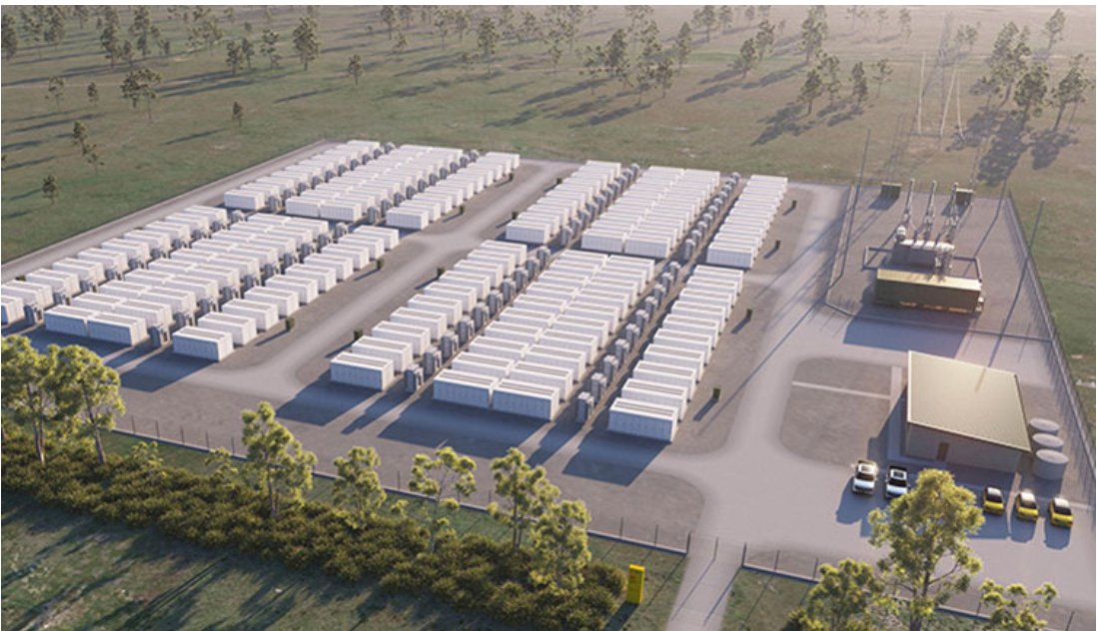
Assumptions – Battery Energy Storage Systems
Research was done to estimate the trends of BESS in a network. South Africa may have a higher battery installation at residential, industrial and commercial level. This is seen in the increase in the number of PV + BESS grid impact studies done across South Africa.
BESS was added to the network on:
  main intake substation level (municipal BESS)
  residential, commercial and industrial level (customer BESS)
Customer BESS was distributed assuming that more affluent areas with PV installations will also have BESS.

Slide 11
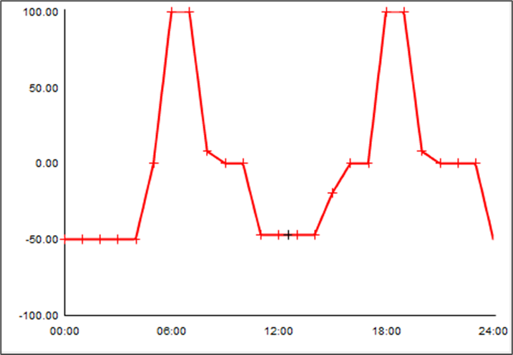
Assumptions - BESS
The usage of BESS is unknown as different customers may setup their installations differently
For the BESS time characteristic, an assumption was made that the batteries will be used following a Time of Use (ToU) tariff, thus, batteries will dispatch power in the morning and evening (during peak tariff times), and mostly charge during the day and throughout the night (low tariff times).
D
D
C
C

Slide 12
Assumptions - BESS
Municipal BESS is connected to MV level and follows the same charge/discharge cycle to alleviate evening / morning peaks.
No reactive power control mode of BESS considered. Active power dispatch only.

Slide 13
2040 BESS Only – Incomer Lines Loading (MW)
1. Reduction in morning – evening peaks
2. Increased loading at night and during the day.
3. If no co-ordinated dispatch of BESS, possible reverse power feed to Eskom (infeed)
Dotted lines - load only results.
2
1
2
1
3
3
POWER FLOW TO ESKOM
Notes:
Load increase at night and midday due to batteries charging.
Reduction in load during peak hours due to batteries discharging (peak shaving).
Reverse power is feed back to the network.

Slide 14
2040 BESS Only – Transformer Loading (%)
1. Reduction in morning – evening peaks
2. Increased loading at night and during the day.
2
1
2
1

Slide 15
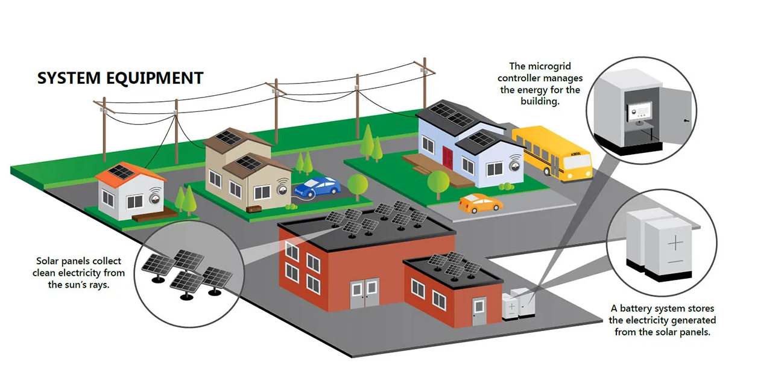
Assumptions – Embedded Generation (EG)
EGs were added to the MV network over the years from 2023 to 2040,
The more affluent areas were considered first.
As the network became saturated, the generation was distributed to the remainder of the network.
Only PVs were considered for SSEG technology in the studies
Notes:
All distributed in MV network. Add com res and ind breakdown

Slide 16

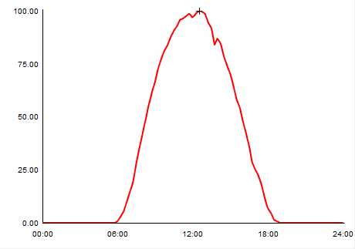
Embedded Generation Assumptions
A typical clear day PV generation profile was used for all the PV systems. Midday peak.

Slide 17
2040 EG Only – Incomer Lines Loading (MW)
Significant reduction in load drawn from Eskom during the day.
Evening load peaks still noticeable.
2
2
1
Notes:
Midday load reduction due to operational embedded generators (PV production).

Slide 18
2040 EG Only – Transformer Loading (%)
Significant reduction in load drawn from through HV/MV transformers.
Pronounced morning/evening peaks though little reduction from load only cases.
2
2
1

Slide 19
2040 EG Only – Feeder Max Voltages (p.u.)
Increased feeder voltages during the day due to reduced feeder loading
1
1
Notes:
Voltage increases due to EG injection into the network.

Slide 20
Electric Vehicle (EV) Assumptions
The average EV battery size is 60 kWh, and the standard charging stations have a range of 3 kW to 25 kW chargers
An average 5 kW charger was used for charging stations at homes
An average 20 kW charger was used for charging stations at office parks and shopping centres

Slide 21
EV Assumptions – Coincidence factors
The MW demand in the table represents ALL EVs charging at the same time.
This is a highly unlikely scenario.
For all EVs connected to a set of charging stations (e.g. at a mall), not all EVs will be charging at the same time since some batteries may already be full.
To take into account the probability of EVs charging at a commercial / office park or for a set of houses with EV chargers connected back to the MV substation, coincidence factors were introduced
Co-incidence factors represent the probability of a set of EVs, charging at the same time.

Slide 22
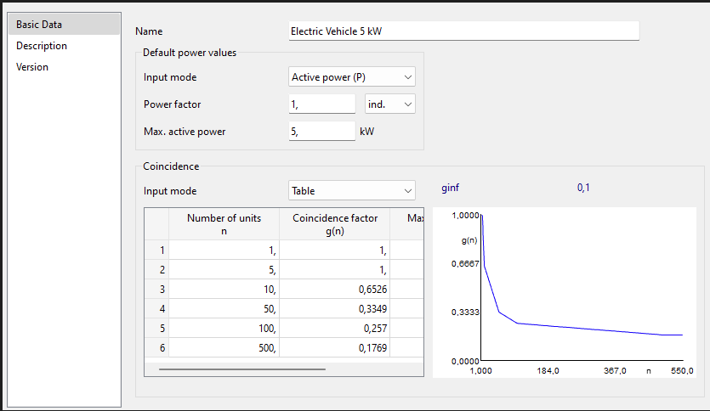
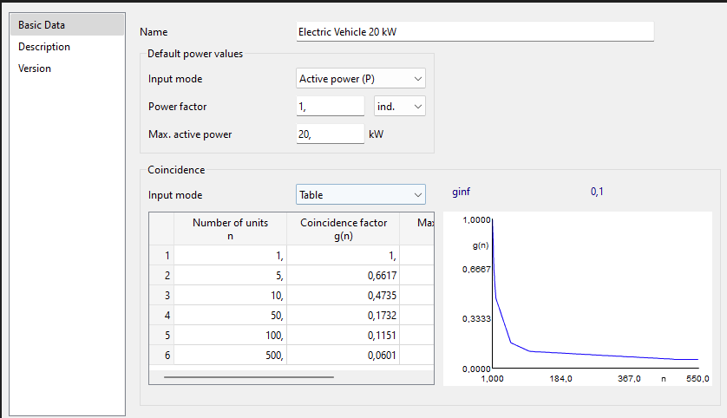
EV Assumptions – Coincidence factors
The coincidence factor for 5kW chargers (homes) shows that to for every 10 EVs charging at homes, the probability is only 65% of them will be drawing load at a time.
The coincidence factor for 20kW chargers (offices) shows that to for every 10 EVs charging, the probability is only 47% of them will be drawing load at a time.
Notes:
If one substation supplies 10 residents that own EVs, the coincidence factor will be 0,6526. Thus, the maximum number of EVs that could charge at the same time is 6 to 7 EVs, and the maximum power consumption will be 35 kW.

Slide 23
2040 EV Only – Incomer Lines Loading (MW)
Overall impact on the municipality incomers in minimal.
Increased night time loading noted due to EV charging.
1
1
2
Notes:
Load increase due to electric vehicles charging from the grid.

Slide 24
2040 EV Only – Transformer Loading (%)
Overall impact on the transformer loading also minimal.
1
1

Slide 25
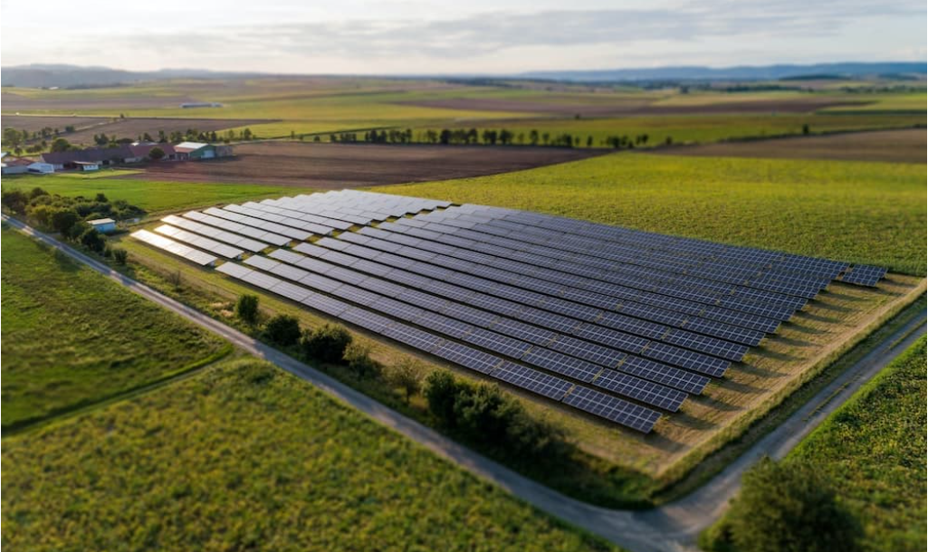
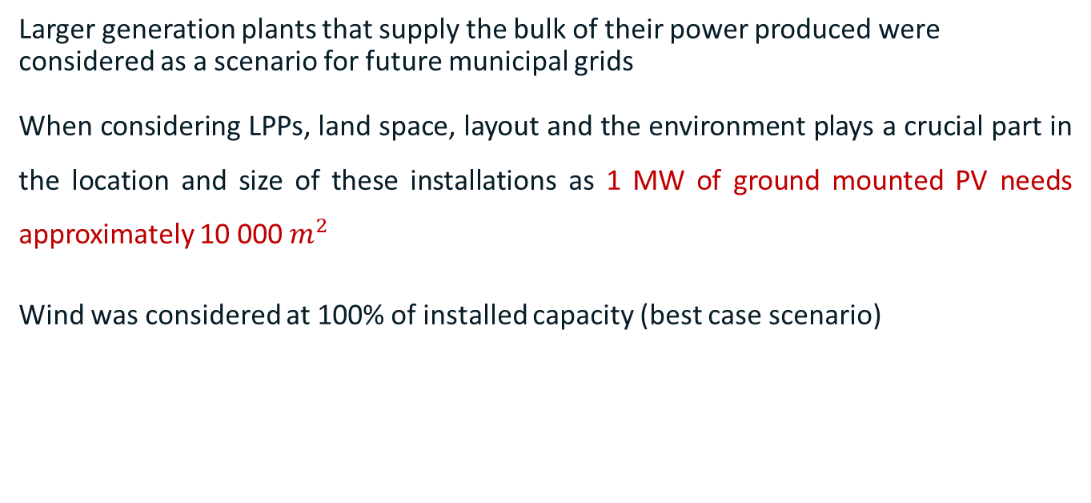
Large Power Producers (LPP) Assumptions
Larger generation plants that supply the bulk of their power produced were considered as a scenario for future municipal grids
When considering LPPs, land space, layout and the environment plays a crucial part in the location and size of these installations as 1 MW of ground mounted PV needs approximately 10 000$m^{2}$
Wind was considered at 100% of installed capacity (best case scenario)

Slide 26
2040 LPP Only – Incomer Lines Loading (MW)
100% output from the wind farm for 24 hours
Large reduction in power from Eskom due to wind and PV
Night reduction due to wind only. Possible backfeed to Eskom due to low
1
2
Notes:
Overall load reduction due to LPPs.
Active power exported back into the network.

Slide 27
2040 LPP Only – Transformer Loading (%)
100% output from the wind farm for 24 hours
Reduction in HV/MV transformer flows due to LPPs connected to MV busbar of main substations.
1
Notes:
Loading reduction due to LPP injection.

Slide 28
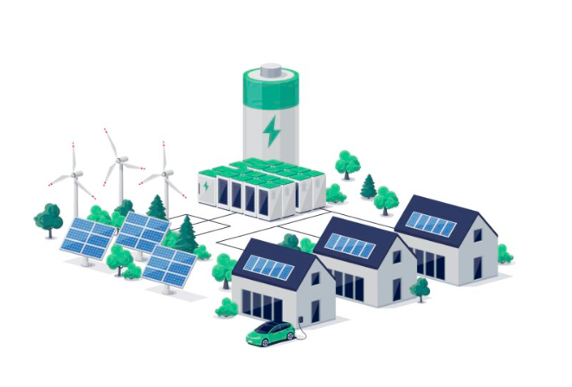
BESS, EG, EV & LPP
All technologies considered in the network simultaneously

Slide 29
2040 All On 100% Wind – Incomer Lines Loading (MW)
Reduction in overall power intake from Eskom
BESS charging contributing to increased night load.
Where BESS discharge is not co-ordinated, reverse power flow to Eskom is possible.
2
1
POWER FLOW TO ESKOM
3
3

Slide 30
2040 All On 100% Wind – Transformer Loading (%)
Overall transformer loading reduced due to EG
BESS charge contributes to night load increase.
2
1

Slide 31

KEY OBSERVATIONS

Slide 32

Key Observations
BESS
The charge / discharge times of municipal BESS needs to be carefully co-ordinated to prevent possible reverse power flow to Eskom.
The length of charge / discharge times need to be optimised to prevent shifting of peaks
The use of BESS for reactive power support or voltage regulation must be considered to prevent excessive voltage increases
Midday BESS charging is complimented by EG/IPPs and therefore shows negligible effect on the grid. Night time charging may be noticeable.

Slide 33
Key Observations
Embedded Generation
EG will significantly reduce feeder daytime loading
Reduced loading may result in increased voltages on feeders
EG with some form of voltage or reactive power control must be considered to prevent excessive feeder voltages.

Slide 34

Key Observations
Electric Vehicles
The impact of EV charging on the network loading is heavily dependent on the number of EVs.
Even though there may be a relatively large number of EVs, not all EVs charge at the same time.
It is excepted that most EVs will charge at home, thus increasing the feeder night time loading though ideal charging would be day time due to complimentary EG and LPPs.
In this study, EVs showed little impact on the network

Slide 35
Key Observations
Large Power Producers
LPPs are expected to be connected to HV or HV/MV substations.
Reduction in intake from Eskom is expected
LPPs may change the power flow on HV networks
Voltage regulation by LPPs is very important in order to manage the HV network voltage and the subsequent MV network voltages (grid code requirement).
Control of the LPPs by the munic is very important i.e. municipalities' control centres need to be equipped to control the LPPs to assist with power curtailment and also voltage regulation.

Slide 36
Key Observations
Considering ALL Technologies
Overall the technologies are complimentary e.g. BESS day time charging is complimented by EGs (PV) generation.
Feeder loading is more steady and peak loading can be ‘smoothed’ with BESS
Management of reactive power by the generation (EG & LPPs) is very important for future network voltage regulation. Management can be done locally (at the generator) or by the municipality (control room).
Municipalities must prepare to actively manage the grid from now otherwise they are going to be OUTATIME!

Slide 37





Acknowledgments
Digsilent Buyisa Team
  Niléne Enslin, Zanele Dlamini, Mosedi Maphale, Mikaela Soobramoney
Sustainable Africa Team
  Josh Dippenaar, Sinawo Sigalelana, Tanaka Shumba-Mukudu, Mark Borchers
GIZ
  Basetsana Molefyane (formerly)
George Municipality
  Daniel Greeff, Aphiwe Matiwane, Thabo Yiga, Kobus Wilken

Slide 38

For more information please contact
Geeven Moodley
info@digsilent.co.za
087 351 6159
Thank you

