Slide 1

SMART GRID INNOVATIONS: HIGH VOLTAGE CABLE SYSTEM TESTING USING AC RESONANT TEST SYSTEM
Presented by Rendani Mutepe PHD Candidate in Electrical & Electronics Engineering (UJ) – Projects/Commissioning Engineer of Aberdare Cables

Slide 2

Introduction
The High voltage (HV) cable testing is essential for ensuring dielectric integrity during commissioning (post-installation) and for assessing aging or in-service cable conditions. The olden methods such as the DC or power-frequency system voltage AC tests face challenges, especially for long, high-capacitance cables, due to the enormous power they require. AC resonant test systems address this by exploiting resonance to efficiently
generate high voltages with much lower input power.
The purpose of this discuss is to highlight the importance of the high voltage cable testing, because over time, cable insulation can degrade due to, thermal aging, moisture ingress and electrical stress. Therefore, High voltage testing can expose weak spots or faults in the insulation before they cause catastrophic failures.

Slide 3
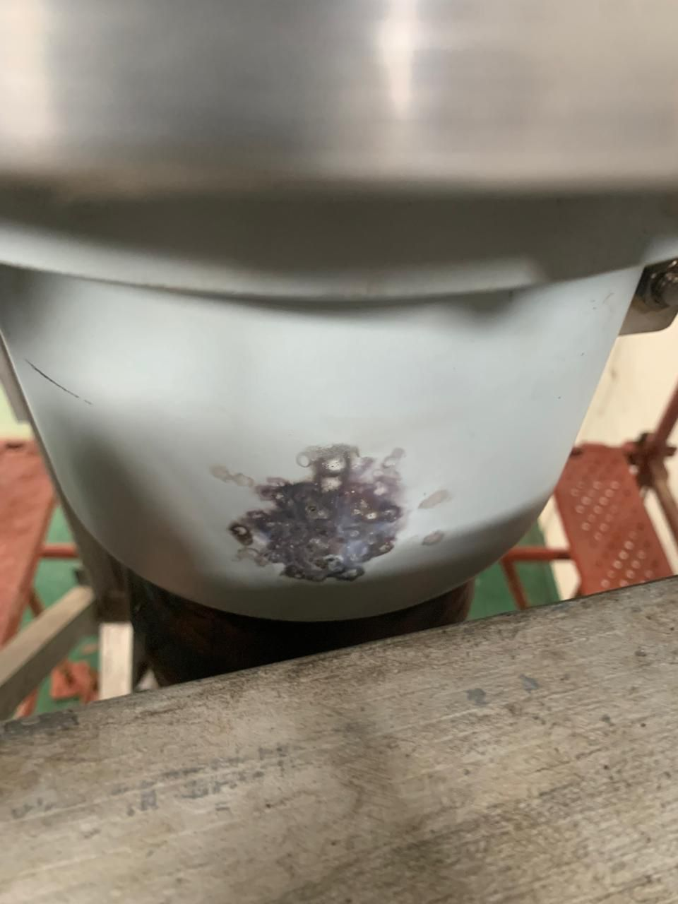
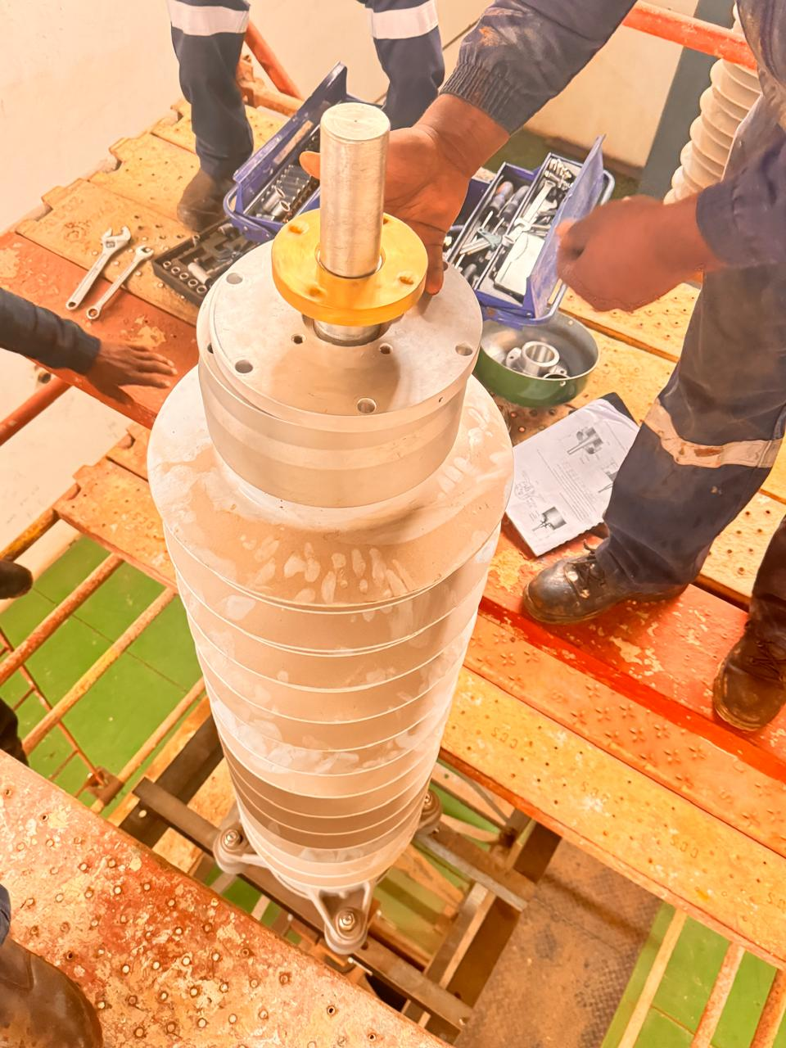
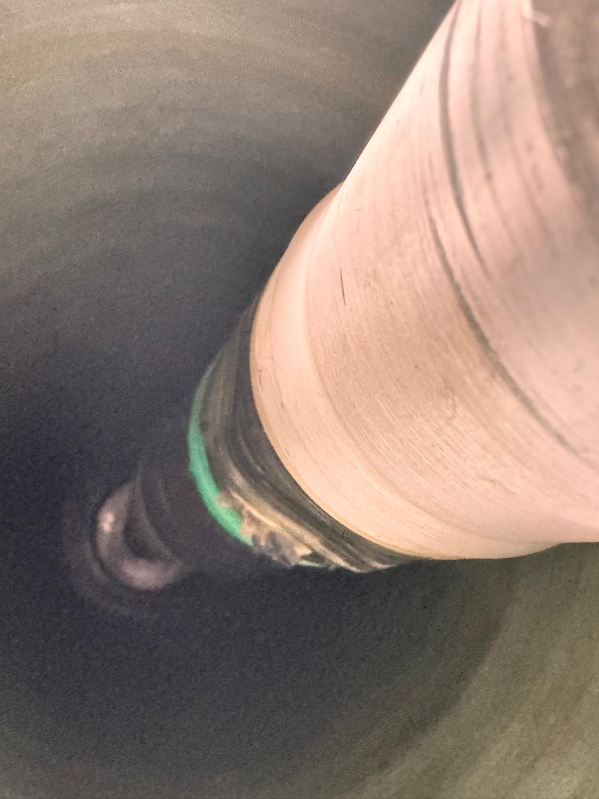
Visual Analysis of the System Breakdown
Break down at the termination

Slide 4
The Concept of AC Resonant Testing
The AC resonant testing is a high voltage testing leverages the principle of resonance in an AC circuit to generate high voltages efficiently with minimal power input. Therefore, for the HV circuits like 132kV cables, the test object itself forms part of the resonant circuit, ensuring a high-voltage output with low input current and reduced risk of damage.

Slide 5
Resonance in LC Circuit
When the system is at resonance, the inductive reactance (L) equals the capacitive reactance (C) of the cable system, producing voltage magnification with minimal input power.
SANS/IEC 60840 (the international standard for high voltage cables between 150kV and 500kV) and SANS/IEC 62067 (the international standard for high voltage cables between 150kV and 500kV) outline the power frequency at which the site testing (after installation) should be performed at as 20 – 300 Hz [1].
The test results performed at power frequency can be considered representative of real conditions. This is specially true when considering the influence of the waveform on the breakdown voltage.

Slide 6
Voltage Amplification and Power Efficiency
Resonance allows the system to use just a fraction (5–10%) of the power needed compared to conventional methods like DC, and AC at power frequency. For example, the testing of a 220 kV XLPE cable requiring 2,000 kVA by conventional means might only need 200 kVA using a resonant set-up. The availability of the system provides a good opportunity to perform best possible testing on the installation prior to energization and for future maintenance requirements [3].

Slide 7
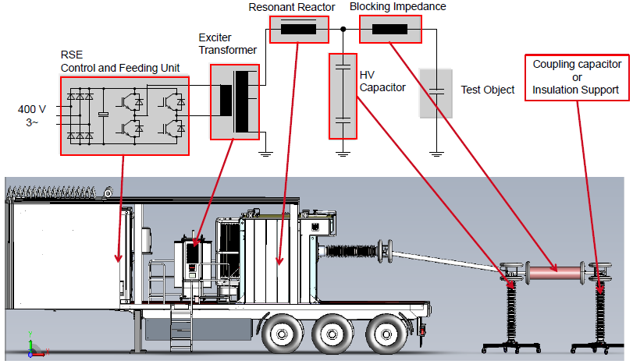
System Components and Setup
• Variable-frequency power supply: 20–300 Hz typical range
• Excitation transformer: to raise voltage to the appropriate level
• HV reactor (inductor): tunes system to match cable’s capacitance
• Capacitive divider and measuring instruments: for voltage monitoring
• Optional diagnostic tools: partial discharge (PD) detectors, oscillographs and recorders

Slide 8
System Setup & Safety
Cable system configuration varies based on voltage/capacitance but often includes reactors, transformer, and safety grounding points. The on-site setups require strict grounding, minimized lead lengths, and stable input power. Resonant systems collapse instantly upon breakdown, restricting fault energy which then enhance safety.

Slide 9
Testing Requirements as per the standards
Testing requirements are governed by industry standards such as IEC, IEEE, ICEA, and AEIC, and vary depending on the cable type, voltage rating, and application (e.g., new installations, commissioning, or maintenance) [2].
A recent increase in the number of breakdowns during the high voltage commissioning test highlights the necessity of a well-designed voltage withstand test as a main filter of the on-site workmanship.
Benchmark [1]:
• Voltage withstand (1.73U0)
• PD Free at 1.5 U0 after 1 hr voltage test

Slide 10
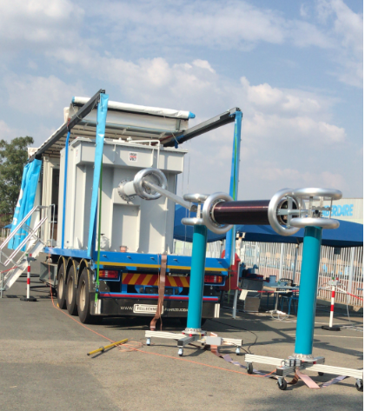
Step-by-Step
1. Preparation: Verify equipment (power supply, reactors, grounding, and connections)
2. Parameter Setup: Define voltage, frequency, test duration
3. Execute Test: Apply voltage and fine-tune to resonance
4. Observation: Monitor for PD and voltage breakdown
5. Shutdown: De-energize, disconnect, and finalize
6. Total duration typically spans between 2–3 hours, depending on conditions
Figure 2 below shows the onsite set-up of the AC resonant set up system. The equipment is powered by 380V, and the control room is powered by the 220V.

Slide 11
Frequency and Duration
Typical test frequencies range from 20–300 Hz, with durations between 30–60 minutes depending on cable standards and voltage levels. Further, the standards also guide in terms of the duration and test voltage.
Key standards include:
• IEC 60502 2 (cables up to 170 kV)
• IEC 60840 / IEC 62067 (extruded cables above 170 kV)
• IEEE 400.3 / 400.4 (AC withstand testing guides)

Slide 12
On-site cable System Testing
The on-site testing, commonly used for after installation commissioning, and on-site validation of cable joints, terminations, and overall integrity. Effective across HV and EHV ranges (e.g., 66 kV–400 kV and beyond). The setup on a high voltage circuit above 66kV, is performed in such a way that one phase of the system is connected to the test object (i.e., cable phase), grounded securely, and calibrated. Voltage is ramped up gradually while tuning for resonance, with tests often including withstand voltage, Tan Delta and PD measurement [4].

Slide 13
Partial Discharge (PD) Testing
Combining AC resonant withstand testing with PD measurements enhances the detection of weak spots in XLPE cable accessories. PD diagnostics with resonance tuning helps detect early defects before failures.

Slide 14
Mobile / Field Testing Systems
Mobile, variable-frequency resonant systems have been deployed across SA, testing several cable systems of different insulation types (XLPE) on-site with documented success. The AC resonant test system with variable frequency generates a practically infinitely variable AC test voltage against earth for testing of XLPE cable, switchgear and the other capacitive test objects.

Slide 15
Comparative Advantages
Compared to VLF testing (0.1 Hz), DC , or power-frequency AC testing:
Very low frequency (VLF): Portable but arguably not representative for HV, less effective for XLPE.
DC: Cheap and simple, but may damage polymer insulation and not reliable for modern cables.
Power system Frequency AC: Realistic waveform but demands enormous power sources, not practical on-site.

Slide 16
The test system benefits and Challenges
Advantages
• Efficient: High voltage with minimal power consumption.
• Accurate: Pure sine wave with fine control improves result fidelity.
• Safe: Rapid fault detection limits energy during breakdowns.
• Flexible: Adjustable frequency suits loads of varying capacitance.
Challenges
• Higher costs: But better efficiency and cost savings .
• Technical complexity: Requires tuning to resonance and skilled operators.
• Setup sensitivity: Grounding and connection details must be precise.
• PD measurement: Skill is required in the interpretation of PD patterns where problematic PD is present.

Slide 17
Conclusion
The AC resonant test systems represent a cornerstone of smart grid innovation, that provide an advanced, efficient, and widely adopted solution for high voltage (HV) and extra-high voltage (EHV) cable testing, particularly for long, high-capacitance systems such as XLPE cables. The AC resonant test systems enable precise, safe, and cost-effective dielectric testing during commissioning and diagnostics, adhering to established industry standards and delivering proven field performance. In addition, by ensuring a balance of accuracy, efficiency, safety, and diagnostic capability, the AC resonant test systems play a pivotal role in enhancing grid reliability and asset management. The system further ensures the long-term performance of HV and EHV cables, detecting insulation weaknesses before they escalate into costly failures. As power networks evolve into more complex and interconnected smart grids, the AC resonant test systems will remain critical in supporting resilient, efficient, and sustainable energy infrastructure, enabling proactive maintenance and optimized grid performance.

Slide 18
Acknwledgement
We express our sincere gratitude to Mr. J. Wang, CEO of Aberdare Cables, Mr. M. Matla, Executive Director, Mr. J. Song, and Mr. A. Teladia for their invaluable contributions and unwavering support in the development of this paper. Their expertise and encouragement have been instrumental in its success.

Slide 19
References
[1] International Electro technical Commission, “Power cables with extruded insulation and their accessories for rated voltages above 30 kV (Um = 36 kV) up to 150 kV (Um = 170 kV) – Test methods and requirements,” IEC 60840:2011, 2011.
[2] International Electrotechnical Commission, “Power cables with extruded insulation and their accessories for rated voltages above 150 kV (Um > 150 kV) up to 500 kV (Um ≤ 550 kV) – Test methods and requirements,” IEC 62067:2020, 2020.
[3] CIGRE Working Group B1.21, “Field experience with insulation diagnosis on service-aged power cables,” CIGRE Technical Brochure 358, 2008.
[4] IEEE Power and Energy Society, “Guide for field testing and evaluation of the insulation of shielded power cable systems rated 5 kV and above,” IEEE Std 400-2022, 2022.

Slide 20

Thank you

