Slide 1


Lessons learned from Installing a 1.1 MW Rooftop Photovoltaic system and strategies for improvement
Presented by Sy Gourrah, BEng Electrical & Electronic Engineering, PrEng, MBA
Divisional CEO
Actom Electrical Equipment

Slide 2
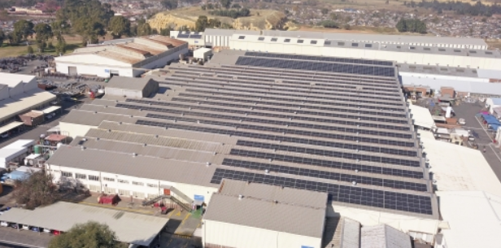

Context:
Introduction
Overview of the Site
Description of the System
Selection of Equipment
Installation Process
Challenges Encountered and Their Solutions
Performance Assessment and Operational Insights
Proposal for Future Expansion
Conclusion

Slide 3
Introduction:
In 2022, the company faced substantial load shedding.
This affected all manufacturing processes.
Electricity costs saw a notable increase.
Utility expenses continued to rise.
Solar energy emerged as a promising solution.
Switchgear was our main client.
The planning stage was comprehensive, with several revisions.
Strategies were formulated to have a phased approach & improve future installations.

Slide 4
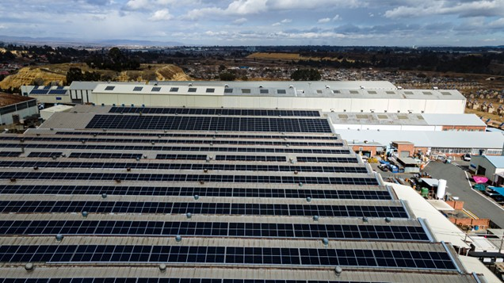
Site Overview:
The Knights facility is situated in Germiston, serving as a key operational site.
It operates an 11kV ring main network, ensuring reliable and efficient power distribution throughout the premises.
The facility encompasses four distinct manufacturing plants: HVE, P&C, ADT, and S/G, each specializing in different production processes.
Among these, the S/G plant covers the largest floor and roof area, highlighting its significant physical footprint within the facility.
Additionally, the S/G plant stands out as the highest individual energy consumer, reflecting its intensive operational demands.

Slide 5
Site Overview:

Slide 6
System Description:
System consists of two independent 550kW grid-tied systems.
Each system includes five 110kW inverters, totaling ten inverters.
Inverters connect to the Low Voltage Distribution Board and transformer.
Photovoltaic panels provide renewable energy input to the system.
Phasing to limit financial exposure and prove the POC.

Slide 7
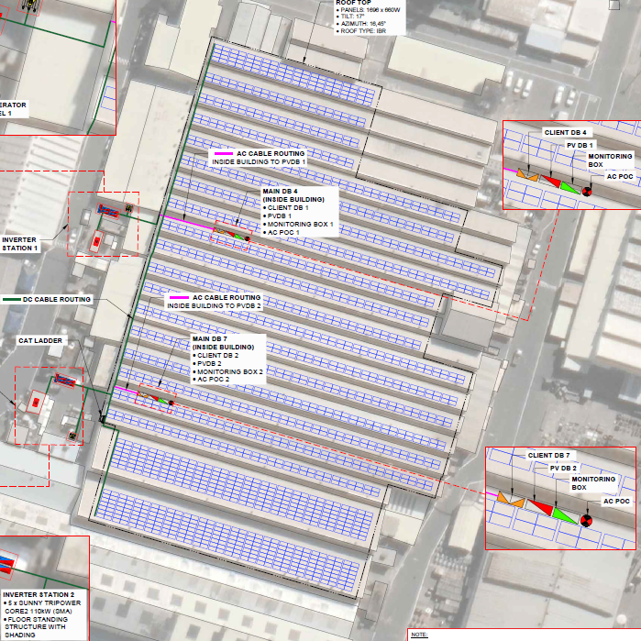
System Description:

Slide 8
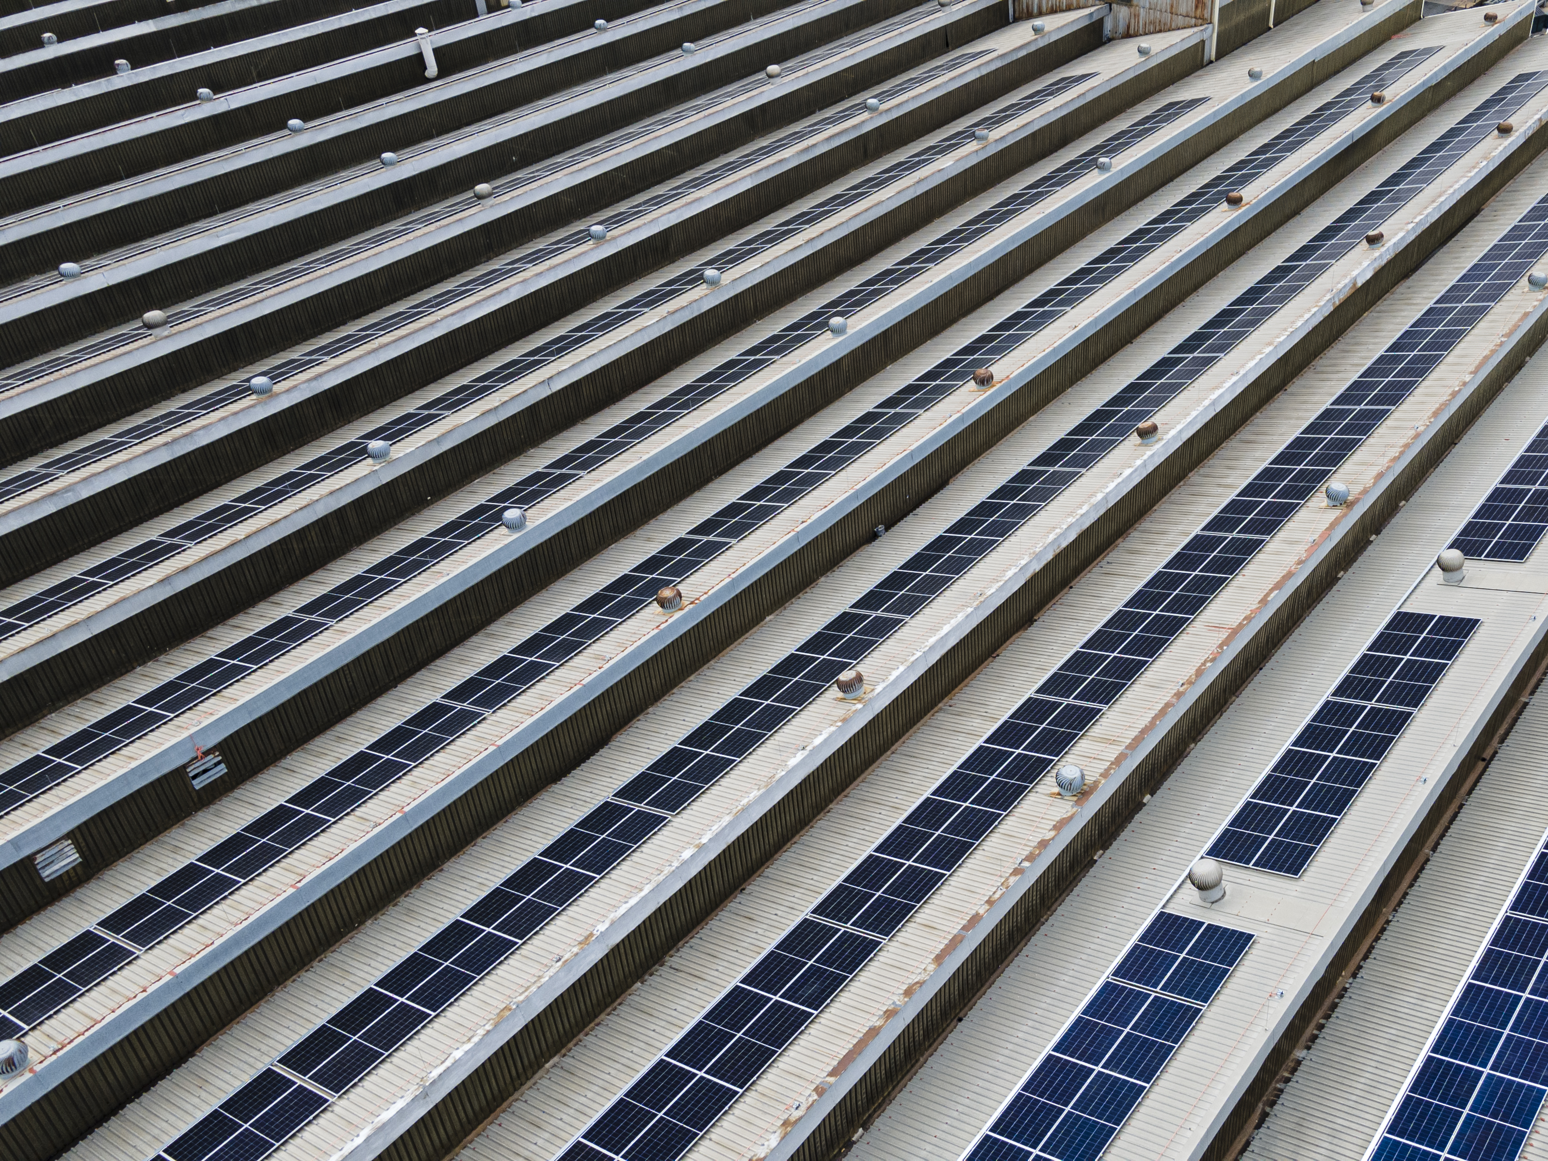
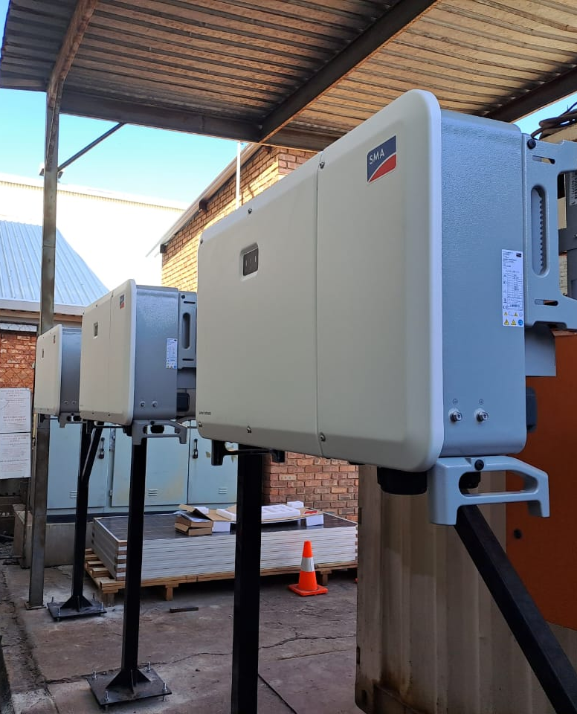
Equipment Selection
Inverters:
  Ten SMA Sunny Tripower Core2
  110 kW

Slide 9
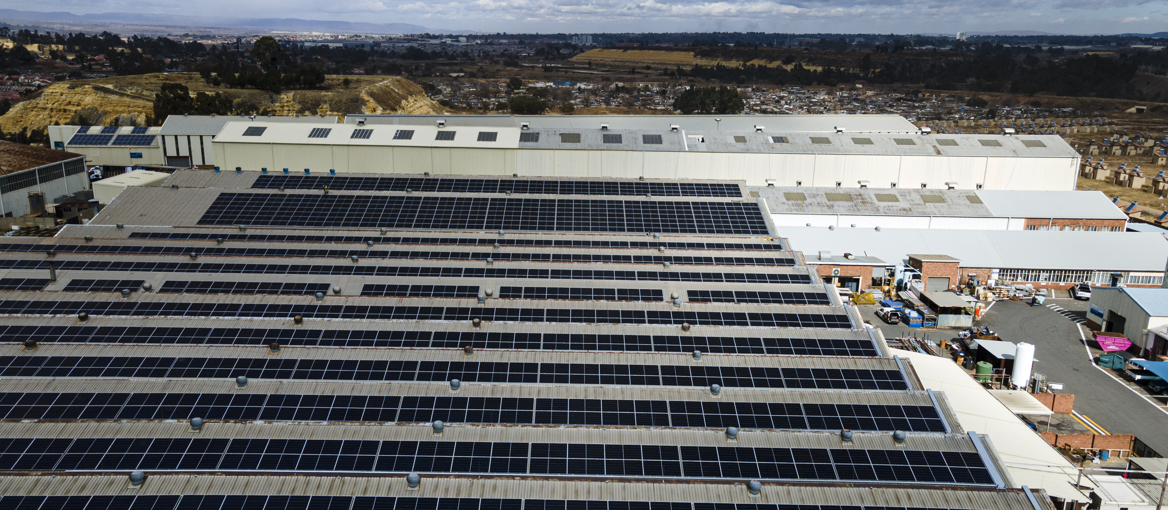
Solar Panels:
Trina Solar TSM-DE21 660W monocrystalline module
A total of 1,696 Trina Solar panels
Equipment Selection

Slide 10
Installation Phase:

Slide 11
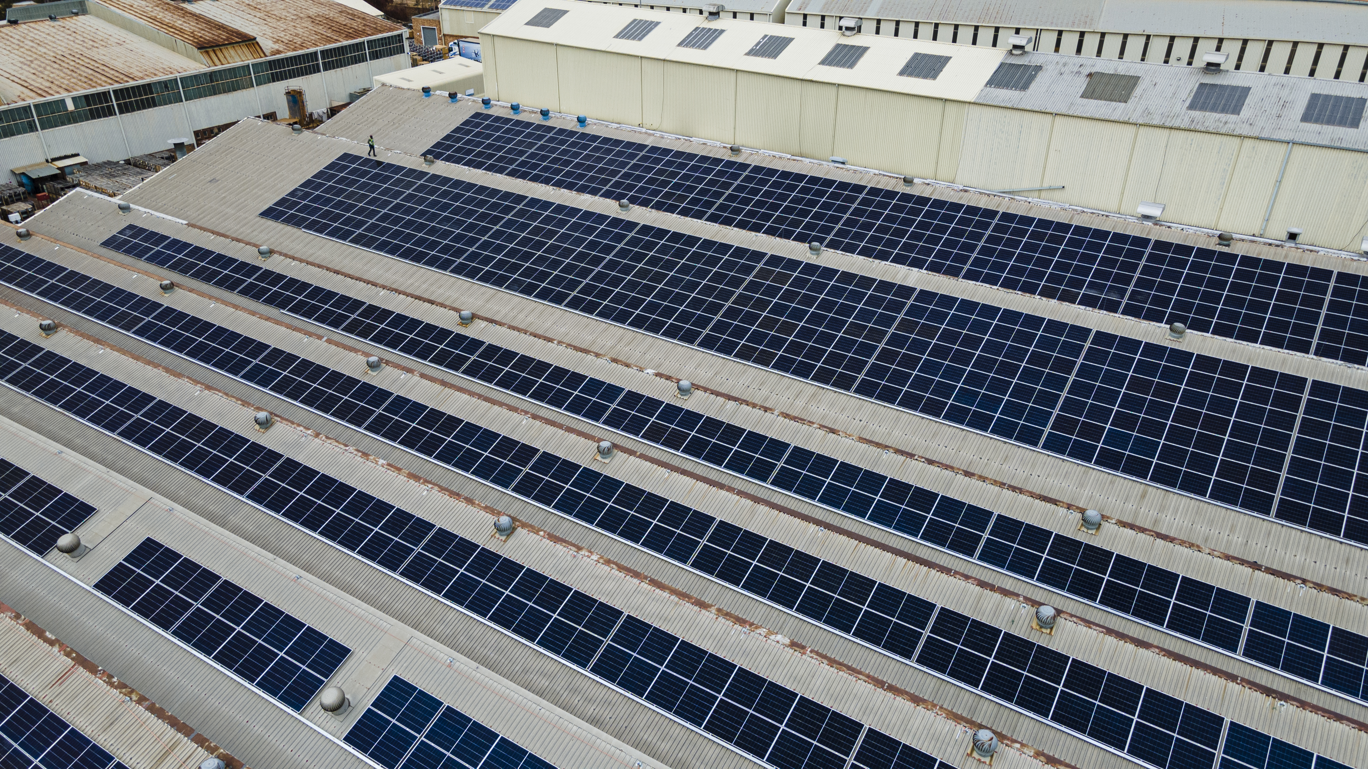
Installation Phase:

Slide 12
Installation Phase
Performed structural assessments
Chose 330W photovoltaic (PV) panels
Reinforced the roof structure
Installed central beams to support larger PV panels
Maintained continuous safety measures during roof reinforcement and work at heights
Operated within an active factory environment
Worked above liquid baths utilized in metal fabrication
Managed damaged panels

Slide 13
Challenges & Solutions:
The PV panel capacity increased from 380W to 660W.
The current roof structure was deemed inadequate.
Central beams were strengthened to support the larger PV panels.
The grid-tied inverter system limits functionality during load shedding.
Integration with generators was postponed to a later phase.
Elevated battery costs hindered the complete installation of the system's full capacity.

Slide 14
System Performance & Operational Lessons:
The installation of photovoltaic modules and inverter stations was completed by June 2023.
System commissioning was finalized within the same month.
The facility reached full operational capacity by July 2023.
Electricity costs were reduced by 35%.
The grid-tied inverter system limits functionality during loadshedding.
Maintenance and critical support systems are in place.
Supervision of contractors activities was ongoing.

Slide 15
Future Expansion Proposal:
Larger panels, lower battery costs, and shifting energy priorities have improved energy arbitrage and peak shaving benefits at Knights.
Battery Energy Storage Systems (BESS) help move usage from peak to off-peak times, lowering Knights' Levelized Cost of Electricity.
Projected internal rate of return (IRR) is about 25%.
Plans include two identical Low Voltage setups next to each diesel generator, each with a 645 kVA inverter and 1.062 MWh battery.
The design features Remote Synchronisation Contactors (RSC) for generators and grid, plus an Energy Management and Monitoring System (EMS) for smooth integration.

Slide 16
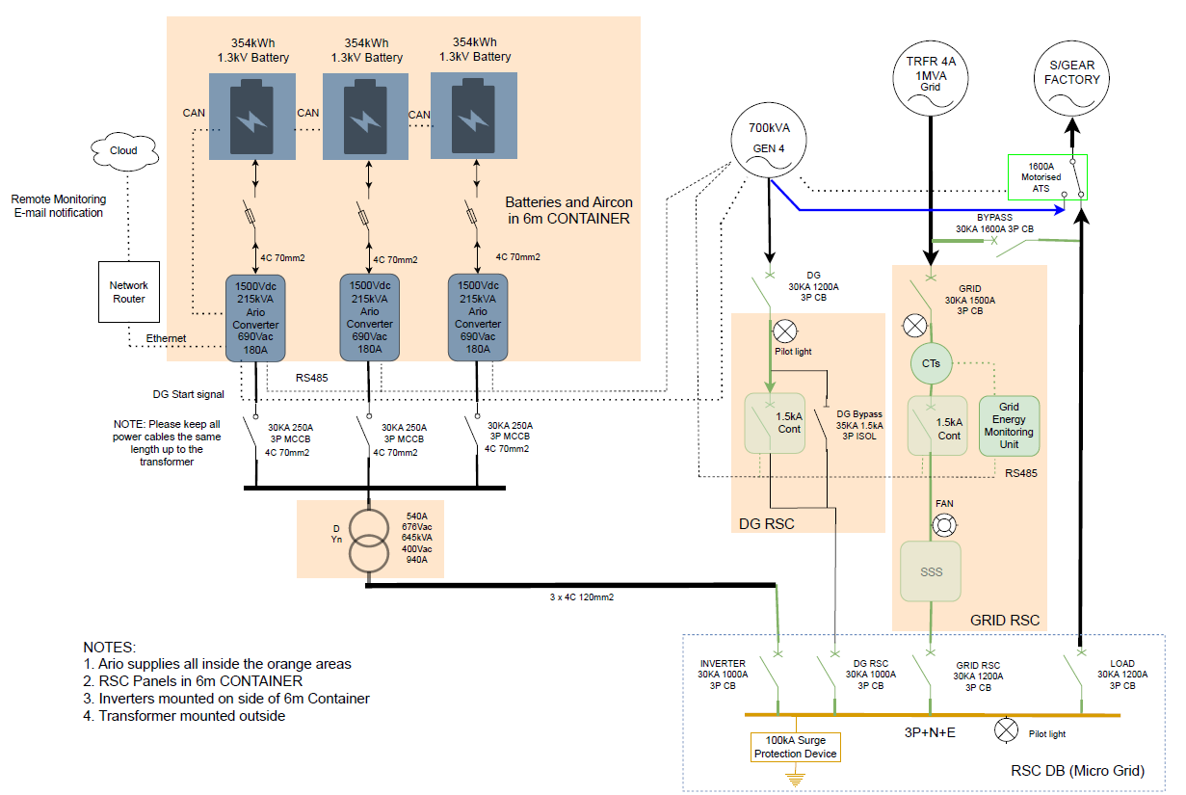

Slide 17
Future Expansion Proposal:
Energy Arbitrage - 17.5% IRR, increasing to 54.8% during constant stage 2 load shedding
Peak clippings - 24,8% IRR, increasing to 59,4% during constant stage 2 load shedding
Integrating AI into future solar installations, especially in using predictive analytics for load forecasting, complex energy mixes, automated controls for optimizing battery usage.
Charging batteries during off peak, clipping the peaks as required and possibly even avoiding usage during peak tariff periods.

Slide 18
Conclusion:
Achieve notable energy savings, lower costs, and favorable investment returns.
Integrating generators, batteries, energy arbitrage, and peak shaving can further reduce expenses, improve efficiency, stabilize the grid, support the environment, and enhance energy independence.
Exploring Power Purchase Agreements, rentals, feeding excess power to the grid, and energy wheeling aims to maximize project feasibility, with preliminary studies considering a mini microgrid at the Knights site.

Slide 19

Thank you

