Slide 1

Machine Learning Model Development for Predictive Maintenance in Industrial Robotics.
Presented by Phathutshedzo Benedict Mathivha,
Masters Alumni
University of Johannesburg

Slide 2

Abstract
The integration of predictive maintenance models in industrial robotics has emerged as a crucial strategy for enhancing operational efficiency, reducing downtime, and improving system reliability. This study focuses on developing and validating a predictive maintenance model using Classification and Regression Trees (CART) with historical maintenance data from industrial robotic systems. The proposed model leverages machine learning algorithms to predict failure events by analysing critical performance indicators such as temperature, cycle time, vibration, current, and downtime.
Data-driven analysis and model development were conducted using Minitab’s predictive modelling environment, employing the Gini impurity criterion to optimize decision-making nodes. The dataset was divided into training and testing subsets, ensuring model reliability through cross-validation. Model evaluation metrics, including prediction accuracy, misclassification rates, and area under the ROC curve (AUC), were computed to assess the model's effectiveness.
Results from the study demonstrated high prediction accuracy, indicating the model's capability to anticipate potential failures and support proactive maintenance scheduling. The validation process confirmed the model’s practicality in enhancing system reliability while minimizing reactive maintenance costs. This research contributes to advancing predictive maintenance frameworks by integrating machine learning-driven insights with real-world industrial robotic applications.
Keywords: Predictive Maintenance, Machine Learning, CART Model, Industrial Robotics, Failure Prediction, Gini Impurity, Model Validation, Data-Driven Analysis, Current, Downtime.

Slide 3
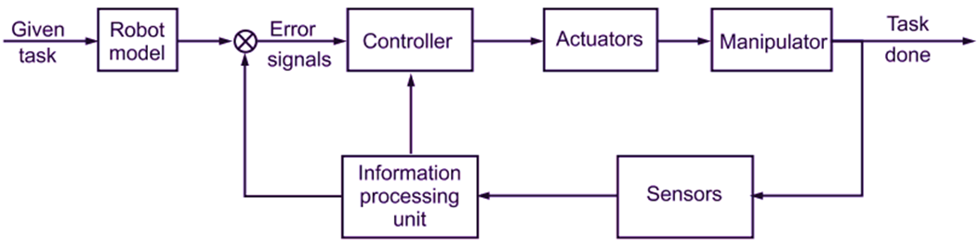
Introduction and Motivation
The reliability of robotic systems is crucial in industrial applications.
Traditional maintenance is reactive, leading to unplanned downtimes.
Predictive maintenance integrates machine learning for proactive interventions.
This study focuses on CART-based predictive maintenance for industrial robotics.
Figure showing: Basic Structure of a Robotic System

Slide 4
Problem Statement & Objectives
• Problem: Existing predictive maintenance models are insufficient for industrial robotics.
• Objectives:
Develop a machine learning-based predictive maintenance model.
Improve system reliability and reduce unplanned downtimes.
Validate the model's effectiveness through simulations and testing.

Slide 5
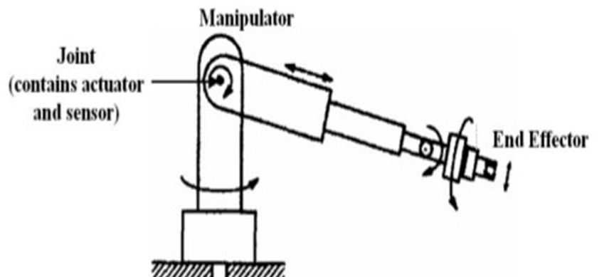
Significance of the Study
Enhances predictive maintenance techniques for industrial robotics.
Integrates machine learning for proactive maintenance planning.
Reduces maintenance costs and operational downtimes.
Contributes to sustainable manufacturing practices.
**see Figure 2 : Basic Industrial Robot Structure here**
Figure showing : Basic Industrial Robot Structure here

Slide 6
Literature Review
• Traditional maintenance models: Reactive, Preventive, Condition-based.
• Machine learning for predictive maintenance:
Supervised learning (CART, Random Forests, ANN)
Unsupervised learning (Clustering, Anomaly Detection)
• Identified gaps: Limited real-time adaptation and industry-specific frameworks.

Slide 7
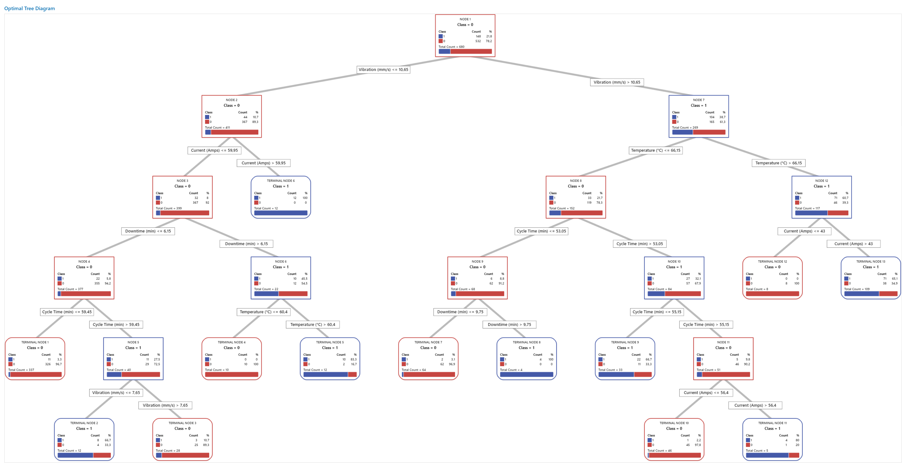
Methodology
• Data Collection:
Sensor data (Temperature, Vibration, Current, Cycle Time, Downtime)
• Model Development:
Classification and Regression Trees (CART)
Model training and validation using Minitab.
• Model Evaluation:
Cross-validation, Misclassification Rate, ROC Curve.

Slide 8
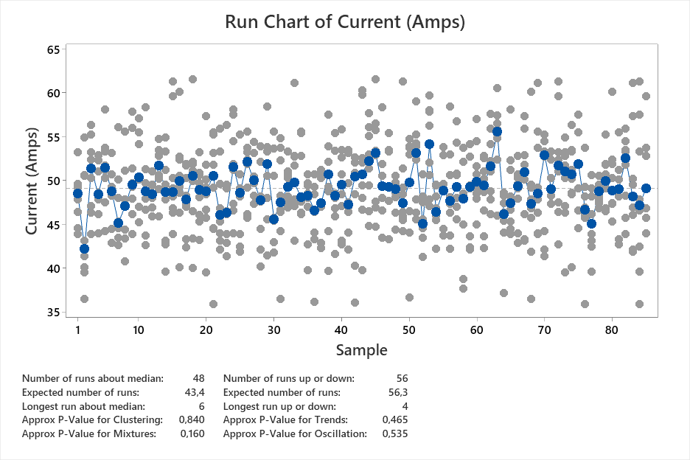
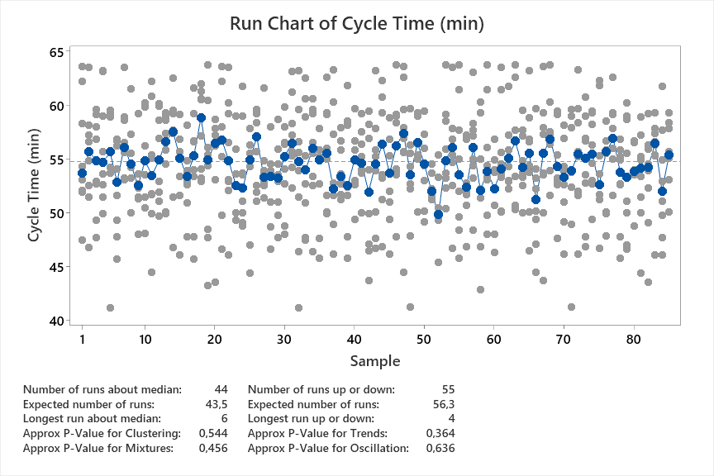
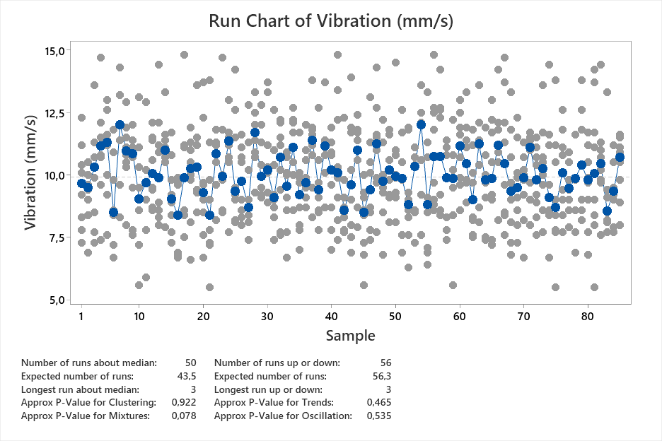
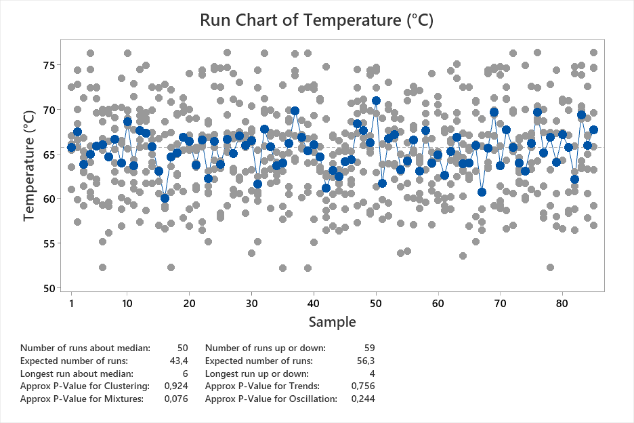
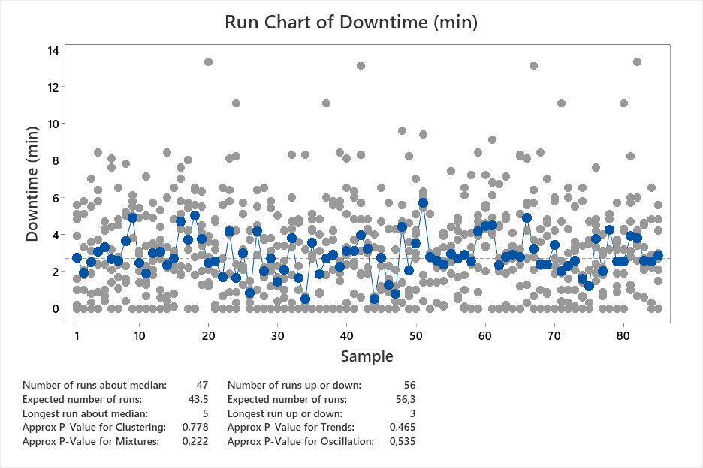
Exploratory Data Analysis (EDA)
• Descriptive Statistics:
Summarized mean, standard deviation, and quartiles for each variable.
• Run Charts:
Time-series visualization of fluctuations and trends.
• Bivariate Correlation Analysis:
Evaluated relationships between predictors and failure likelihood.
**[see 4 Figures showing : Time Series Run Charts ]**

Slide 9
Regression & CART Model Development
• Regression Analysis:
Logistic regression applied to quantify failure probabilities.
• CART Model Training:
Gini Impurity used for splitting nodes.
Overfitting controlled by limiting max depth.
• Predictor Significance Analysis:
Feature importance rankings from CART.
**See Table showing : Regression Coefficients and Summary **

Slide 10
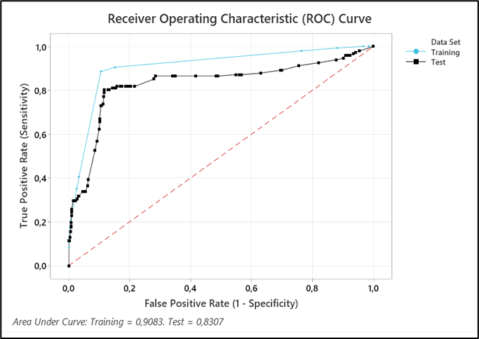
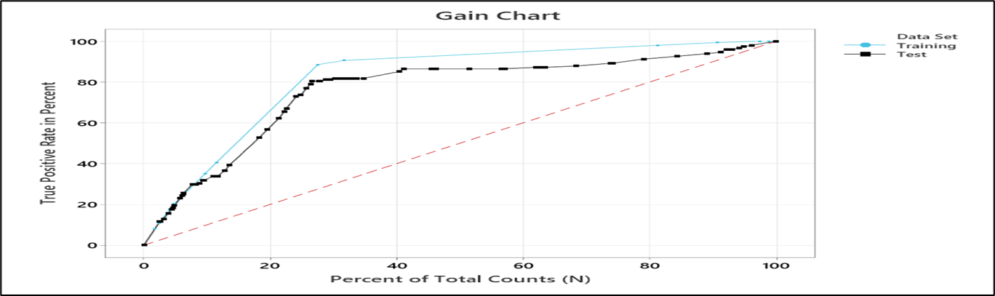
Model Performance Metrics
Fig 6: Model Receiver Operating Characteristics (ROC) Curve
Figure 5: Lift charts
• Accuracy and Misclassification:
Performance measured using Confusion Matrix.
• Receiver Operating Characteristic (ROC) Curve:
AUC score validated predictive power.
• Sensitivity & Specificity:
Evaluated true positive and false positive rates.
**[See figures below: ROC, Gain, and Lift Charts here]**
Figure 7:Gain Chart

Slide 11
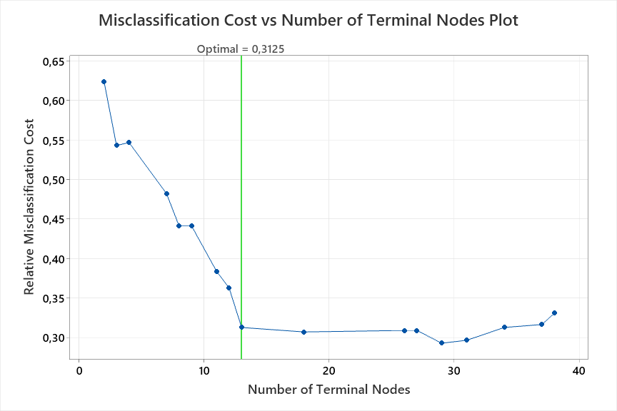
Findings & Discussion - Key Insights
High temperatures and vibrations were strong failure predictors.
CART model demonstrated an accuracy improvement of 15% over traditional methods.
Proactive scheduling using this model could reduce downtime by 30%.
Figure Shows: Misclassification Cost vs. Terminal Nodes
Figure 9: Misclassification cost vs number of terminal nodes plot

Slide 12
Practical Implications
• Predictive Maintenance Strategy:
Real-time monitoring can improve maintenance planning.
•Integration into Industry:
Implementing the model in industrial robotics can cut operational costs.
• Recommendations for Implementation:
Adopt hybrid predictive techniques for enhanced robustness.

Slide 13
Conclusion & Recommendations
• Conclusion:
Predictive maintenance using CART improves reliability.
Machine learning enhances failure prediction accuracy.
• Recommendations:
Implement real-time predictive maintenance systems.
Further research on hybrid machine learning models.
Extend validation with industry-based case studies.

Slide 14
Acknowledgments & References
Special thanks to my supervisor and co-supervisors.
Support from the University of Johannesburg.
References available in the full thesis document

Slide 15

Thank you

