Slide 1

The role of municipalities in a liberalised electricity sector: challenges and opportunities in South Africa’s wholesale electricity market
Presented by Mmaphuthi Nkwana
Energy Consultant
GLS Consulting (Pty) Ltd

Slide 2
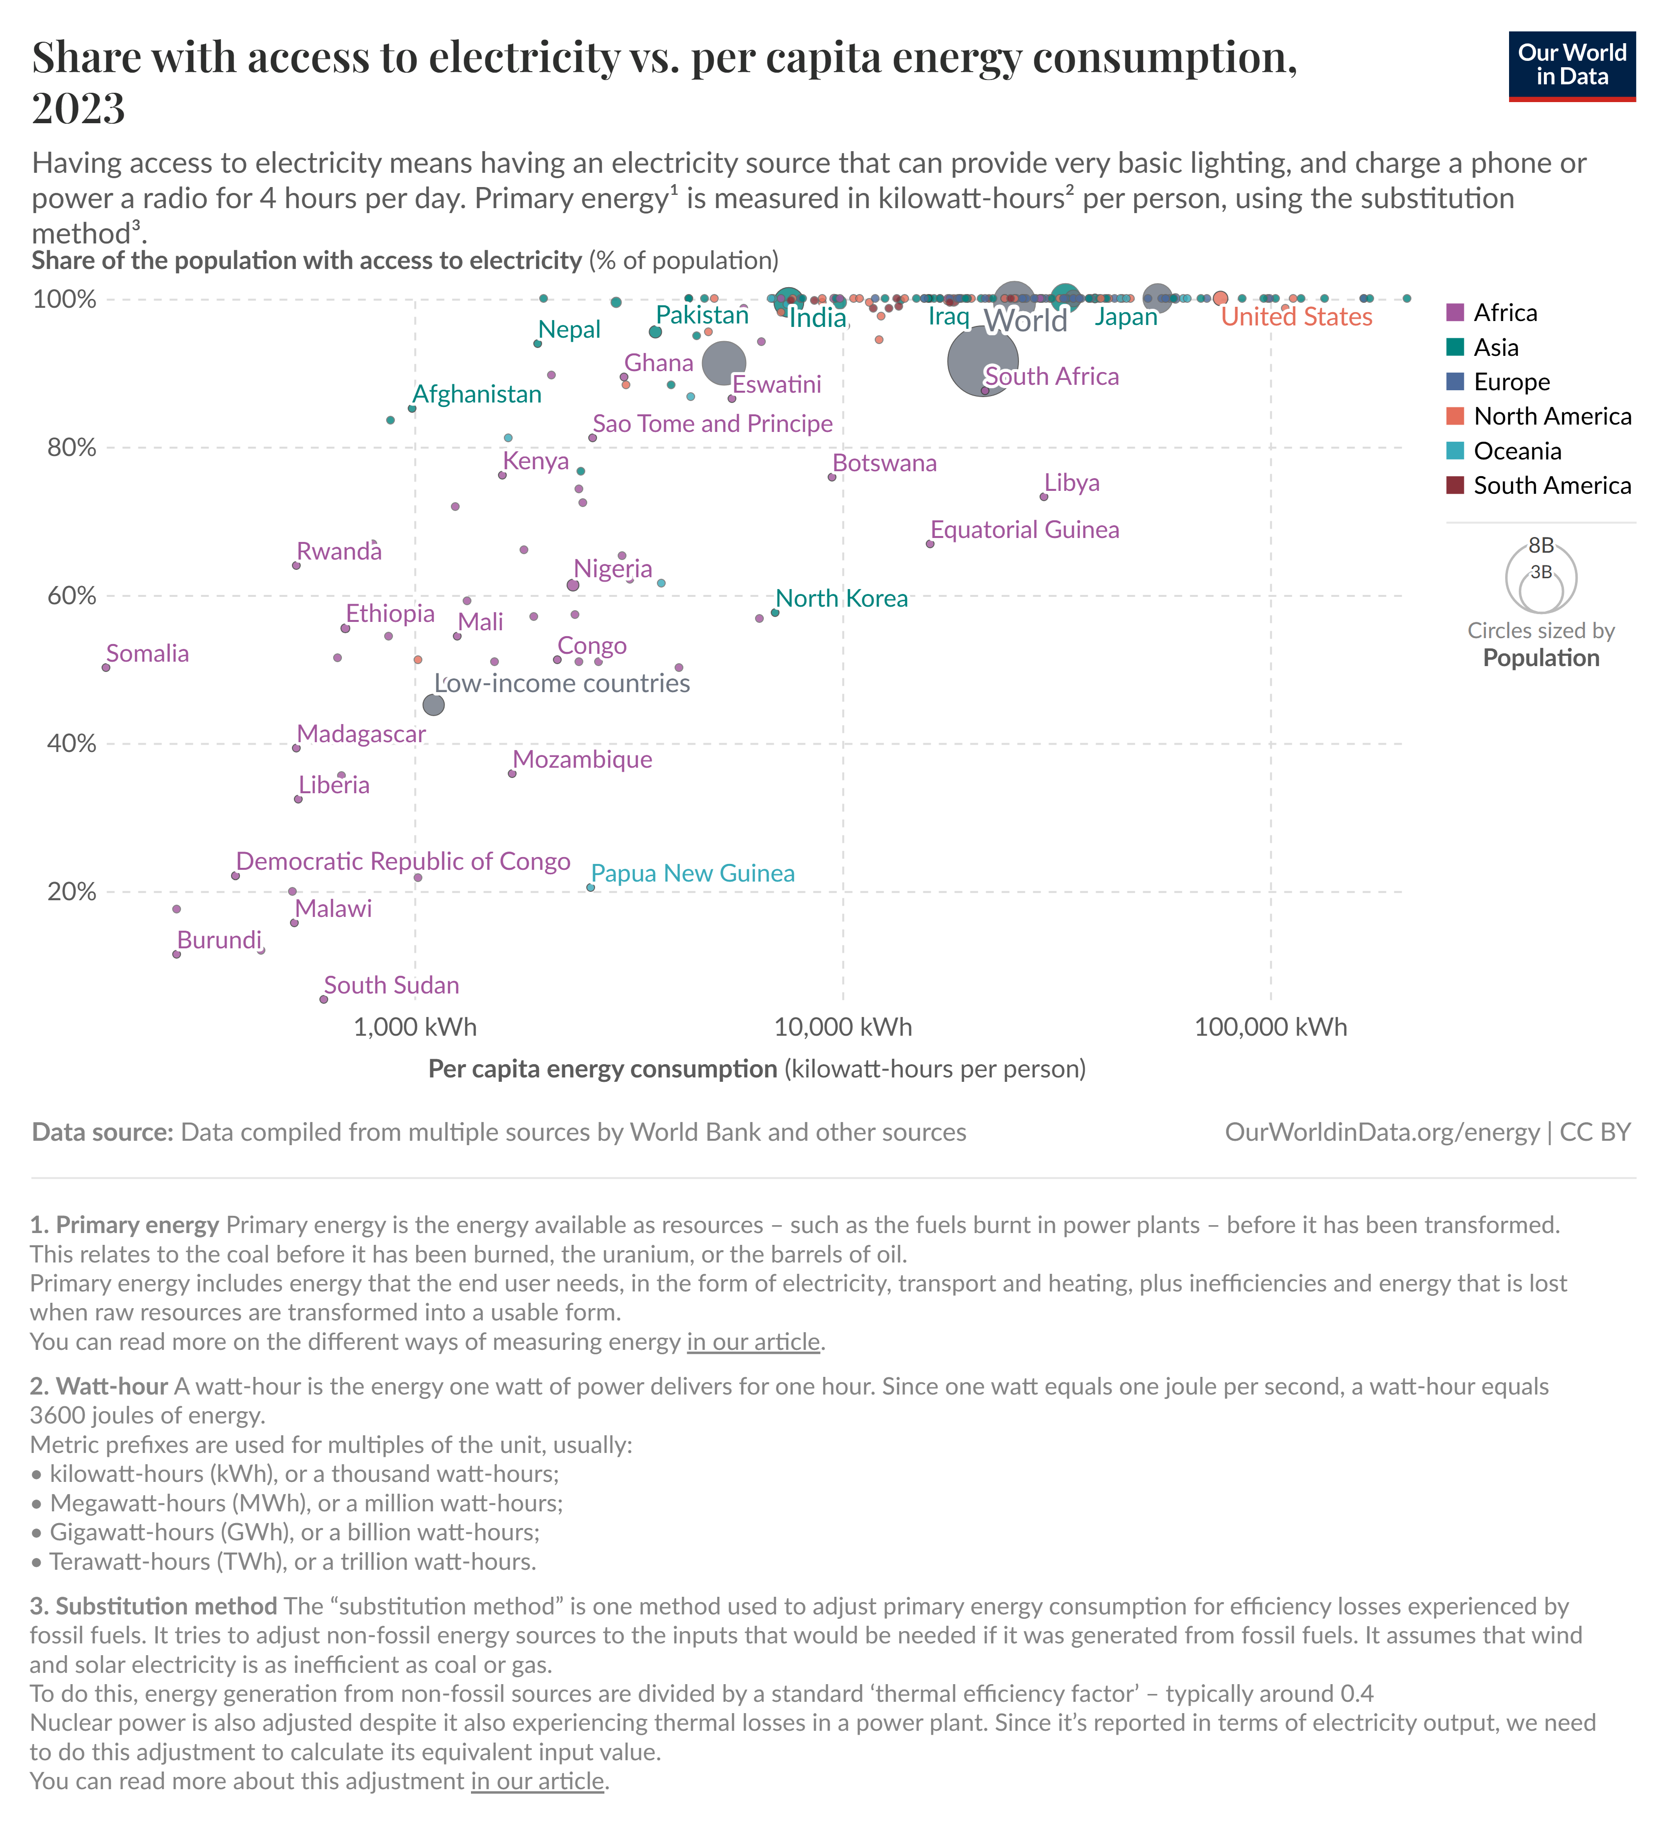

The role of municipalities in a liberalised electricity sector: challenges and opportunities in South Africa’s wholesale electricity market
Notes:
The Electricity sector is one of the primary industries of the national economy and an important safeguard for economic development and social progress. Traditionally, state-owned monopolies were set up to leverage the economy of scale allowing the rapid construction of generation facilities and the long-distance transmission/distribution systems in order to increase access to electricity.
These entities performed all functions, including generation, transmission and distribution, sound familiar? Another key mandate was to deliver power to citizens in disadvantaged areas at a high-cost risk due to the lack of incentive for private companies to provide electricity to these regions.

Slide 3
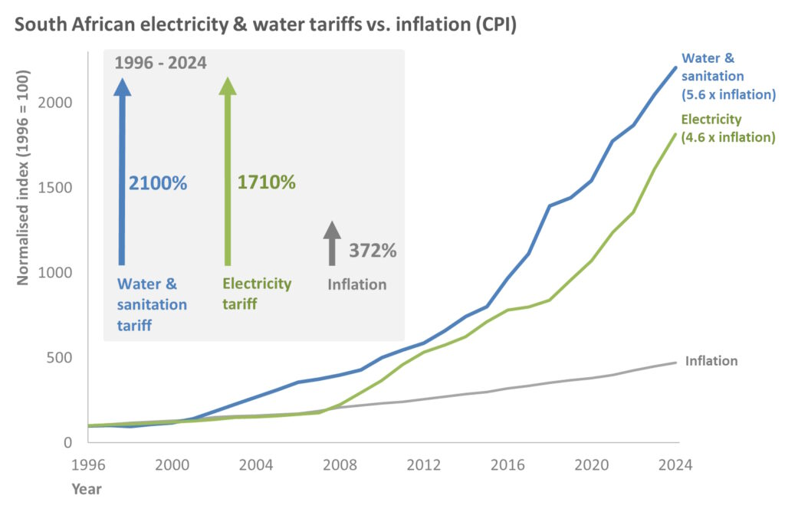
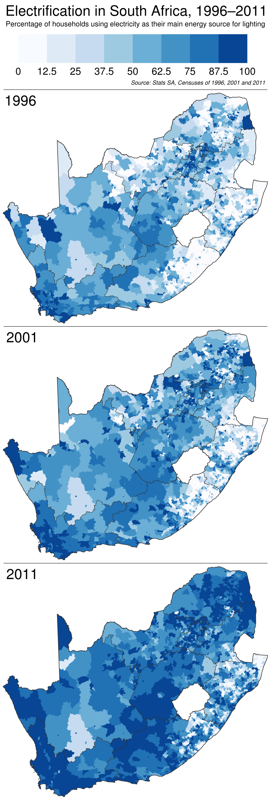
Source: Adrian Frith - Map of electrification from 1996 to 2011
Source: PowerOptimal – the Future of Energy
Why Conduct Market Reforms?
Notes:
Over time, these entities started to fail to provide access to quality supply of electricity. This is said to primarily be due to lack of managerial accountability, outdated infrastructure, operational inefficiency and end-user tariffs being set below cost-recovery levels. According to the World Bank in a 1994 Infrastructure for Development report, issues in operations, inefficient planning, and investment plagued many monopolies, and in a more recent review in 2019, such problems still persist. With the progress made in the expansion of the grid and access to electricity, this state-owned monopoly concept is beginning to change with more countries looking to adopt electricity markets through market reforms. Governments are introducing competition in the electricity ecosystem to address multiple challenges including:
Inefficient investment
High operating or investment costs
Poor billing and collection
Pressure on the fiscal system resulting in a drain on public finances
Need to attract private finance
Slow adoption of innovative technologies required to facilitate an energy transition
And an attempt to dampen the high cost of electricity

Slide 4
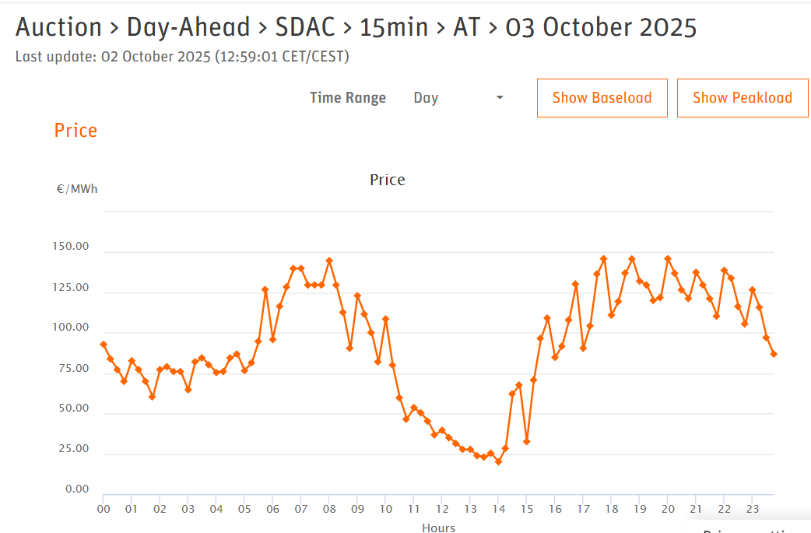
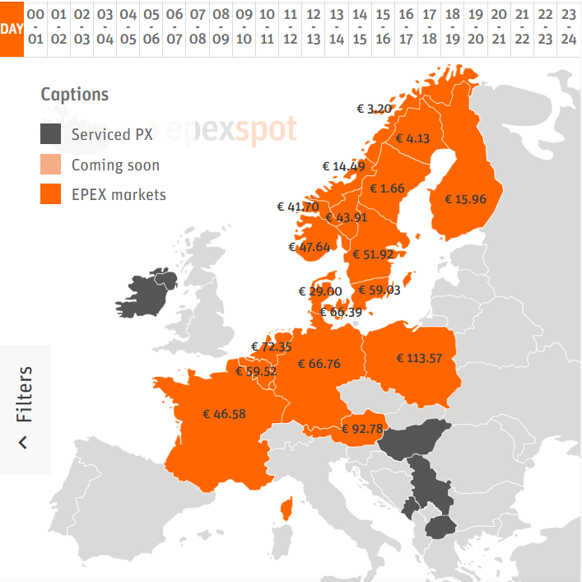
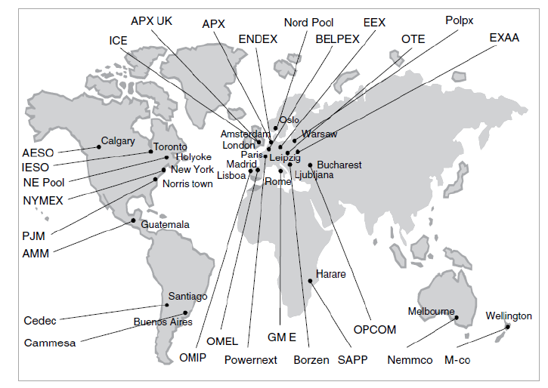
What is an Electricity Market?
Source: EpexSpot site
Notes:
So, what is an electricity market? An electricity market is a system where energy is traded between producers and end-users which is typically overseen by a market operator and facilitated by a system operators.
There are various electricity markets where electricity is traded around the globe. These electricity markets were developed to address the previously mentioned challenges by introducing much needed competition to increase efficiency, boost generation capacity, drive innovation by attracting private investment into the sector and of course eventually reduce the cost of electricity.
South Africa actively participates in the Southern African Power Pool, where electricity is traded among countries in the Southern Africa Development Community. Locally, however, we remain in a vertically integrated model until the launch of the South African Wholesale Electricity Market next year in April.

Slide 5
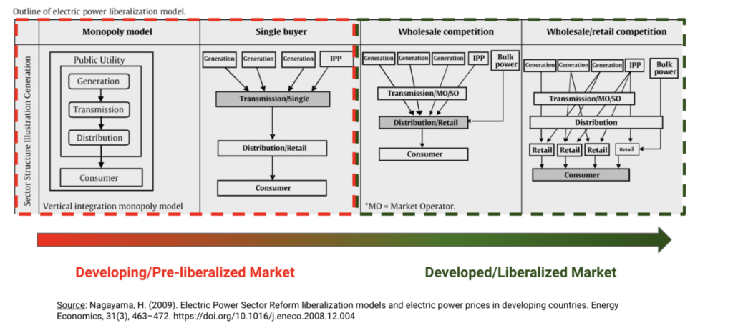
Transition Path to a Liberalized Market
Notes:
In order to reform the sector, the vertically integrated model needs to be deconstructed by firstly unbundling of the state monopoly, secondly deciding whether the market is centralized or decentralized, thirdly placing the necessary regulatory and policy frameworks in place, then setting the market code and eventually compliant participants decide to enter and participate in the market. This is no different to the current reforms happening in the South African electricity sector. The unbundling of Eskom Holdings providing us with the National Transmission Company South Africa, Eskom Distribution division, and Eskom Generation separating generation, system operators and network managers. The latest market code for the proposed South African Wholesale Electricity Market was published in June 2025 and there are various mechanisms for monitoring participants within the market to ensure it remains transparent, operational and efficient.

Slide 6
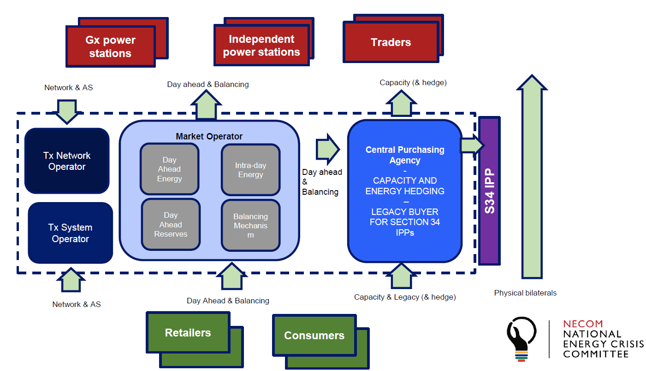
South African Wholesale Electricity Market (SAWEM)
Source: NTCSA – South African Market Specification V1
Notes:
Some key roles and responsibilities within SAWEM will include:
Market Operator: Developers of the market code, responsible for ensuring transparency, providing non-discriminatory trading platform and governing the affairs within the market . NTCSA has formally applied to be the market operator and has developed a division overseeing the market to achieve its mandate.
Generators: Generate energy that will be traded, schedule their production of their units to deliver energy at the agreed time. Eventually they will generate and sell energy into the market, or directly to customers. Examples of generators would likely be Eskom Gx and several IPPs.
System Operator: Responsible for the reliability of the grid, maintaining grid stability while facilitating the transfer of energy between generators and consumers. Where required balancing of the system will be done when the market outcomes do not balance the energy generated with the demand required.
Establishment Central Purchasing Agency: Oversee capacity and energy contracts including legacy contracts during the transition period. This is where agreements can be made between generators and traders or distributors to offer risk reduction within the market. Legacy contracts entered into as part of the REIPPP will also be managed under this agency. NTCSA will also oversee this function.
Network Operator (distributor): Responsible for the reliability of the grid and facilitating the physical transfer of energy based on the market outcomes. NTCSA will fulfil this at transmission level, and distribution level for many points of the national grid with Eskom having vast amounts of electrical infrastructure connecting our municipal utilities.
Retailers: Are the purchasers of energy from the market for their consumers whether large or cluster of small power users
Consumers: Are the end-user of the traded electricity, either purchased from the retailers, traders or directly from generator through agreements.

Slide 7
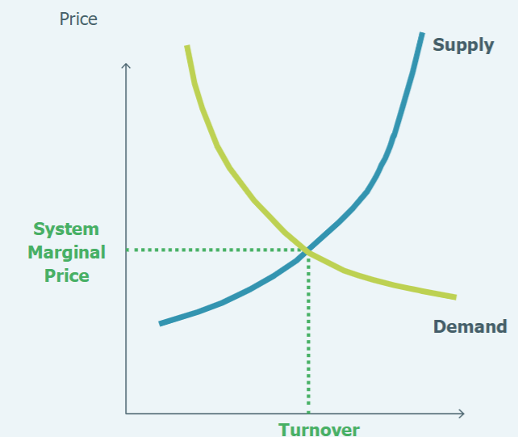
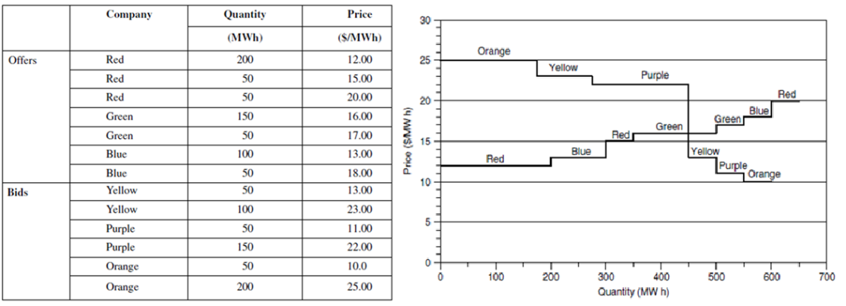
Electricity Trading Mechanisms
Day-Ahead Market
Intra-Day Market
Balancing Responsibility
Bilateral Contracts
Bids
Offers
Notes:
There are currently four main means for energy to be traded within the proposed design of SAWEM:
The day-ahead and intra-day markets are short-term physical markets based on bids and offers made by producers and consumers. Electricity here is traded at the system marginal price, the point where the demand meets the supply. This is determined using a sophisticated algorithm stacking bids from generators and offers from retailers.
Naturally, there won’t be the perfect prediction of energy required in the system, to alleviate this problem, the balance responsibility is where any imbalances created due to difference in real and predicted supply and demand is reconciled to ensure system stability. The cost of the electricity purchased by the balancing responsibility will be more expensive than that of the system marginal price.

Slide 8
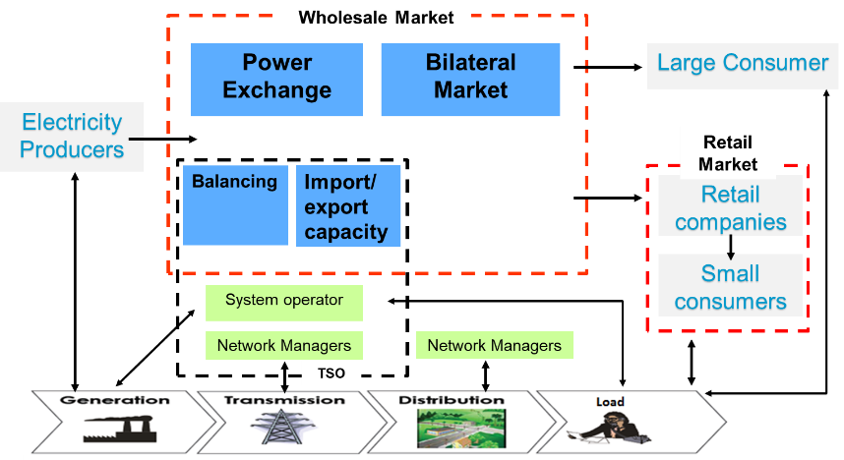
Electricity Trading Mechanisms
Day-Ahead Market
Intra-Day Market
Balancing Responsibility
Bilateral Contracts
Notes:
Longer term bilateral trades which are both financial and physical are traded directly between seller and buyer outside of the short-term physical markets. This method allows participants to hedge against volatility in the price of electricity as a means to reduce risk within the market.
These electricity trading mechanisms should allow participants in the market to select where and how they procure electricity.

Slide 9
South African Wholesale Electricity Market (SAWEM)
Notes:
In essence, our current vertically integrated structure will be de-constructed into a wholesale market structure. Eventually providing competition at generation and the retail space that is envisioned to promote operational efficiency, provide transparency and hopefully reduce the cost of electricity.

Slide 10
South African Wholesale Electricity Market (SAWEM)
Notes:
The proposed design for SAWEM is to be a multi-market model providing for market transactions, physical bilateral transactions and regulated transactions for participants. Essentially, there are different ways for electricity to be traded within its proposed structure, a stark contrast to the vertically integrated structure. The energy trading mechanisms discussed previously fall within this wholesale market allowing qualifying market participants to select where they would like to participate. This will introduce competition at various sections of the structure. So, what now for municipalities?

Slide 11
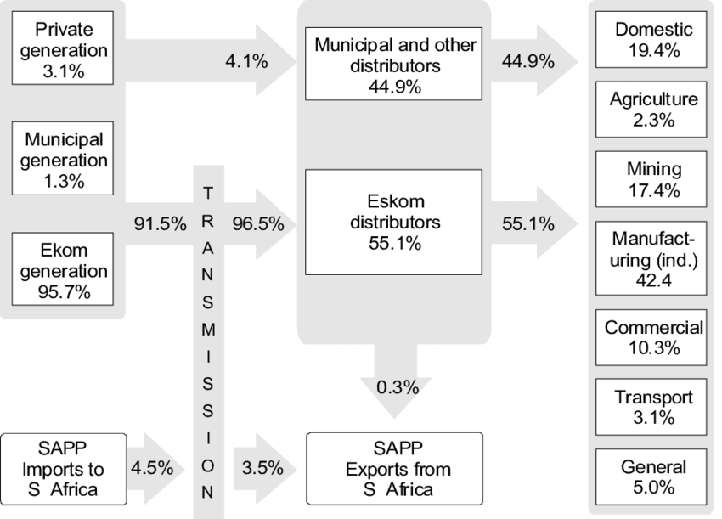
South African Wholesale Electricity Market: What now for municipalities?
Source: Harald Winkler - Energy policies for sustainable development in South Africa: Options for the future. ISBN: 0-620-36294-4
Notes:
The transition to the SAWEM redefines the roles of municipal utilities introducing a complex mix of profound limitations and transformative opportunities. What those roles are, we are not sure about? This is quite scary considering that municipal utilities distribute over 40% of electricity through their networks to end users. However, in order to tackle this concern, we should explore some limitations spotted already.

Slide 12






Limitations
Legal and Structural Misalignments
Municipal Creditworthiness (High Debt)
Overwhelming Operational Complexity of the Market
Notes:
The core limitation is rooted in a fundamental misalignment of the MFMA and the redefinition of the municipal business model, another is the budget allocations and contract timeframes. The MFMA’s requirement for annual appropriations (Sections 16 & 24) legally prevents municipalities from binding future councils to the 20-year financial commitments of standard PPAs without appropriately navigating a long and complex process to seal such agreements, which few municipalities have been able to achieve, creating untenable risk for investors and the market. This is compounded by a crisis of creditworthiness; given widespread municipal financial distress, most lack the financial standing to provide the bank guarantees required to participate as reliable off-takers or to meet the stringent credit cover requirements mandated for Balancing Responsibility Parties and other Market Participants under SAWEM. Another more concerning limit is the lack of sufficient capacity to meet current operational requirements. If municipal utilities are to participate in SAWEM, the technical, trading and financial skills to act as a market participant may potentially exceed the current capacity of most municipalities.
However, it is possible that municipalities that choose not to actively engage with the SAWEM risk financial and operational decline. By remaining passive bulk buyers of electricity, they remain fully exposed to escalating wholesale tariffs without the tools to manage this cost. Municipal utilities particularly those in good financial standing may forgo critical opportunities to generate new revenue streams through activities such as wheeling third-party power across their grids by means of cost reflective use-of-system rates or selling their own excess generation into the market.

Slide 13
Potential Opportunities
Generators
Use-of-System
Collaboration with Eskom Distribution and NTCSA
Demand Response
Notes:
Municipalities in good financial standing could look into establishing generation facilities and becoming a generator selling electricity into the day-ahead and intraday market.
By restructuring the business model, some municipalities could concede selling electricity, and subsequently the purchase of electricity, to instead manage and charge cost reflective use-of-system rates, facilitating the transfer of electricity between generators, retailers and large power users. This could even potentially attract more large power users into the municipal boundary by offering attractive rates further bolstering economic activity within the municipality.
Larger municipalities with significant load sizes could take control of load management by strategically leveraging the municipal load during peak hours getting paid to help balance the grid.
Municipalities could also retain their role as default off-takers to Eskom Distribution and NTCSA, however some policy changes would be required that will guide and enable municipal participation in the market. This can be through formalising the existing relationship between Eskom distribution, and in some cases NTCSA where service level agreements are signed to regulate Eskom’s activities within that municipal boundary to ensure a mutually benefit for both parties while serving customers.
Realising some of these opportunities though requires good financial management, market understanding and innovative models that work within the confines of existing legislation. Clarity in the envisioned role of municipalities within the proposed design of SAWEM is needed to allow municipal utilities and their representatives to consider where, and how municipalities can respond to the upcoming changes.

Slide 14
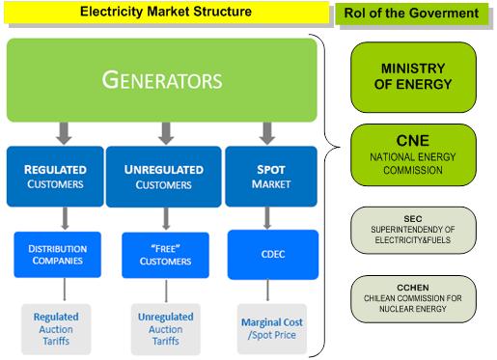
Chile’s Electricity Market Reform – Key Takeaways
1. Role & Evolution of Utilities/System Operator
1982 Electricity Act - unbundled generation, transmission, distribution.
System operator is now independent, neutral referee (no assets).
Functions: market dispatch, grid planning, congestion management.
2016 Transmission Law - stronger role in renewables integration & proactive planning.
2. Sector Impacts
Competition & efficiency: Specialization & cost reduction.
Renewables growth: 2008 NCRE Law, 2014 Block Bidding with boosted solar & wind.
Market innovations: Block bidding (time-specific), capacity mechanism (investment security).
Energy efficiency: National strategy, MEPS, consumer labels.
Challenges: Price volatility (fuel imports), drove push for renewables & energy security.
Source: Pablo Serra - Chile's electricity markets: Four decades on from their original design
Notes:
When we look at the market reform that took place in Chile, some lessons included

Slide 15
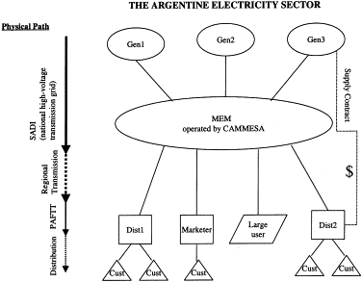
International Benchmarking - Argentina
1. Public Utilities / System Operators
Pre-reform: State-owned monopoly (generation, transmission, distribution).
1992 Law 24,065 - unbundling + privatization.
CAMMESA: New market operator
ENRE: Regulator (tariffs, consumer protection).
Secretariat of Energy: policy + oversight.
Public utilities shifted from operators to market admin & regulators.
2. Sector Impacts
Positive: +75% gen capacity (private investment).
Modernized networks (better efficiency & quality). WEM (Wholesale Electricity Market): futures + spot markets. Clearer regulatory framework (competition, lower costs).
Challenges:
Aging infrastructure & new investment needs.
Policy/regulatory instability
Source: Kent Anderson & Amy McCarthy- Transmission pricing and expansion methodology: lessons from Argentina

Slide 16

Conclusion
Notes:
The municipal utility journey in SAWEM will be one dependent on the capability and capacity of the utility. While a few well-resourced metros and LMs may develop the capacity to act as sophisticated Market Participants, for most, the immediate future will seem bleak without an understanding of what the end game for the market is.
With all this said, the SAWEM design should also not be an exact blueprint, but rather an evolutionary process, as in the case of Ireland, where with new challenges, new market conditions and changes to technology bringing refinement to the market. It’s expected that the proposed SAWEM will need to adapt and be crafted over time to sustain such changes. It becomes critical for metros and LMs to be actively involved in the market to prevent falling behind, and a being passive participant, missing out on opportunities within the market. Clarity is needed to ensure municipalities understand where they can participate, if they can participate, this will enable them to plan and strategise better. Municipalities involvement in the development of the market over time can be from inserting representatives (AMEU and/or SALGA) in market advisory committees to share challenges and experiences that can be considered in the refinement of the market model. Institutions such as AMEU/SALGA supporting metros and LMs, will also play a key role in facilitating discussion platforms, and advocating for necessary policy changes supporting the sustainable participation of municipal utilities within the market. Without this, the existence of our electricity utilities will be threatened, continuing the financial downward spiral affecting the most vulnerable constituents.

Slide 17

Remember, we have to ask the questions now, before it’s too late!
Thank you
Notes:
If I there is one thing I wish colleagues will take from my presentation today, it’s to leave here with more questions than answers, because those questions should be asked of the market designers and envisioned participants to ensure the voices of municipalities are heard and answered! Thank you

Slide 18
Bibliography
[1] “Electricity Market - an overview | ScienceDirect Topics.” Accessed: Sep. 11, 2025. [Online]. Available: https://www.sciencedirect.com/topics/social-sciences/electricity-market
[2] M. Barrett, “Basic principles of Electricity Markets,” 2024.
[3] “SA Wholesale Electricity Market (SAWEM) – NTCSA.” Accessed: Sep. 11, 2025. [Online]. Available: https://www.ntcsa.co.za/sa-wholesale-electricity-market-sawem/
[4] K. Bowen, “Market Code Transition and the Central Purchasing Agency,” 2025.
[5] K. Bowen, “The South African Wholesale Electricity Market (SAWEM) Market Code REVISED DRAFT,” Pretoria, Jun. 2025.
[6] National Transmission Company South Africa SOC Ltd, “Market Operator License Application,” Sandton, 2025. Accessed: Sep. 13, 2025. [Online]. Available: https://www.ntcsa.co.za/wp-content/uploads/2025/08/Application-for-a-Market-Operator-Licence.pdf
[7] EirGrid, “Group-I-SEM Quick Guide to the Integrated Single Electricity Market The I-SEM Project Version 1,” Dublin, 2016. Accessed: Aug. 20, 2025. [Online]. Available: https://www.semcommittee.com
[8] C. Ahlfedt, A. Hernandez, and B. Saenz, “ELECTRICITY PRICING AND SECTOR REFORM: ELECTRICITY PRICING AND SECTOR REFORM: Key Decisions to Consider for Electricity Sector Liberalisation,” Mar. 2025.
[9] E. Engel, R. D. Fischer, and A. Galetovic, The Economics of Public-Private Partnerships: A Basic Guide. Cambridge University Press, 2014. doi: 10.1017/CBO9781139565615.
[10] B. Khonjelwayo and T. Nthakheni, “Determining the causes of electricity losses and the role of management in curbing them: A case study of City of Tshwane Metropolitan Municipality, South Africa,” Journal of Energy in Southern Africa, vol. 32, no. 4, pp. 45–57, Nov. 2021, doi: 10.17159/2413-3051/2021/V32I4A8704.
[11] Commission for Regulation of Utilities, “An Coimisiún um Rialáil Fóntais Commission for Regulation of Utilities Executive Summary,” Dublin, May 2025.
[12] SEM Committee, “SEM arrangements (2007-2018) | The Single Electricity Market Committee,” SEM Committee website. Accessed: Aug. 21, 2025. [Online]. Available: https://www.semcommittee.com/sem-arrangements-2007-2018
[13] National Treasury, Local Government: Municipal Finance Management Act 2003. Republic of South Africa, 2004.
[14] Auditor General South Africa, “Consolidated General Report on Local Government Audit Outcomes 2022-2023,” Midrand, Aug. 2024.
[15] “Financial management | 2022-23 Consolidated report on local government audit outcomes | AGSA.” Accessed: Sep. 14, 2025. [Online]. Available: https://mfma-2023.agsareports.co.za/pages/financial-management

