Slide 1

Smart Grid Innovations: Real-time adaptive protection for evolving networks
Presented by Kobus Wilken
Deputy Director: Specialized Services and Control
George Municipality
Notes:
Explain equipment replacement and not utilizing full potential
George Munic started replacing all RTU’s with Substation gateways for SCADA monitoring and Control

Slide 2

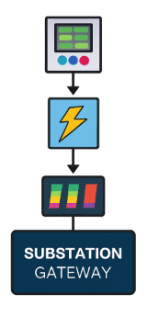

Background
Substation Integration in George Municipality:
Since the early 2000s, George Municipality has actively implemented substation integration by deploying substation gateways. These gateways enable direct data retrieval from protection relays and associated equipment, including Automatic Voltage Regulators, power controllers, and annunciators etc.
This approach significantly simplifies the process of adding new features and functionality, while keeping implementation costs minimal and ensuring seamless scalability.
Notes:
It is all about digitizing substations

Slide 3

Adaptive Power System Protection:
Adaptive protection is a dynamic approach to power system security in which relay settings and protection logic are automatically adjusted in real time.
This ensures that protection parameters remain optimal as network conditions change without requiring manual intervention.
Notes:
Using the built in functionality and features I thought of adding value to my power system

Slide 4
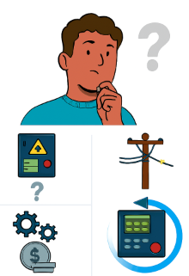
Why Adaptive Protection?

Slide 5
Five Basic Principles of Power System Protection
1️⃣ Reliability
  Protection systems must operate correctly during faults and remain dependable under all conditions.
2️⃣ Stability
They should remain stable and avoid unnecessary tripping during normal or non-fault conditions.
3️⃣ Speed
Fast fault detection and isolation minimize equipment damage and maintain system integrity.
4️⃣ Sensitivity
Protection must detect even low-magnitude faults without missing genuine fault conditions.
5️⃣ Selectivity (Grading)
Only the faulty section of the network should be isolated, preserving service continuity elsewhere.
Notes:
Mention principles – go to the 5 basics principles of power system protection

Slide 6
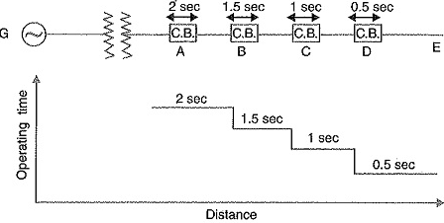
Protection grading
Protection grading is the coordinated configuration of protection relay settings to ensure that only the protection closest to a fault operates.
Notes:
We have smartgrid systems available but not using full capabilities
it is the effective coordintion to minimizes unnecessary outages.

Slide 7
With a bit of imagination, anything
is
POSSIBLE !!!
Notes:
Imagination – that’s why

Slide 8
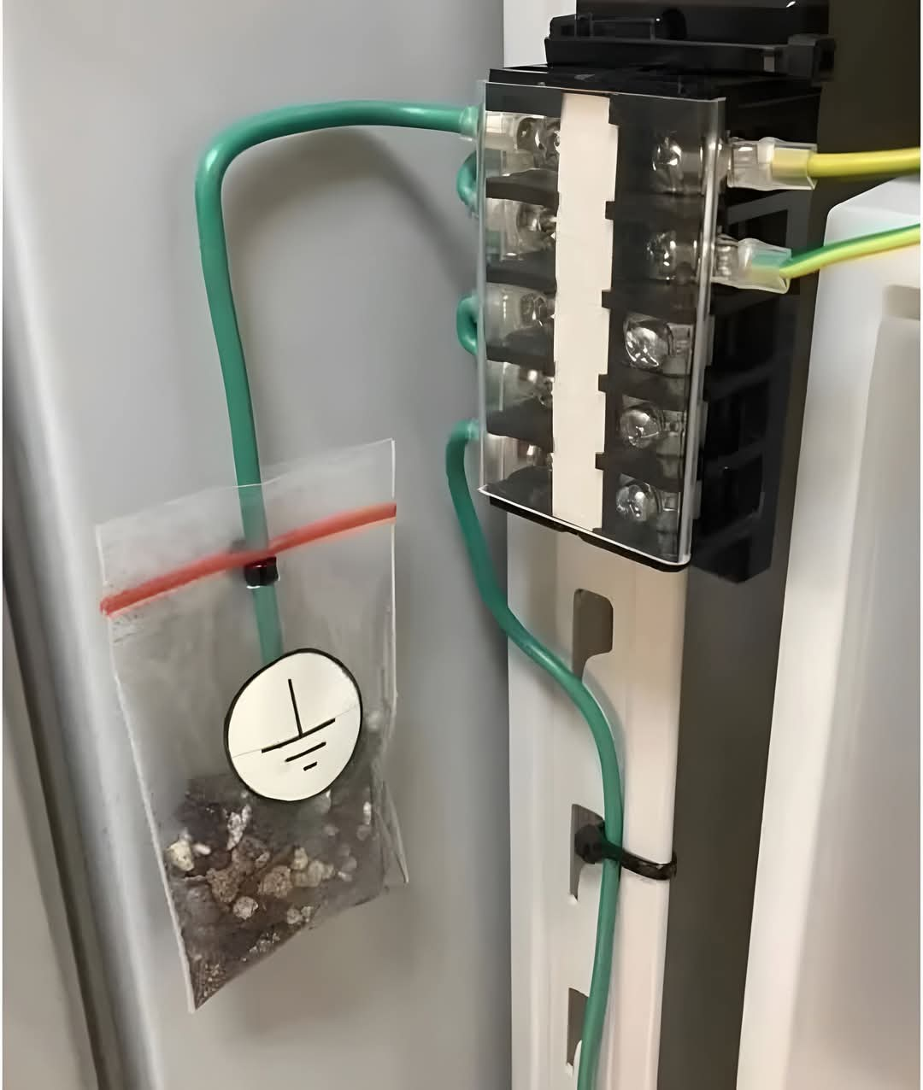
Notes:
A lot of imagination…….

Slide 9
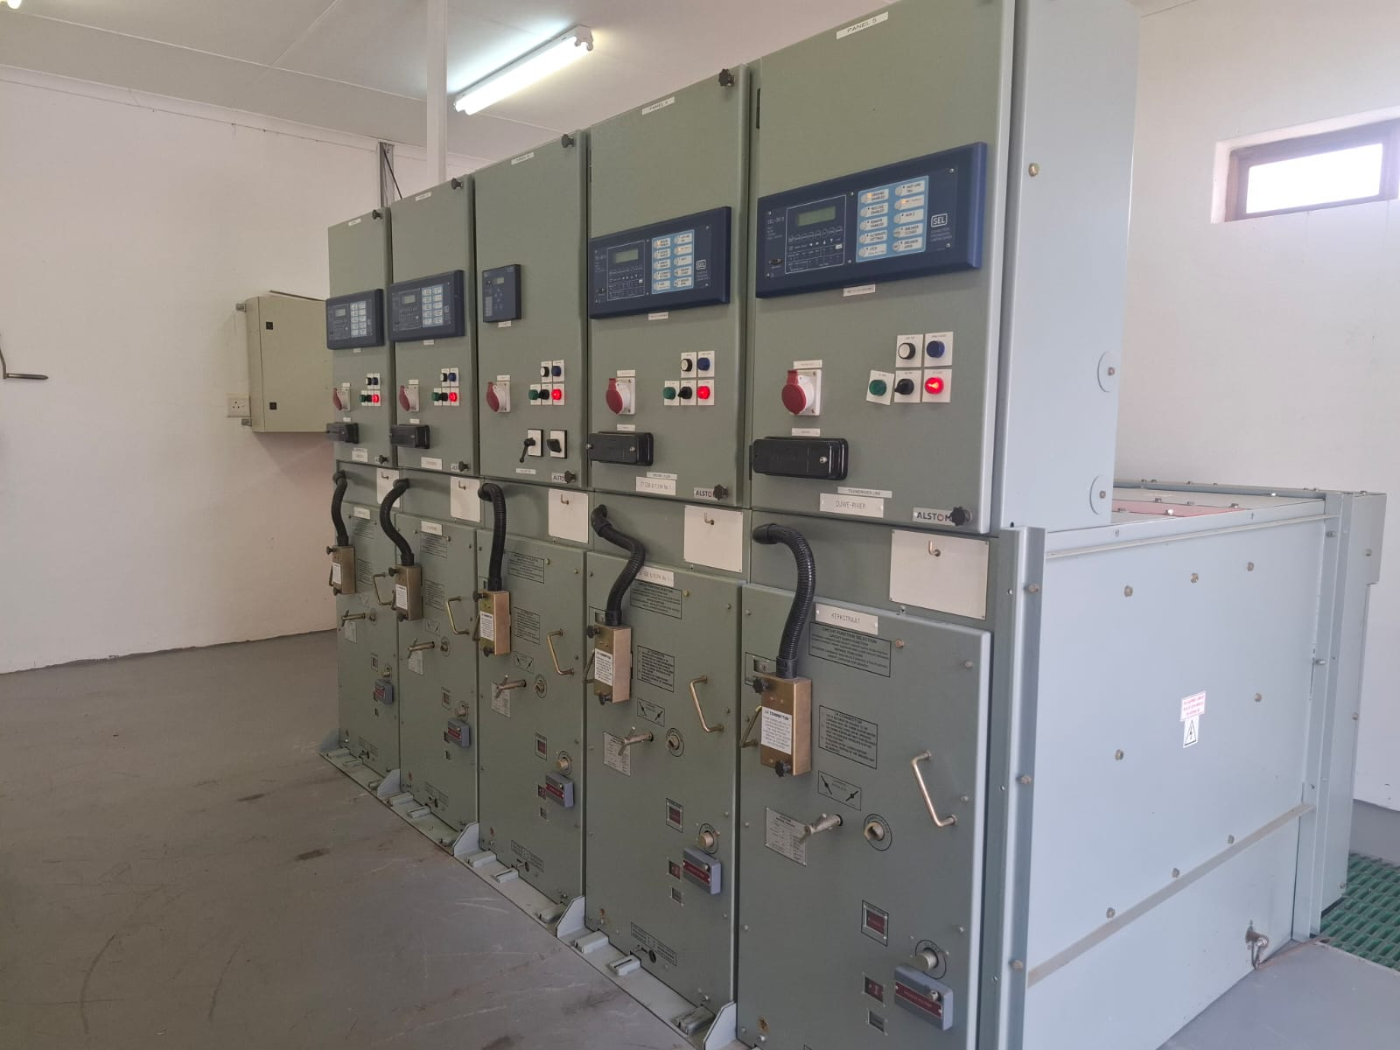
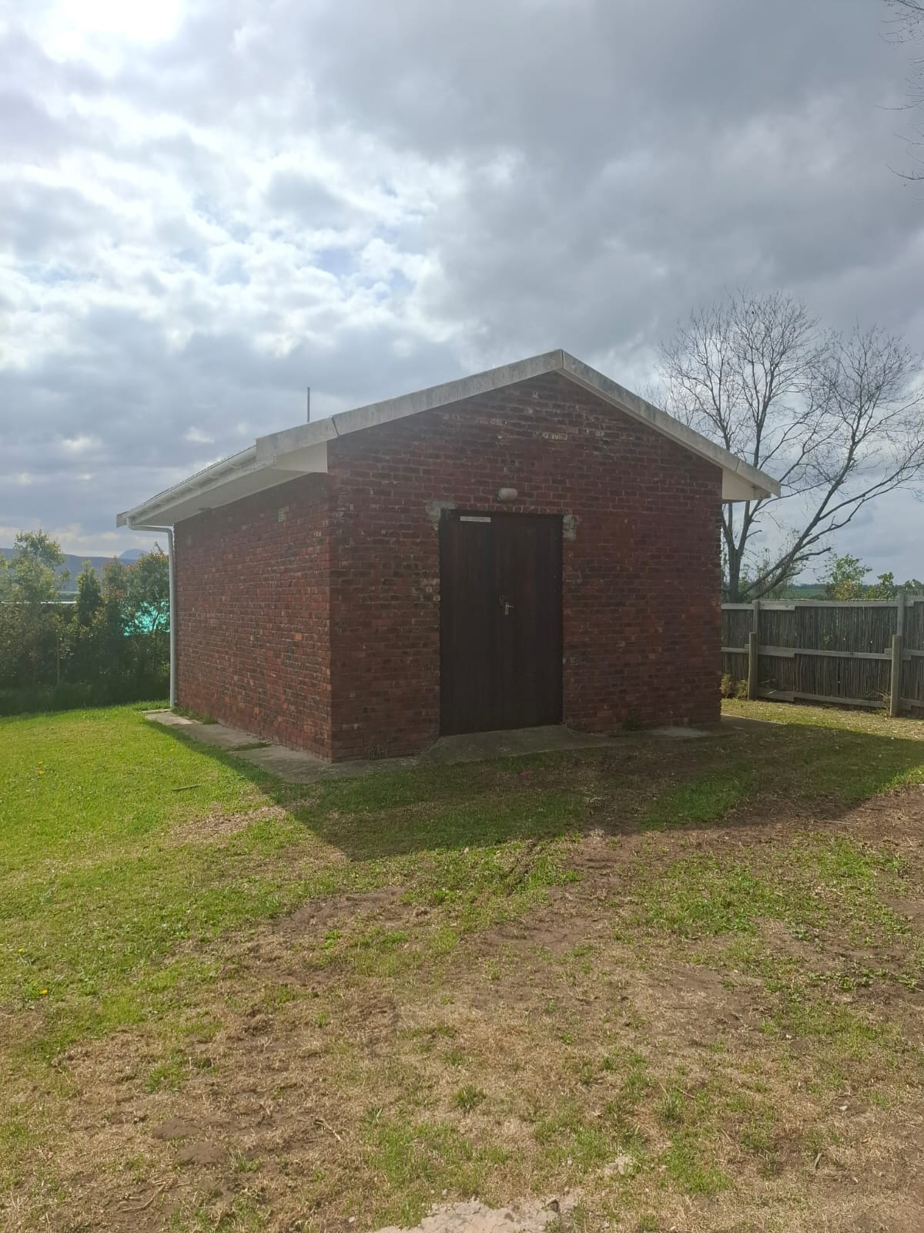
Implementation: A Practical Example
Hoekwil Substation Wilderness
Notes:
I will now take you through a practical example at Hoekwil substation in the beautiful town of Wilderness

Slide 10
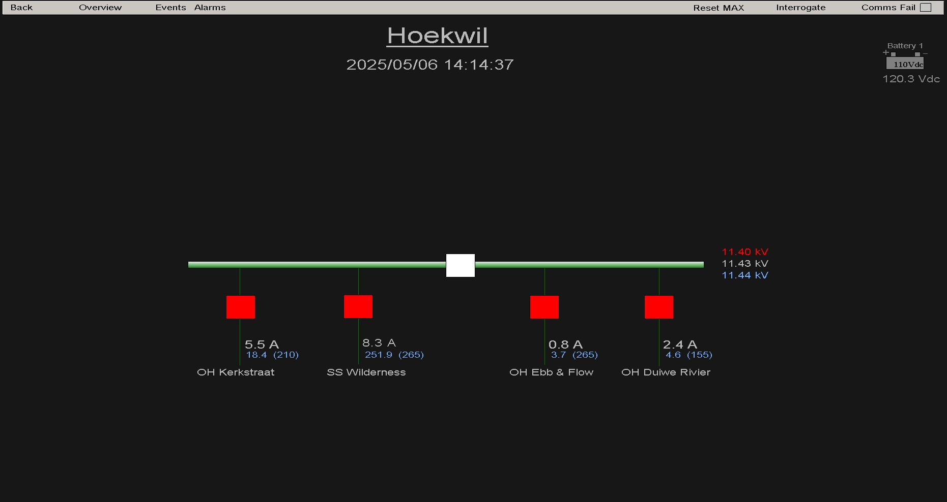

Notes:
Screen capture of our Hoekwil substation from our SCADA system – RURAL.

Slide 11
Notes:
Screen capture of our Hoekwil substation from our SCADA system – RURAL.

Slide 12


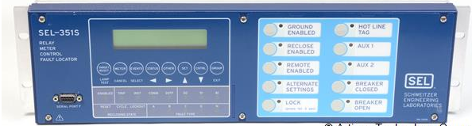
Substation Gateway
DNP over APN
SCADA
Network Control
Feeder Protection Relay
Feeder Protection Relay
Feeder Protection Relay
Feeder Protection Relay
Notes:
Explain RTAC as workhorse
Since early 2000’s George Municipality started implementing substation integration.
We currently have NO RTU’s and only use RTAC’s as our substation gateways.
Monitoring, control and engineering access to the protection relays.

Slide 13

Functionality of Gateway
  Monitoring
  Control
  Latest Event and Fault Current
  Engineering Access to individual protection relays
  Synchrowave Phasors
Notes:
The functionality we use for all our gateways is….
Monitoring
of all front panel LED’s and targets and Inputs
Controls
CB Open/Close, SEF on/off, ARC on/off, Target Reset
Collect the latest event and display on SCADA
Direct Remote Engineering Access to the protection relays
Some gateways send synchrowave phasors to Control

Slide 14
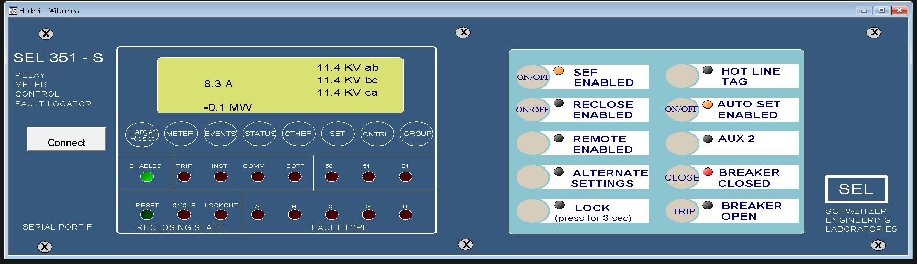
Notes:
Screenshot of the protection relay as displayed on the SCADA system
A Button is designated and configured for automatic settings change to be enabled or disabled
Comms to SCADA – control center

Slide 15
Methods
Torque Control Bits:
Enable/disable relay elements by toggling the torque control bits.
True Settings Change:
Directly modify relay parameters in set mode.
Settings Group Change:
Switch between predefined relay profiles / settings groups dynamically
Notes:
Explain methods
Torque Control bits – We are using on our sub-transmission network
True settings change not a good idea to do, but it is an option
Explain last point being used in your case
Why and comms structure etc etc

Slide 16
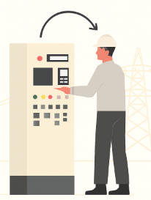
Method Used at Hoekwil s/s:
Settings Group Change
  Changes in protection philosophy (feeder to incomer and vice versa)
  SEF
  Auto Reclose
  Relay Logic Changes
  Less Complex
Notes:
Gee detail oor logic implementation
You do not want to reclose onto a busbar –ARC cannot even be switched on – George Munic philosophy
Less Complex – 2 Completely separate settings groups and it can be commissioned as such

Slide 17
Adaptive Protection Code
The following code illustrates how protection settings groups can automatically switch based on real-time system conditions. The code dynamically selects the appropriate protection scheme to maintain system stability and responsiveness.

Slide 18
The Code
PROGRAM Set_Change
VAR
Loss_of_Potential, Settings_Group_1, Settings_Group_2, WNESS_EN,E_and_F_EN, Direction_Reverse, Enable_Set_Change, Comms_OK : BOOL;
Direction_Delay_1, Set_Delay_1, Set_Delay_2 : TON;
Fail_to_Set_Wness, Fail_to_Set_EandF : BYTE;
END_VAR
Loss_of_potential := SS_WILDERNESS_SEL_351S_SEL.FM_INST_LOP.stVal OR EBB_AND_FLOW_SEL_351S_SEL.FM_INST_LOP.stVal;
Enable_Set_Change := SS_WILDERNESS_SEL_351S_SEL.FM_INST_LED7.stVal AND EBB_AND_FLOW_SEL_351S_SEL.FM_INST_LED7.stVal;
Comms_ok := NOT SS_WILDERNESS_SEL_351S_SEL_POU.Offline AND NOT EBB_AND_FLOW_SEL_351S_SEL_POU.Offline;
IF Enable_Set_Change AND NOT Loss_of_Potential AND Comms_ok THEN
IF EBB_AND_FLOW_SEL_351S_SEL.FM_INST_P_WATTS.instMag < -1000 THEN
Direction_Reverse := TRUE;
Direction_Delay_1(IN:= (Direction_Reverse),PT:= T#10M);
IF Direction_Delay_1.Q THEN
Settings_Group_1 := FALSE;
Settings_Group_2 := TRUE;
SS_WILDERNESS_SEL_351S_SEL.FO_RB_RB6.operClear.ctlVal := FALSE;
EBB_AND_FLOW_SEL_351S_SEL.FO_RB_RB6.operClear.ctlVal := FALSE;
SS_WILDERNESS_SEL_351S_SEL.FO_RB_RB6.operSet.ctlVal := TRUE;
EBB_AND_FLOW_SEL_351S_SEL.FO_RB_RB6.operSet.ctlVal := TRUE;
END_IF
ELSE
Direction_Reverse :=FALSE;
Direction_Delay_1(IN:= (NOT Direction_Reverse),PT:= T#10M);
IF Direction_Delay_1.Q THEN
Settings_Group_1 := TRUE;
Settings_Group_2 := FALSE;
SS_WILDERNESS_SEL_351S_SEL.FO_RB_RB6.operSet.ctlVal := FALSE;
EBB_AND_FLOW_SEL_351S_SEL.FO_RB_RB6.operSet.ctlVal := FALSE;
SS_WILDERNESS_SEL_351S_SEL.FO_RB_RB6.operClear.ctlVal := TRUE;
EBB_AND_FLOW_SEL_351S_SEL.FO_RB_RB6.operClear.ctlVal := TRUE;
END_IF
END_IF
IF NOT Loss_of_Potential THEN
Enable_Set_Change := TRUE;
ELSE
Enable_Set_change := FALSE;
END_IF
END_IF
Notes:
Example how quick and minimal code is
The complete code – less than 40 lines
Various methods like
function blocks
Ladder logic
Structured text

Slide 19
Conditions
Healthy Relay Communications
Check Network condition/state
Data Quality
Start Timer
Relay Auto Settings Enabled
No Loss of Potential
Execute Protection Group Change
Notes:
Before the network condition or state is checked, the following conditions must be met
Explain conditions and fail safes behind logic
I opted for a 10 minute timer to allow for switching operations to be executed and completed – because it is rural.

Slide 20
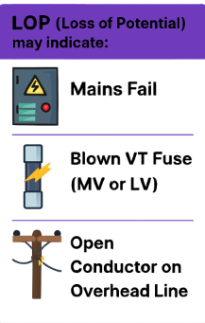
Why check for LOP?
LOP (Loss of Potential) may indicate:
  Mains Fail
  Blown VT Fuse (MV or LV)
  Open Conductor on Overhead Line
Notes:
Mains fail is the obvious reason
But, the loss of a phase voltage, be it a jumper, VT Fuse or voltage missing on the panel

Slide 21
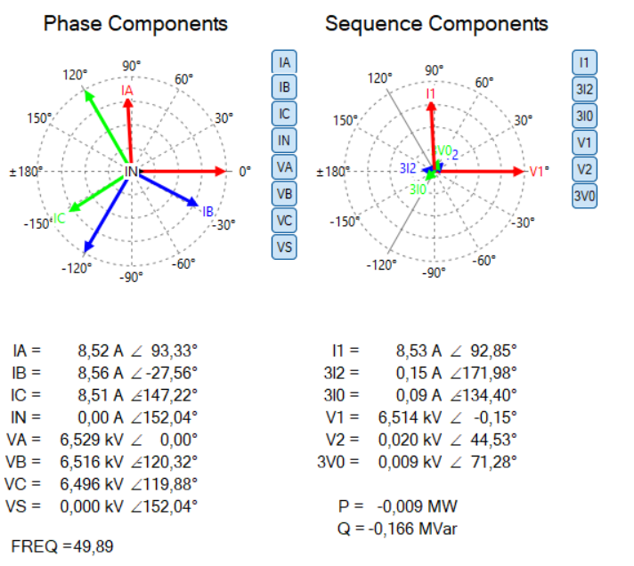
Healthy Voltage Phasors
Notes:
Phasor shows a definite rotation
No negative sequence voltage component present

Slide 22
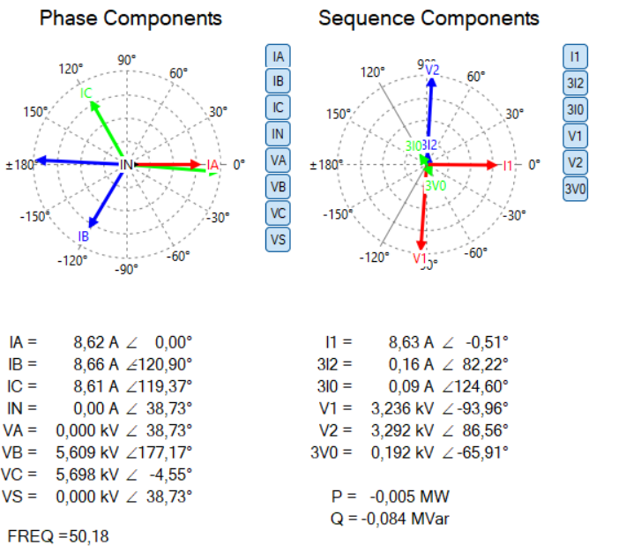
Phasors with Missing Voltage
Notes:
2 Phases 180 deg – so no definite phase rotation
Large V2 - Negative sequence voltage component
This is why we check for LOP and not only Mains Fail

Slide 23
Other Applications
Lines in parallel
Microgrid Protection
(Grid protection vs Islanded mode)
Automatic Reclosing Coordination
Cold Load Pickup
Changes in Source Fault level
Distributed Energy Resource Integration
Notes:
Automatic Reclosing Coordination
Modifies relay logic to prevent reclosing into permanent faults or during unstable system conditions. Such as SOTF
Cold Load Pickup
Adjusts protection settings to accommodate high inrush currents when loads are restored after outages
Distributed Energy Resource (DER) Integration
Adapts to variable fault contributions from solar, wind, and inverter-based sources, which challenge traditional protection schemes.

Slide 24

Conclusion
By utilizing existing equipment
Applying innovative logic
And making small incremental changes…
We move a step closer to realizing a fully integrated smart grid.
Ultimately improve service delivery
Notes:
By using existing equipment
And applying some innovative thinking
And ultimately improve service delivery

Slide 25

Thank you

