Slide 1
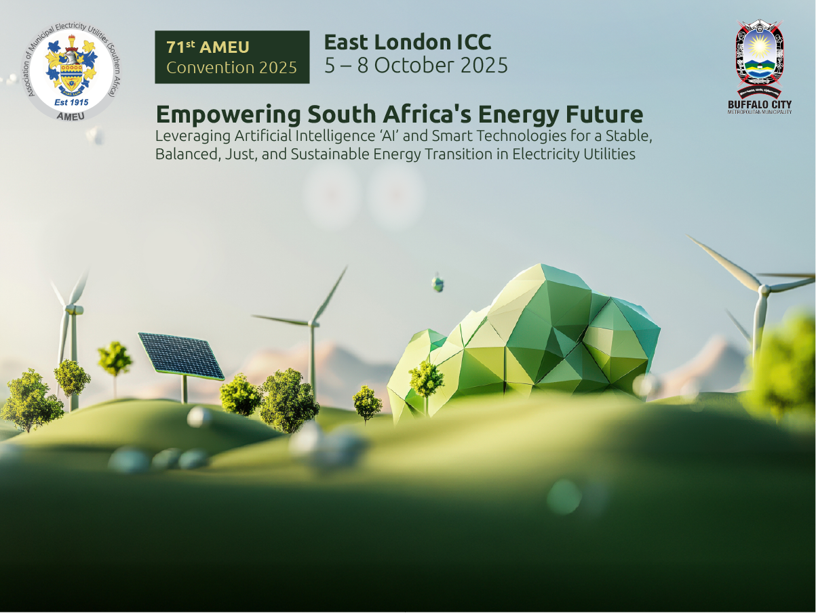
Reflections on Co-Designing a Solar Public Lighting Pilot in Marikana Informal Settlement, Cape Town
Presented by Thandeka Tshabalala
Senior Professional Officer
City of Cape Town, Sustainable Energy Markets Department

Slide 2




Viability and Validation of Innovations for Service Delivery Program (VVISDP)
This Project is Implemented as Part of the VVISDP
The VVISD is a programme implemented by the implemented by the Department of Science and Innovation (DSI) to help municipalities pilot technology and innovations that could assist in improving basic service delivery
The City has signed an MOU with the department of Science and Innovation.

Slide 3
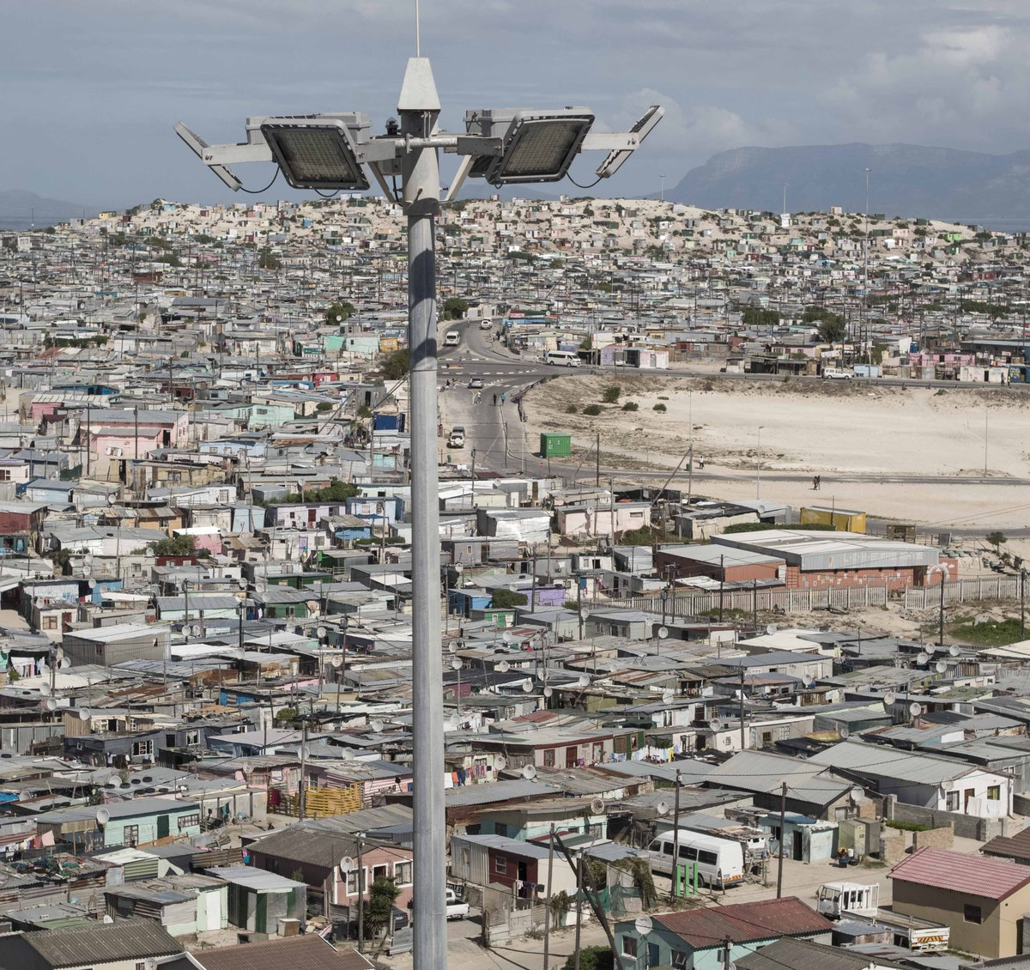
Problem Statement
The City of Cape Town provides public lighting through high mast lighting and conventional streetlights, based on the settlement density and electricity grid availability.
Although Cape Town’s overall electrification is high, about 80,000 households (2023/24 data)mostly in informal settlements still lack a grid connection.
In unelectrified informal settlements, conventional public lighting is not feasible, leaving these areas without public lighting.

Slide 4
Project Objectives
  Demonstrate solar-powered public lighting as a viable interim service solution by evaluating the technical, financial, and social feasibility of solar-powered public lighting through gathering data and insights on performance, reliability and community acceptance of these lighting systems
  Involve the community from design to implementation of the lighting project, the aim is to enhance local buy-in for the project and ensure infrastructure longevity
  Test institutional acceptance of an alternative service delivery model for delivering public lighting in informal settlements
  Determine the perceived impact of solar-powered public lighting interventions on public safety and socio-economic activities

Slide 5
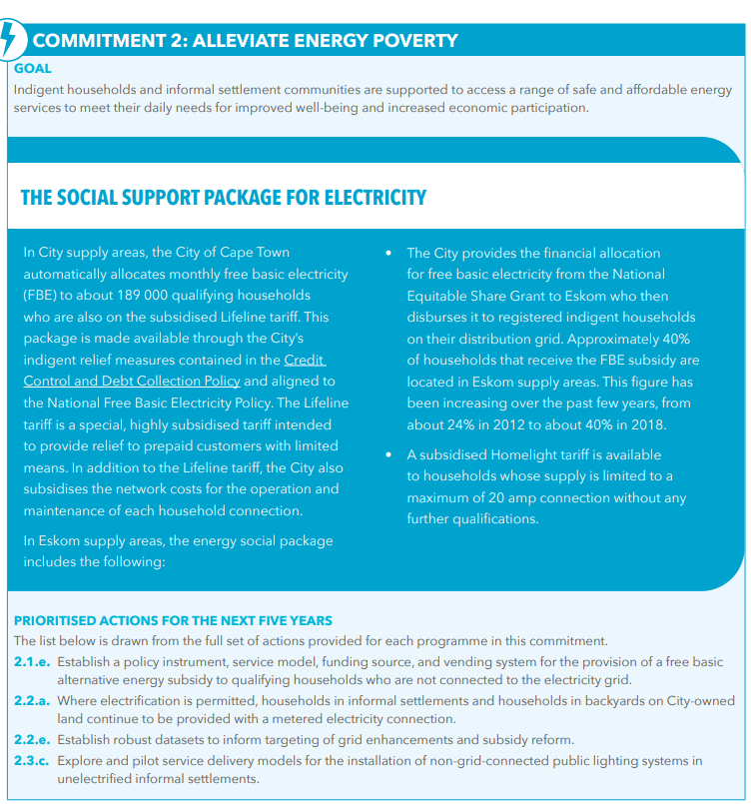
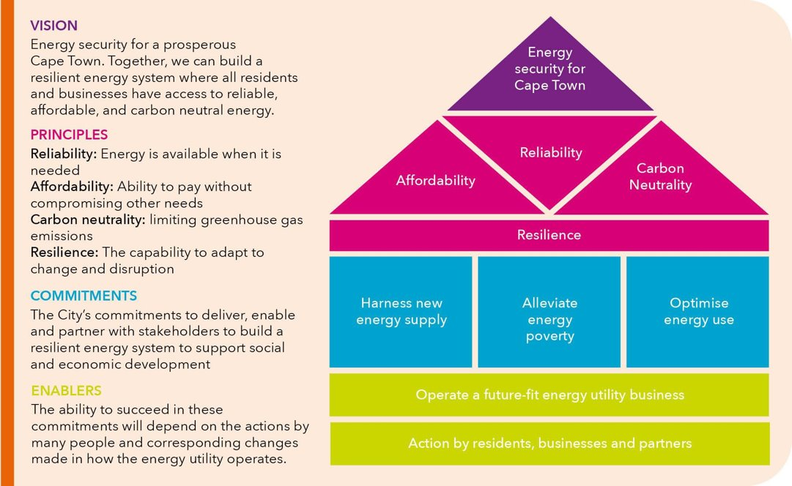
Cape Town’s 2050 Energy Strategy

Slide 6
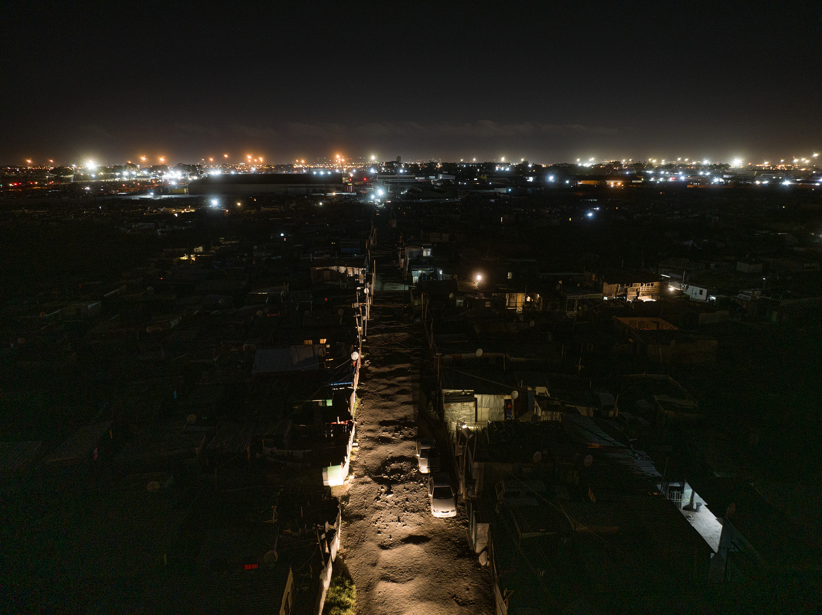
Chosen Site: Marikana Informal
Settlement
Marikana has about 12 000 households.
Eskom supply area, not connected to grid electricity due to land ownership challenges.
Land acquisition process by the HS department completed in July 2024.
Currently, the settlement is in the informal settlement upgrading process.
Super blocking being planned and this provided viable site to test an interim public lighting solution while awaiting grid connection.

Slide 7
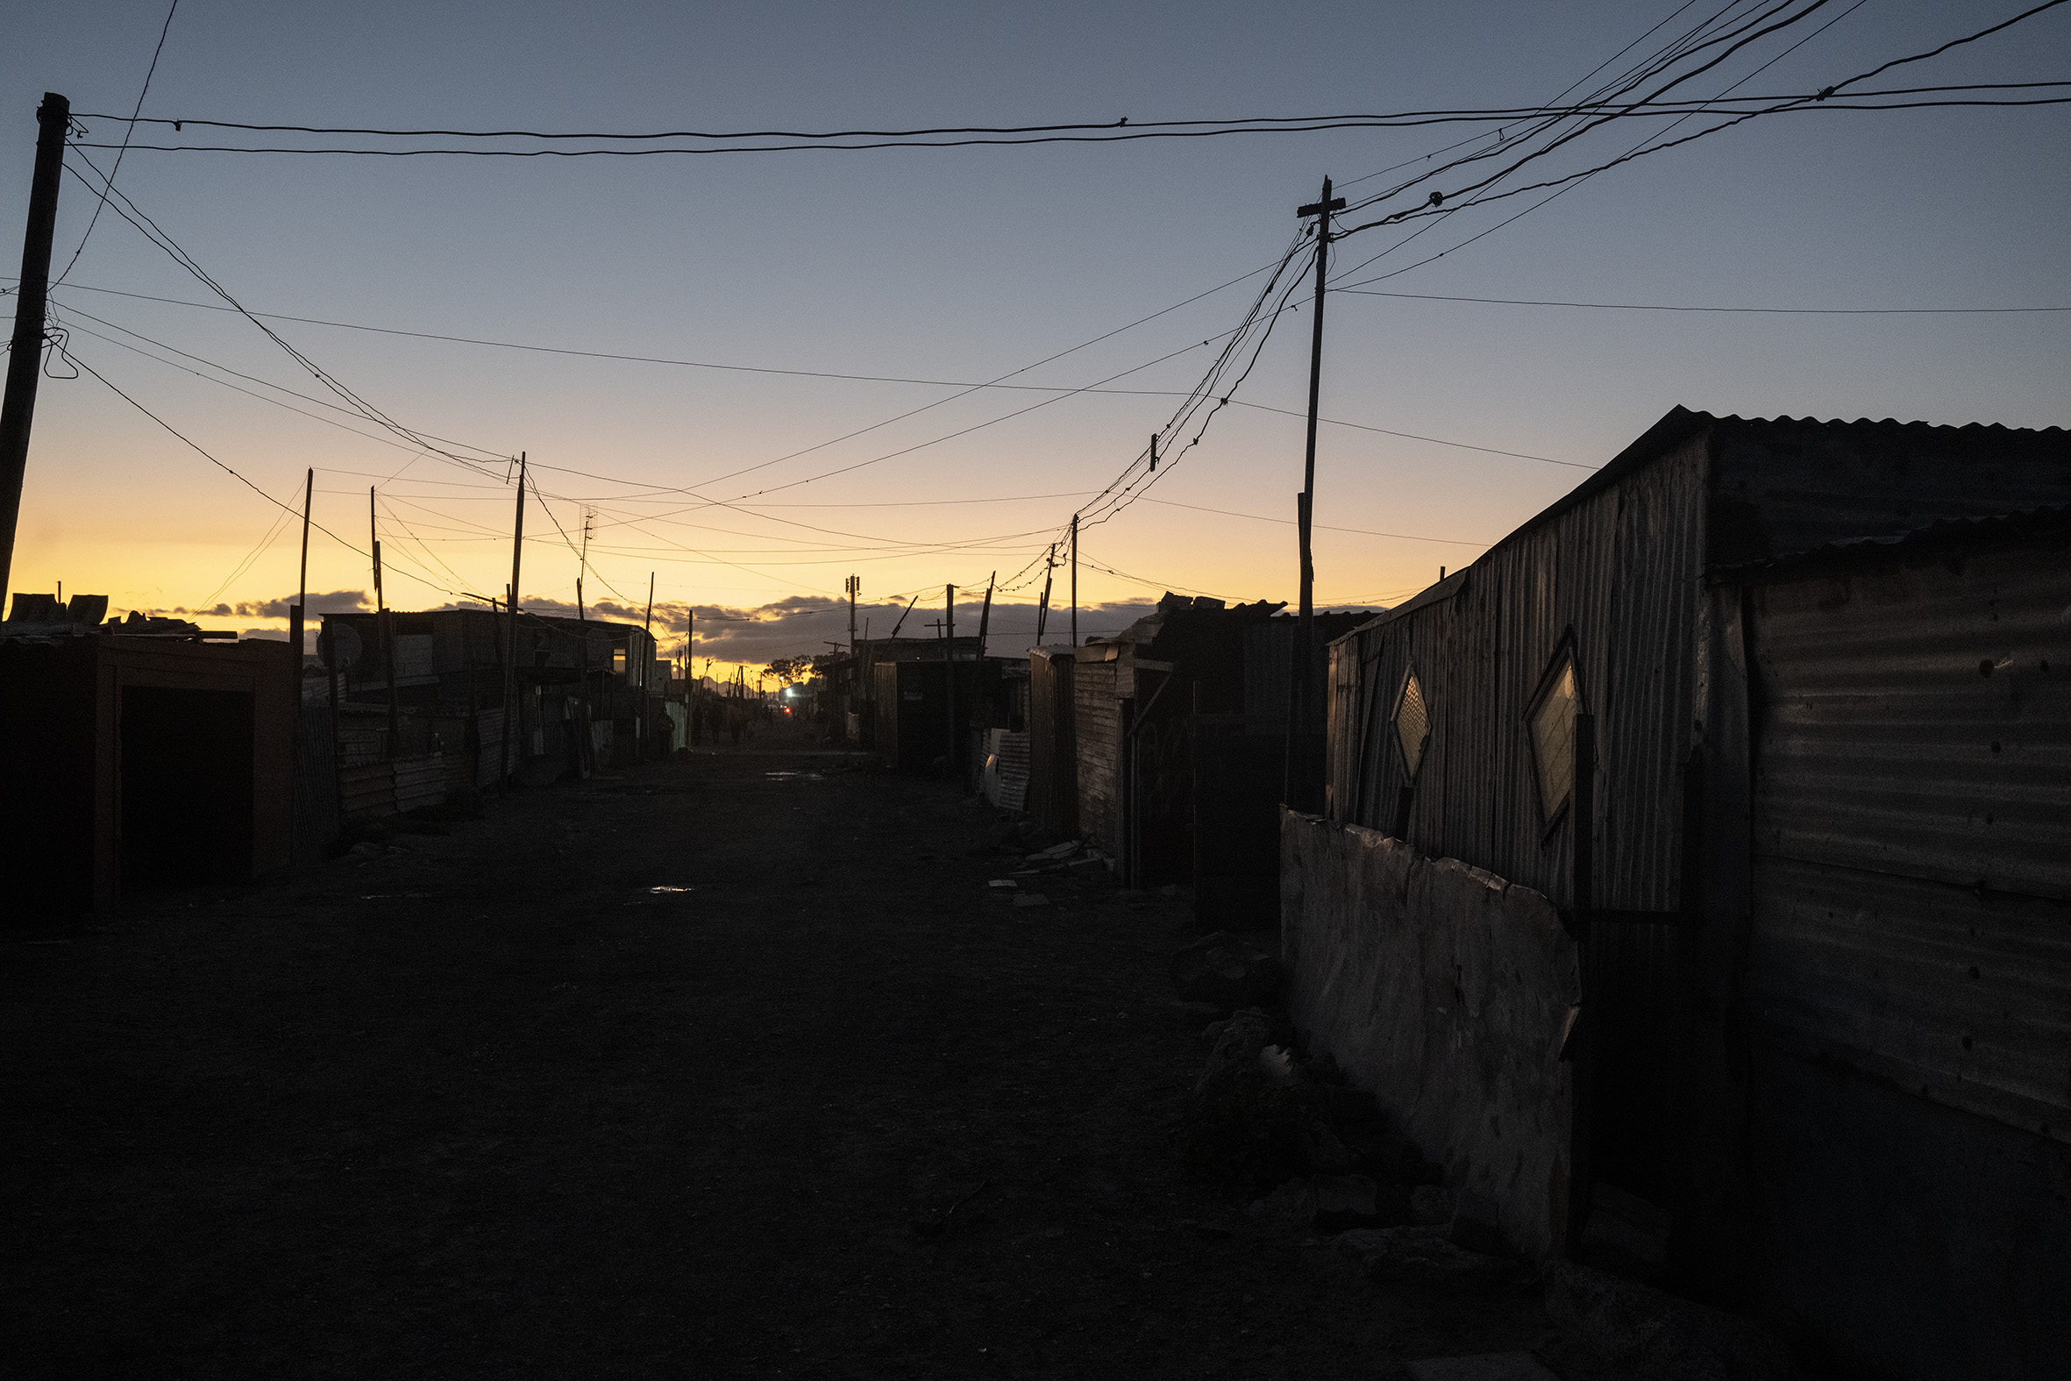
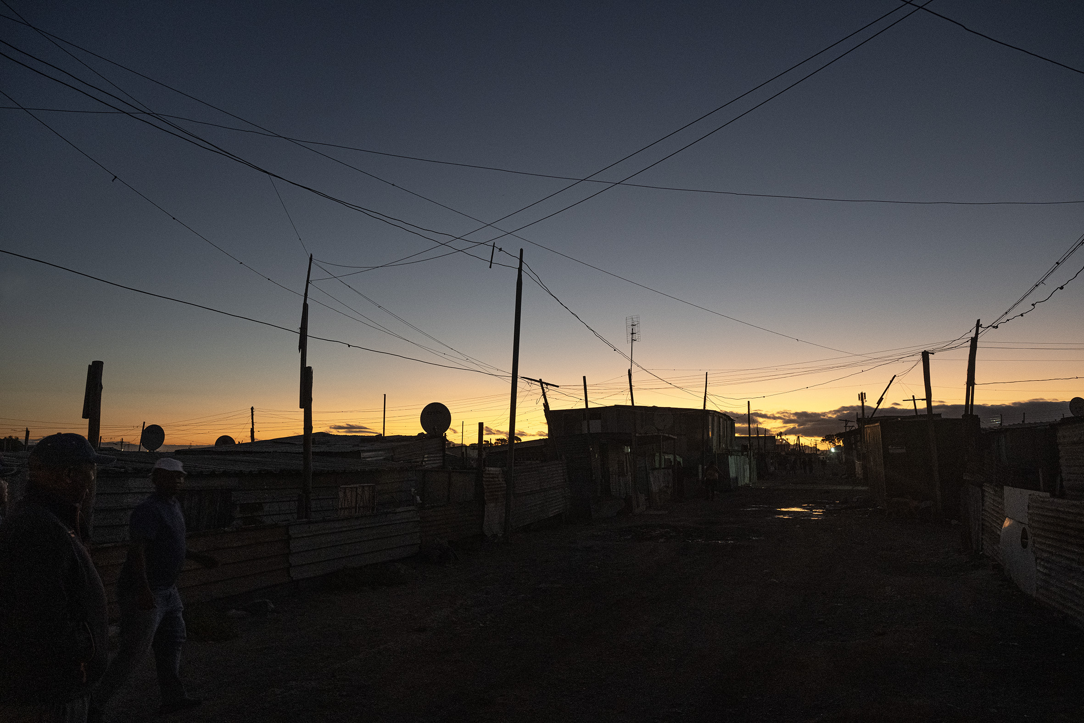
Marikana Informal Settlement at Night

Slide 8
Marikana Informal Settlement at Night

Slide 9
Phase 1: Project Design and Preparation ( October 2024 – June 2025)
Community Engagement
Setting up a Project Engagement Committee (PEC)
Site Prioritisation and Mapping
Baseline Survey
Detailed Design &Layout
Design and costing specification
Technology selection
Installation Guide
Operation and Maintenance plan
Regular engagements:
The councillor and Sub-council manager
Human Settlements department
EGD team: Public lighting unit and, Enterprise and Asset Management Unit
Phase 2: Planned Activities ( July 2025 – June 2026)
Procurement process and installation of solar lights in the settlement
Continue with M + E to gather data

Slide 10
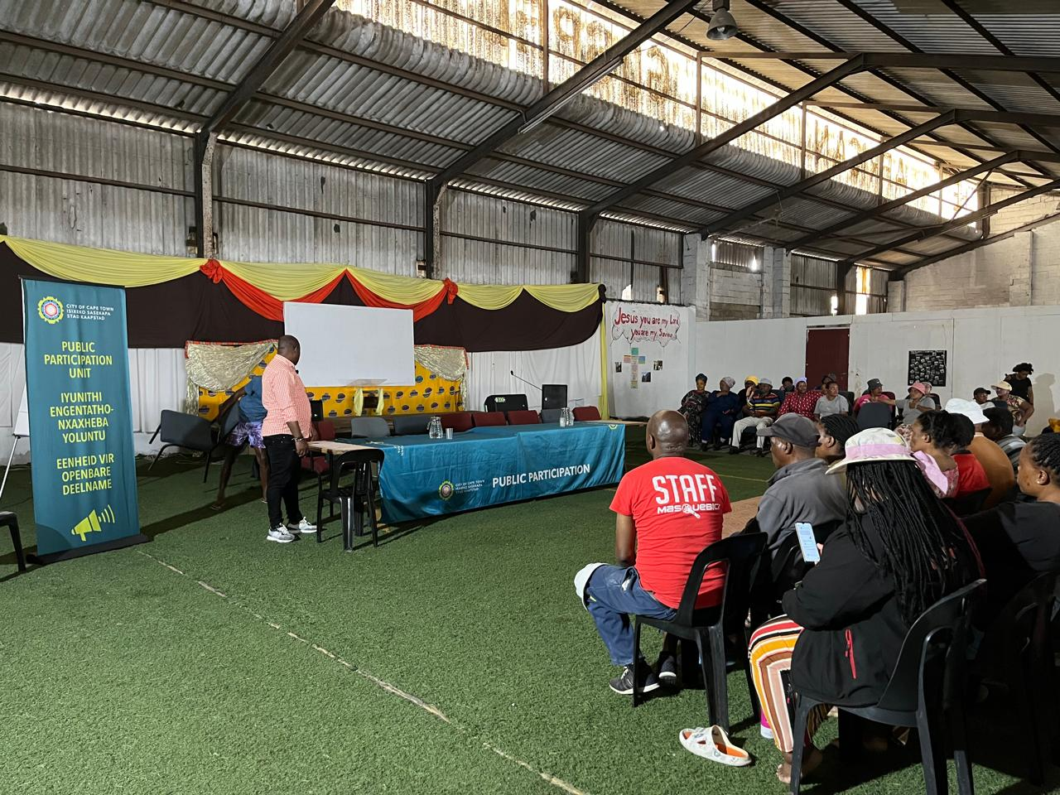
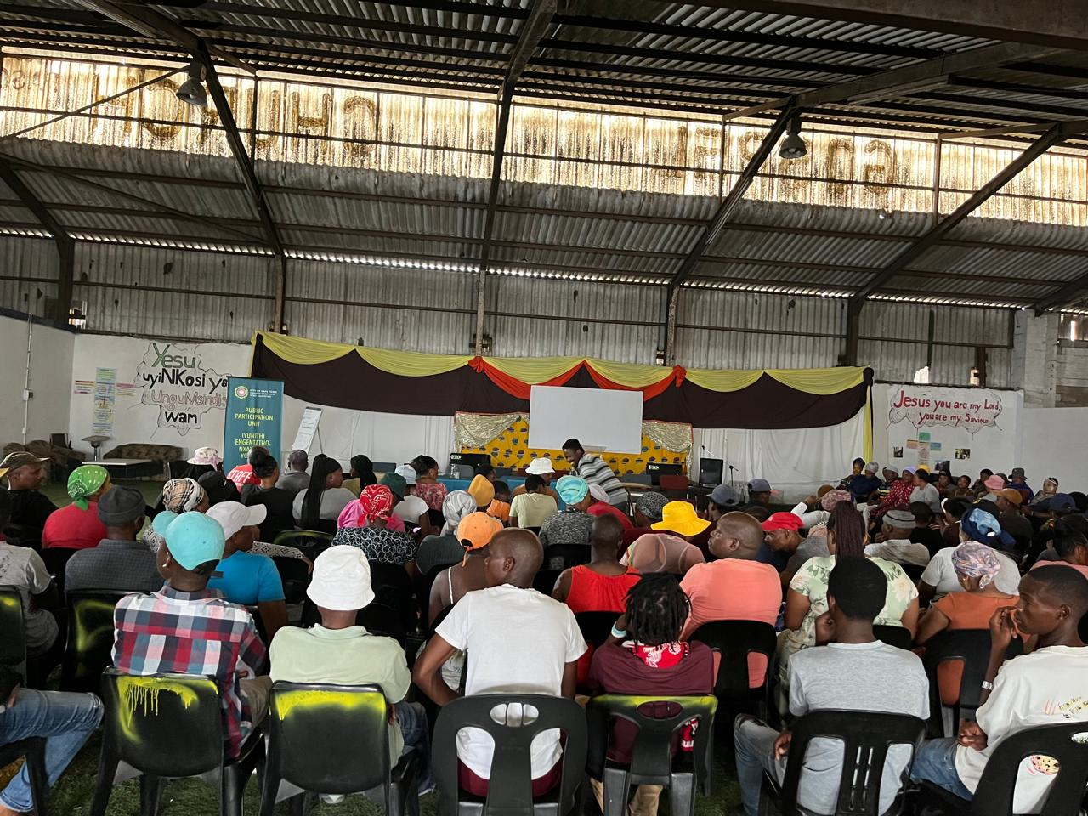
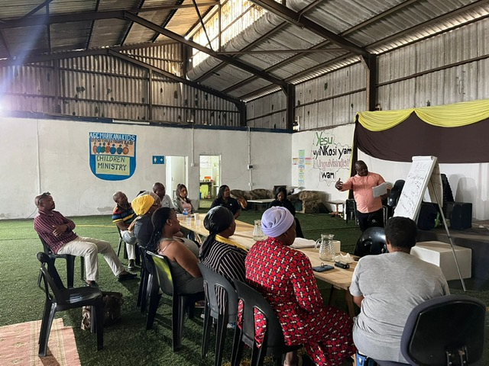
Community Engagement Activities
Presentations at sub-council meeting
Presentation to the community leaders ( Eskom and human settlements department representatives)
Public meeting with the assistance of the Public participation Unit and PEDI.
Formation of Project Engagement Committee (PEC)
PEC Terms of Reference (TOR), which set out how we will engage and resolve any disputes
Site visit and mapping - Marikana 1, 2 and Rholihlala

Slide 11
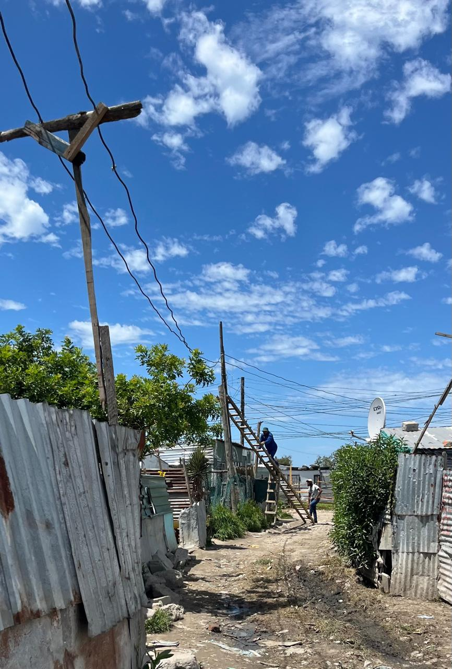
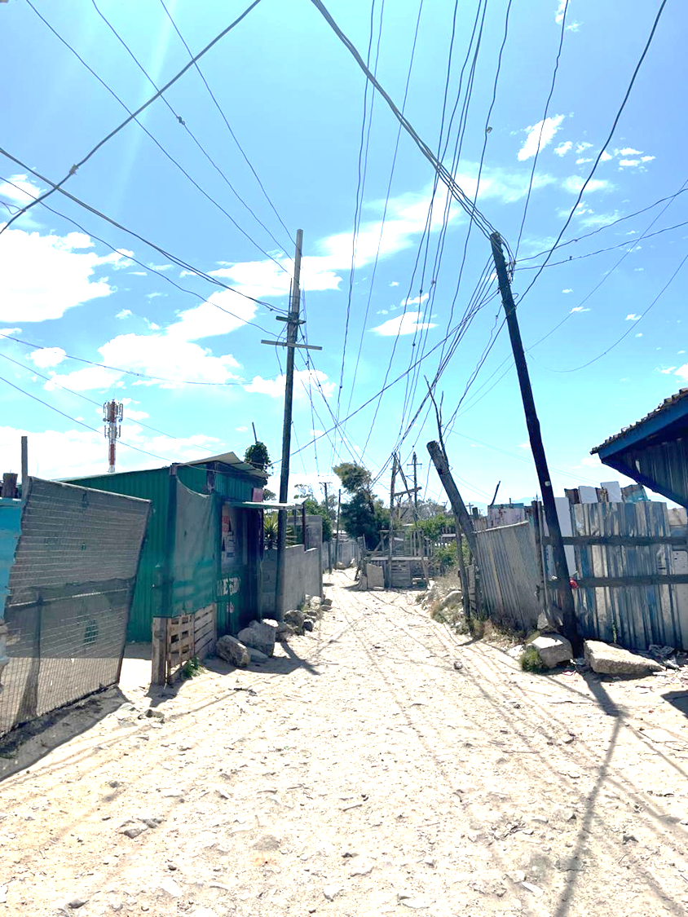
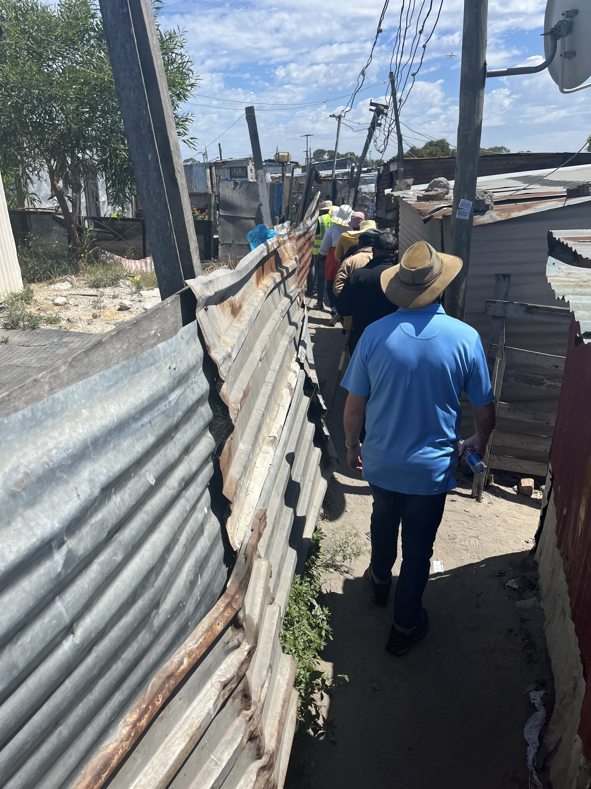
Observations from Marikana Site Visits
High rate of illegal connections.
Very narrow pathways
Densely populated
PEC pointed out key community areas (creches, churches, toilets etc.).

Slide 12
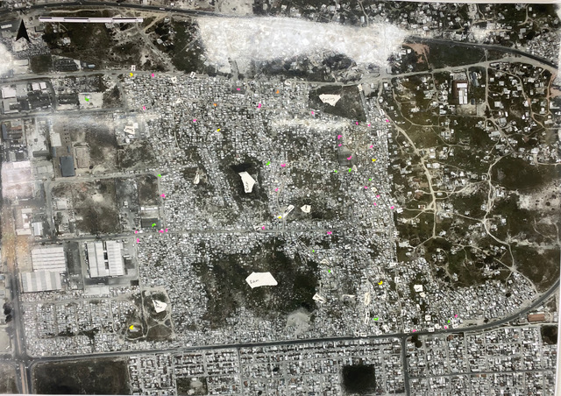
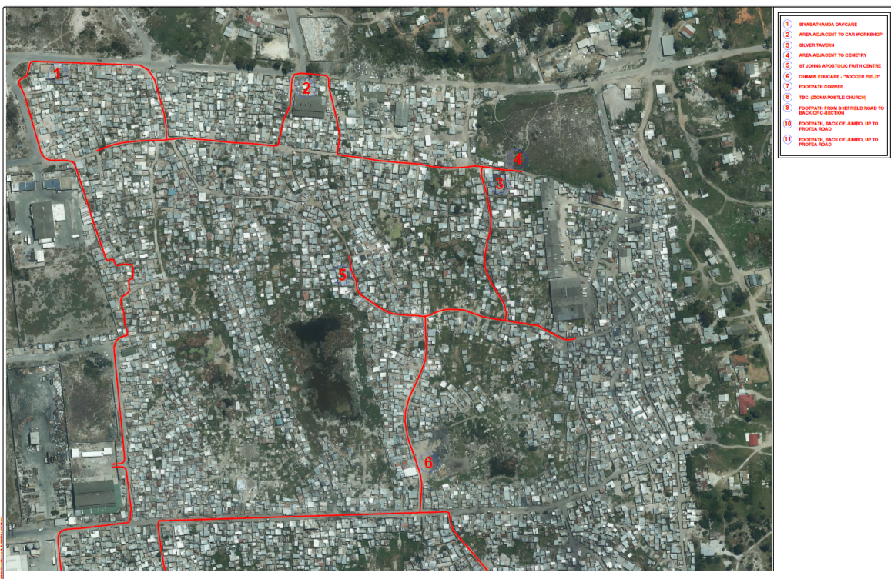
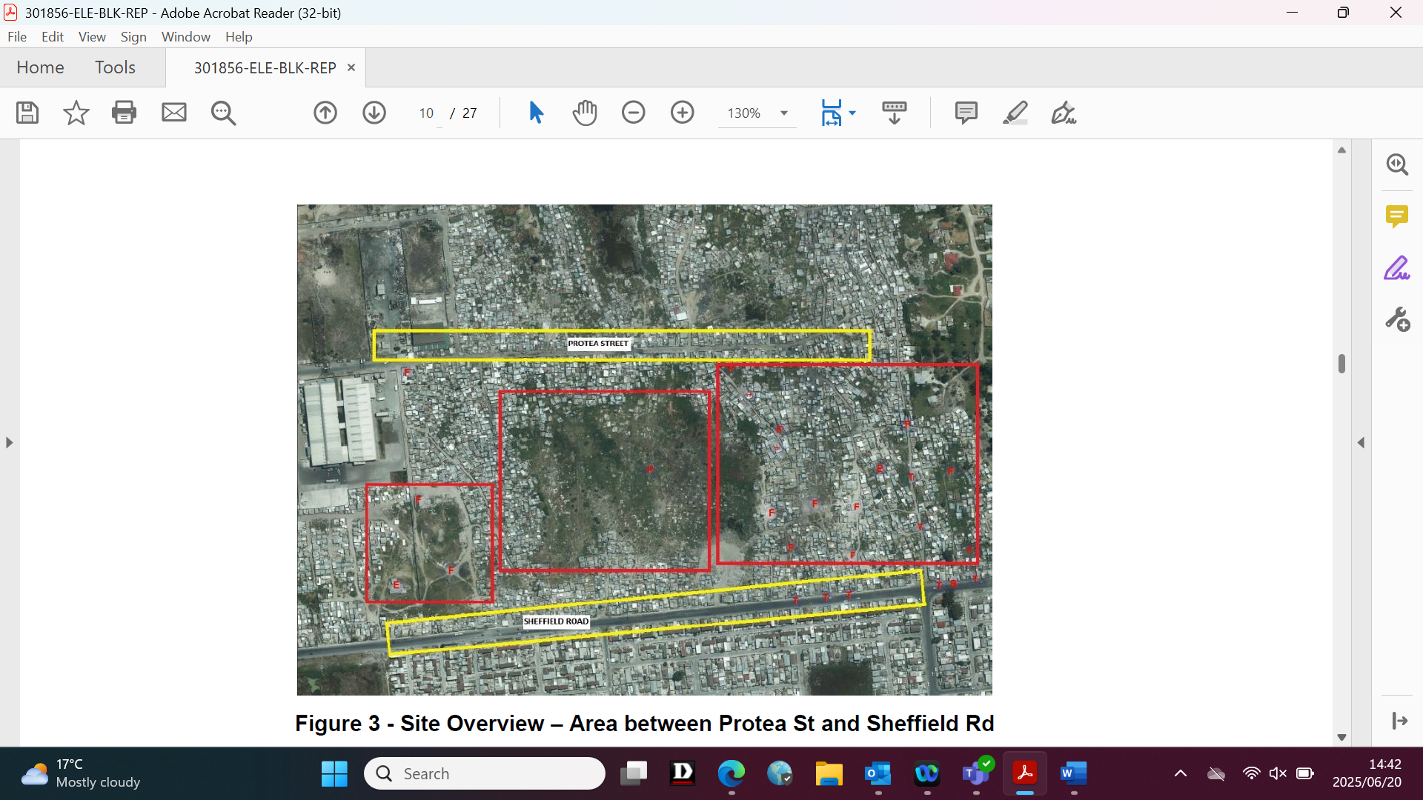
Key Priority Areas and Informal Pathways Mapping
Community Inputs Manually Marked
STRAVA informal pathways mapping
Key Priority Sites Mapped

Slide 13
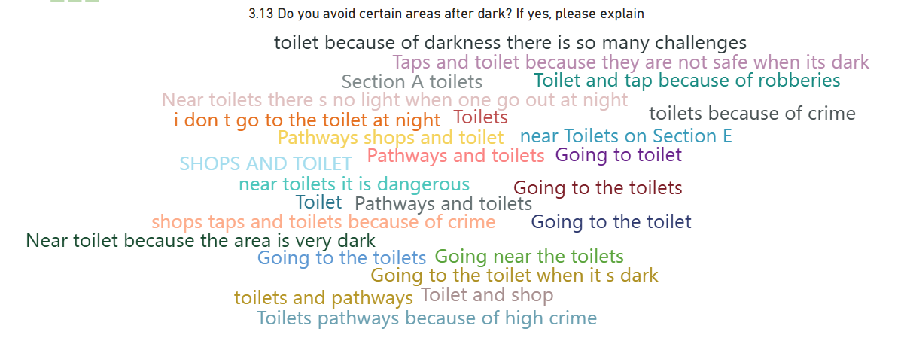
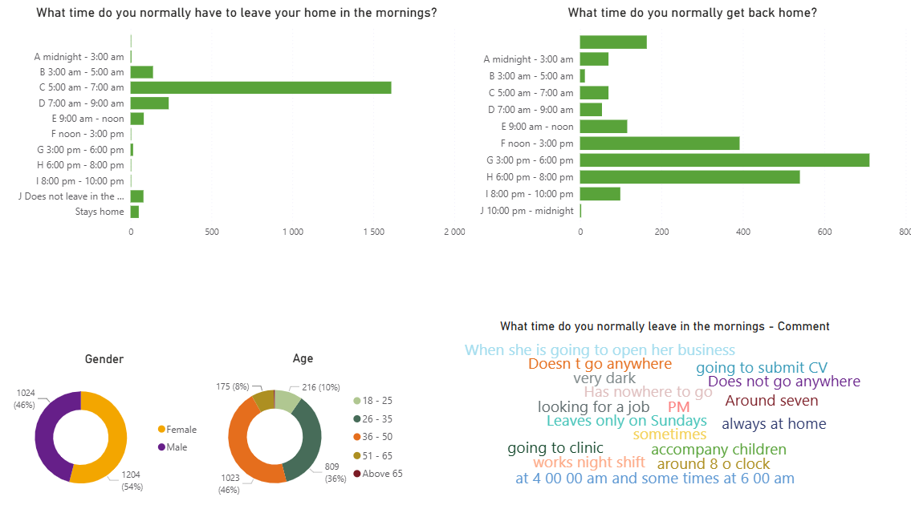
Community Survey
Key Informant Interviews with spaza shop owners, crèche owners, Law Enforcement, Commuters.
Baseline survey - 2231 people surveyed
A total of 14 local surveyors and 4 data capturers were recruited via PEC
7 community leaders supported survey teams for community entry and safety.
Survey design: Policy and Strategy department
Data collection: PEDI
Data analysis: Energy Systems Planning and Analysis

Slide 14
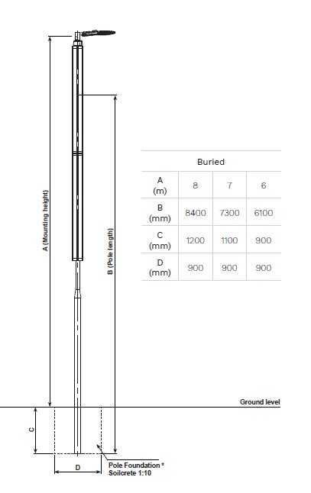
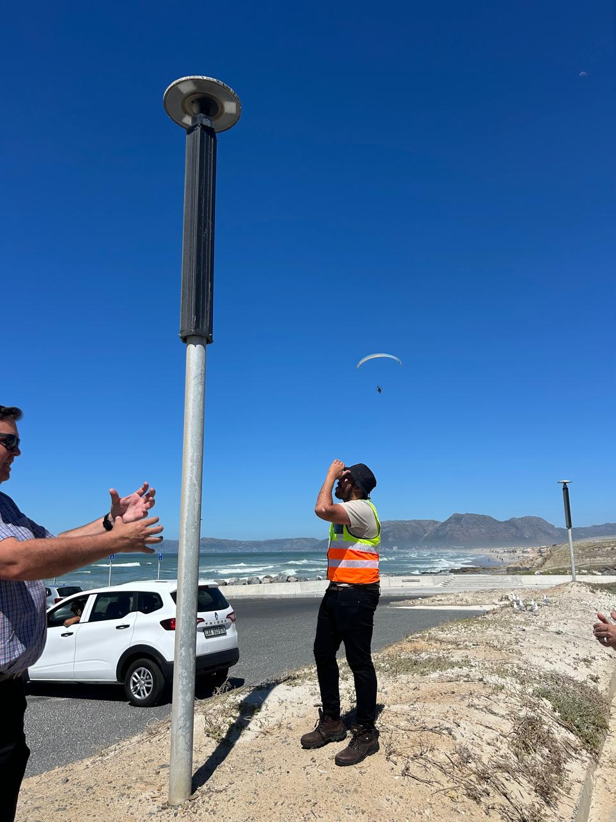
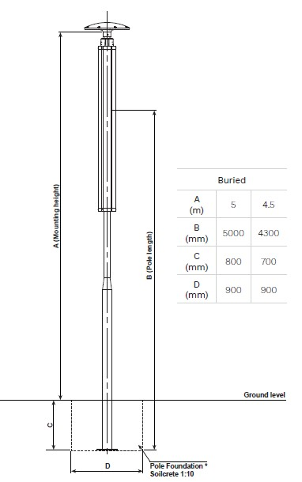
Considered Option Pole Mounted Solar Light
Installed in CCT Area – Strandfontein Pavilion
Installed by Recreation and Parks dept
± 18 months with no faults (faults reported since)
Option 1: 6-8m (steel pole)
Option 2: 3-4m post-top

Slide 15
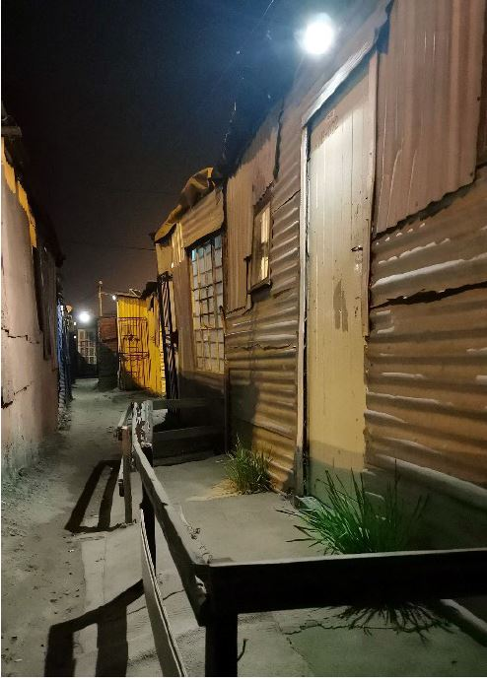
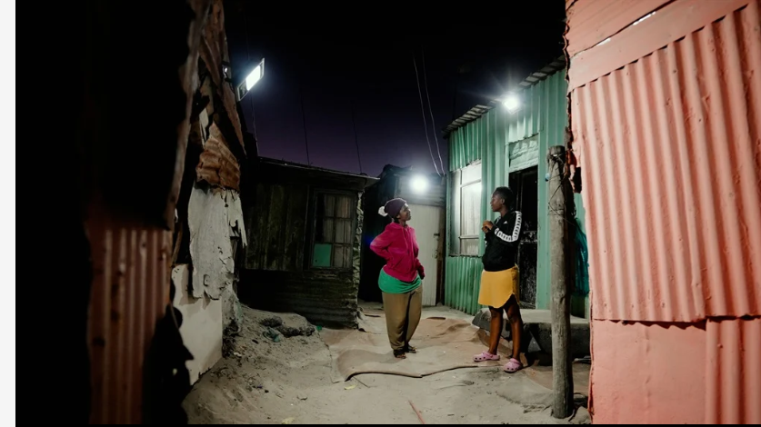
Selected Lighting Typology: Shack-Mounted Lights
Images from the lightup collective website

Slide 16
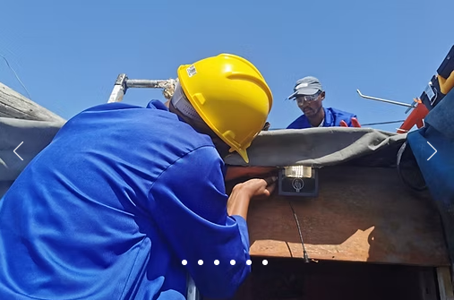
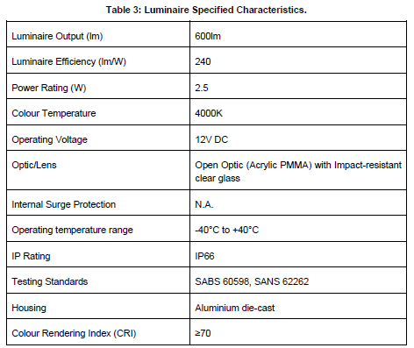
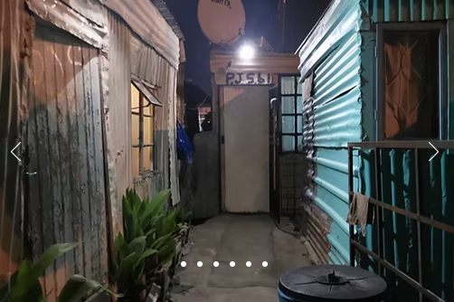
Pole Mounted Solar Light
Design
Proof of Concept - LightUp
Shack mounted Floodlight Type
Proven to have worked in informal settlements (LightUp pilot)
Individual solar powered floodlights to be fixed to informal structures / shacks
Readily available / off-the-shelf type solution
System autonomy – 12-15 hours (system configuration dependent)
Battery lifespan – 1 500-2 000 cycles, possible 4 - 5.5 years

Slide 17
Lessons Learnt
Institutional lessons
Advantage of a multi disciplinary team – views from various angles.
Needed to balance designs, compliance with SANS standards with in put on operations and maintenance which all affected the technology choice
Liability, a big challenge ( eskom vs City supplied areas)
Coordination with the human settlements department team
Governance lessons
Ownership of assets still not resolved
Maintenance and operations will require much more community involvement

Slide 18
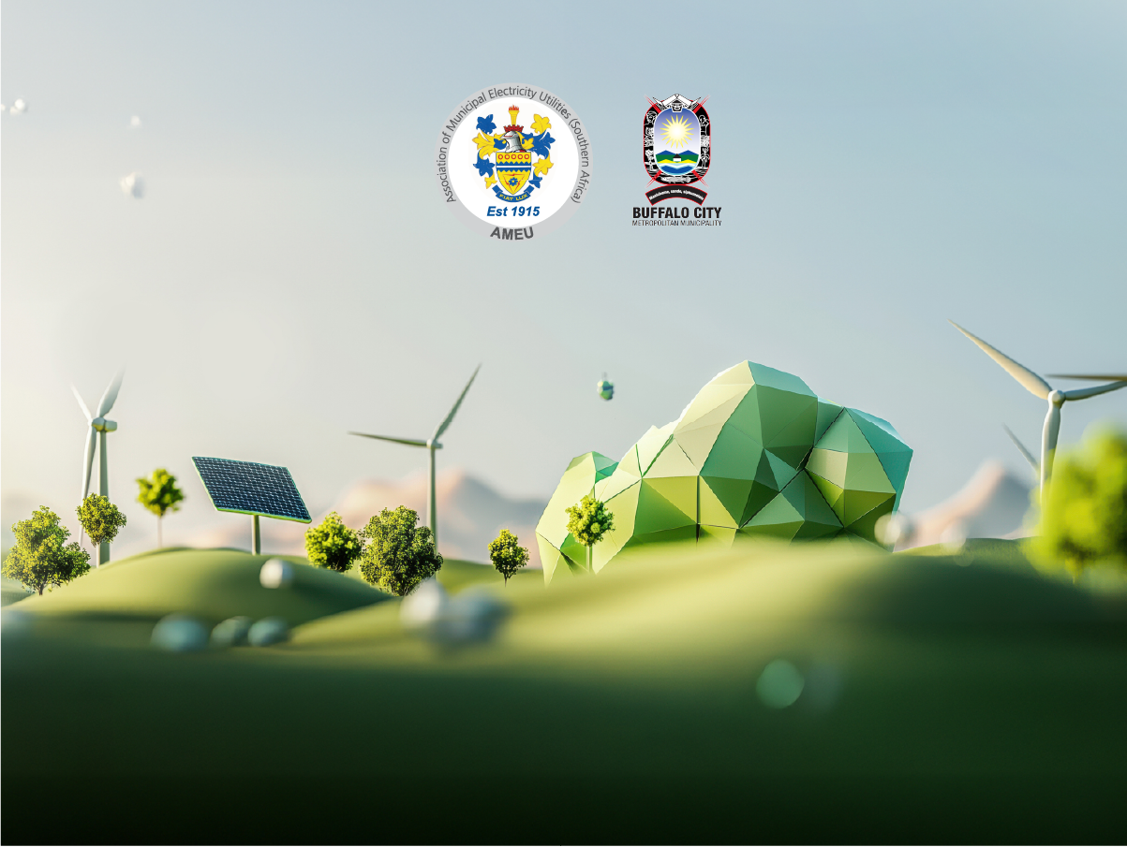
Thank you

