Slide 1
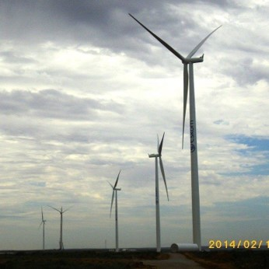
Virtual Wheeling
May 2025

Slide 2



Dx Wheeling Options
Varied >> simple transport to generation optimization to low voltage participation
Virtual Wheeling
(available)
Portfolio Wheeling
(coming soon FY2025)
One-to-one Wheeling
(available)
Large industry and mining
Low-voltage connections
Optimization large industry and mining and traders
Multiple generators and off-takers with or without portfolio.
LV and MV connected offtakers.
All connected generators and off-takers.
Energy Claims for Eskom Load Accounts and for Load Accounts linked to qualifying Municipalities.
Monthly reconciliation
Accounts qualifying for an Energy refund claim Payments must comply with business rules – this avoids debt.
Single generator to one or multiple off-takers.
Limited to HV and MV connected generators and off-takers.
Monthly reconciliation
Multiple generators and off-takers (across provincial borders)in a portfolio – investment optimization
Limited to HV and MV connected generators and off-takers.
Monthly reconciliation
Transacted in billing system

Slide 3
Wheeling Implementation
Varied >> simple transport to generation optimization to low voltage participation
Virtual Wheeling
(available)
Portfolio Wheeling
(coming soon FY2025)
Traditional Wheeling
(available)
Large industry and mining
Low-voltage connections
Optimization large industry and mining and traders
Agreed wheeling rates, or energy offset against the Bill
21 Gen- Wheeling Contracts active, 1 Municipal Wheeling Contract (8 Entities and 1 Municipality)
The current wheeling rates and offers are being reworked to ensure potential losses are not overlooked. This will have to be presented to NERSA before any changes can be implemented.
For Eskom Connected Loads, full recovery of billed charges before refund is processed.
Refunds at WEPS less losses, which is lower the energy charges for most Load Customers on LV.
Potential to add a management fee to these contracts due to volume transactions and administrative effort (contractual changes – adding and deleting participants, physical audit verifications).
Similar one-to one wheeling.
Recovery of multiple service, network charges per contract.
Potential to charge a management fee for these contracts similar to a KSACs fee as these contracts – monthly recons, contract changes, updates, monthly allocations changes.

Slide 4
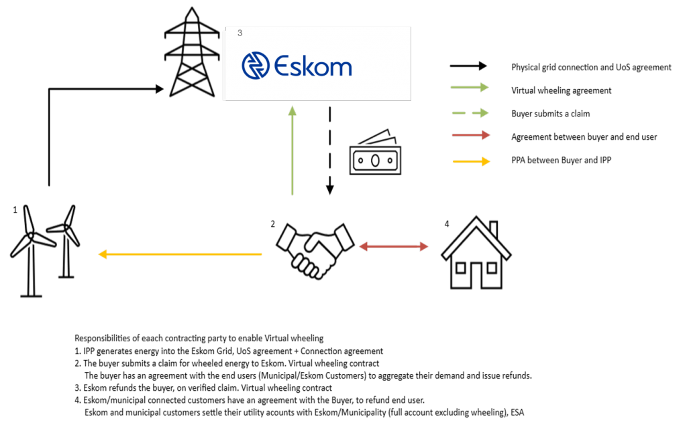
How does Virtual Wheeling work
Virtual wheeling enables retrospective energy claims (based on power purchase agreement with a generator) across all networks, irrespective of distributor boundaries in line with the Virtual Wheeling Business rules.
This process takes 45 - 60 days (customer Type dependent) from last day of Energy consumed (Bill generated, issued, paid, verified, claim initiated, claim verified, Claim processed)
End users/off-takers who have contracted with an entity for wheeled energy (Virtual wheeling) will still be required to settle their utility accounts with Eskom/the Municipality.
Eskom will refund energy claims for this product at WEPS, Local and Non-Local rates link to tariff book, depending on where the end user sits.
Claimant will submit a monthly claim to Eskom for wheeled energy to receive. their refund.
Virtual Wheeling - Distribution

Slide 5
Virtual Wheeling Business Rules
Eskom will not contract with the individual offtakers for such refund, only with the buyer. This includes municipalities; that is, there is no relationship between Eskom and the municipality for virtual wheeling. The municipal revenue will not be affected.
The refund to the buyer will be based on a wholesale rate WEPs), excluding losses, as losses are payable.
    Refund will be calculated based on TOU Periods
    Refund shall equal Total Energy consumed (Claimed metered points). Any additional Energy pushed onto the Grid can be sold or wheeled to another account or Entity.
Where an Eskom connected offtaker or a Municipality with municipal connected offtakers is in debt to Eskom, there will be no wheeled energy refund processed for the wheeled energy associated with the offtaker, until the Eskom account is in good standing.
  There is no avoidance of any tariff charges on each offtaker’s account.
    Eskom Connected End user – Must be on a Time of Use tariff (measured in TOU periods)
    Municipal Connected End user – Eskom metering standard compliant in a “good standing” Municipal Area
The buyer will be responsible for providing the data of all the municipal-connected offtakers in a format to be prescribed by Eskom.
No updated deposits or amendment agreements to the supply agreement shall be required for virtual wheeling agreements.
An administration charge will be raised (per day).
An application fee for processing will be charges

Slide 6
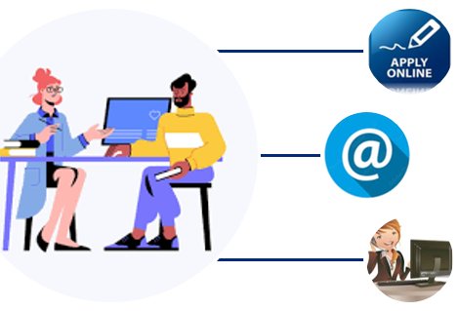









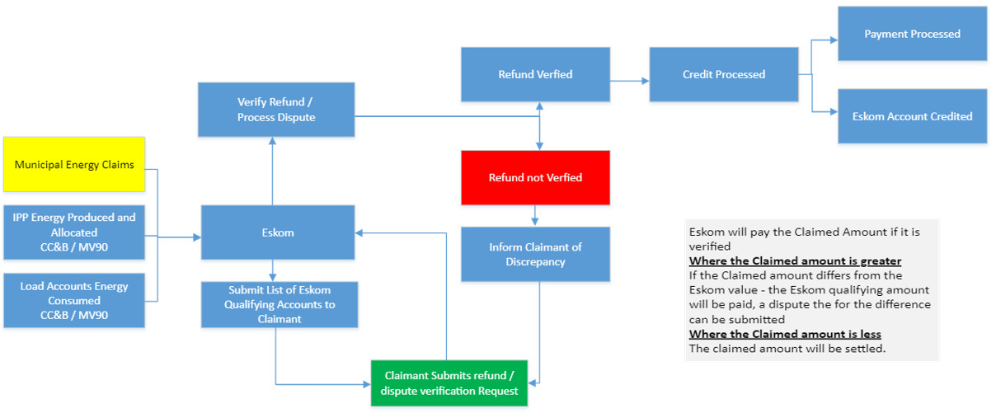
High Level End to End Process for Virtual Wheeling
Using the prescribed channel, applicant contacts Eskom to apply for VW
Confirmation of participants confirmed (Offtakers / Generators)
Contracts are developed
Customer signs all required agreements and provides all requested documents
Contracts Concluded
Account for the Owner of VW Contract is set up in Billing System
Claim Process Initiated & executed
Claim form received from Customer
Monthly Updates of Qualifying List Issued
All Eskom Offtakers incl. in Script for Account Status
Customer Created
This Contract will valid be for a specific period unlike Grid Connection Contracts

Slide 7
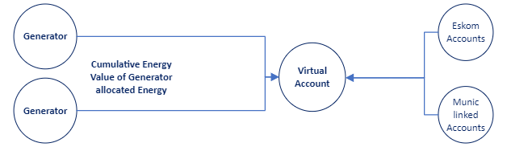
Virtual Wheeling Clarity (detail)
Claims
Only the cumulative energy will be claimable, no other charges or fees may be claimed.
Metering for accounts connected on the municipal side of the Grid must meet the Eskom metering specification - all premises and installed metering must be auditable. Random audits may be required to validate claims
Municipal linked accounts are only claimable if the municipality is in good standing with Eskom.
Eskom linked accounts are only claimable if the there is no outstanding debt on the account (excludes current account not due yet).
Eskom will settle claims based on;
  When the list of registered premises to be claimed for is amended, this amendment will be affected within a 30 day period. Notification has to be sent to Eskom for this change to be affected.
  Eskom will provide a list of qualifying accounts (via extract or system) to the claimant with the estimated energy claimable. On day 15 after the month end.
Should the claimant claim a value greater than the Eskom value, the estimated amount will be processed.
The difference between what was claimed vs what was paid, may follow a dispute process. If the dispute is deemed valid, the difference in the original claim and the vetted disputed amount will be processed.
Should any of the submitted values be proved incorrect or fraudulent, the claim in its entirety will not be processed. A new claim will have to be submitted.
Once a claim has been verified, the refund adjustment will be prepared for processing.
The refund amount is added to the Virtual account as a credit adjustment type.
Once the credit adjustment is loaded onto the account, the Refunds process will be initiated. This is an automated system process in the Billing System

Slide 8
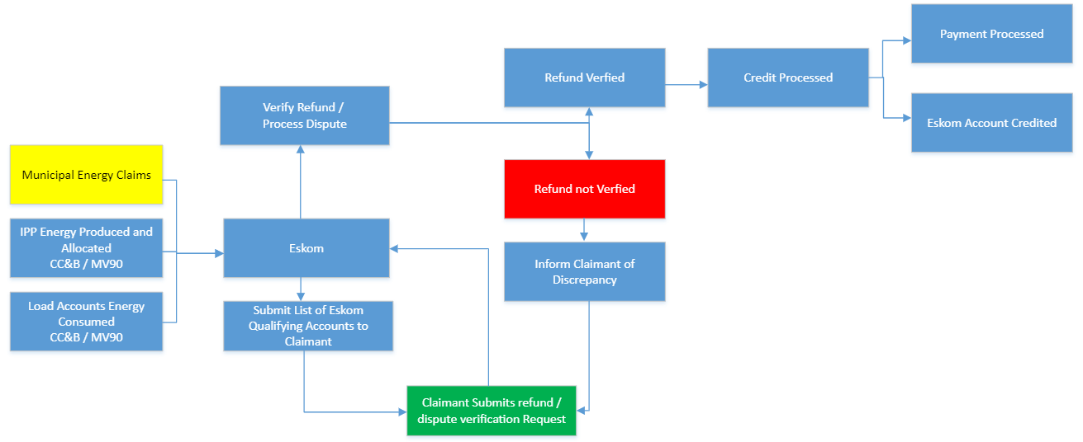
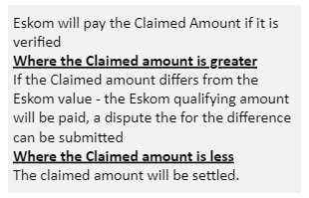
Virtual Wheeling Claims Process
High level Workflow for Quasi Manual / System Mapping
7 – 14 Days Process for Claims – Once claim has been received

Slide 9
Virtual Wheeling Pilot - Outcome
The Virtual Wheeling Pilot was initiated in June 2023 with Vodacom. The pilot is rolled out in 3 Phases to test the Quasi Manual Process to support the proof of concept;
Pre- Pilot – MOU, pilot requirements, Pilot Scope
April 2023 – October 2023
Phase 1 – Eskom linked Accounts only
November 2023 – February 2024
Testing Process, methodology, Completing ESAs, MOUs, Data Requirements
  No issues with the process or the methodology
  Calculations of claimed values within parameters (<0.5% Variance)
  Dispute Process Verified
  Challenges identified but not preventing sign-off:
  Unpaid accounts – 20% could not be claimed based on business rules
    Claim was adjusted accordingly
  Bill Date vs Calendar month Claims
    Variances for Vodacom in these values exceed 14% on a specific month
    Variance applied on other segments were as high as 50% in values.
    This will be a core business decision in terms of application, but not impacting this Pilot Testing
  No application received for Virtual Account
Phase 2 – Inclusion of Municipal linked Accounts
February 2024 – June 2024
Testing Process, methodology, Auditing of external sites, Meter specifications and Data
  No issues with the process, No issues with the methodology
  Calculations of claimed values within parameters (<0.2% Variance)
  Outstanding: Meter verification (Eskom dependent)
Phase 3 – Monthly runs (Claims)
April – October 2024
Testing the monthly overall implementation, onboarding of additional Partners
  In progress, monthly claims and processing (Dummy runs on actual Data and Accounts)
  Metering Checklist finalisation for Munic connected meters – submitted
  Pilot deemed successful – November 2024
Virtual Wheeling Pilot Team:
Mutenda Tshipala (Project Owner)
Ayesha Hardien (Pilot Lead)
Abduragmaan Jacobs (Revenue Management Lead)
Paula Snyman
Sanjeeth Ramdhani (Pilot Support)
Justus Beckett (Pilot Support)
Hylton Hiralal ((Pilot Support)
Until System automation is implemented, a Quasi-manual process has been implemented – expected implementation date April 2026:
Means all data extractions, data exchanges, and data processing is done via persons on spreadsheets, some manually executed sql,
Data exchanges are then from person to person via emails with those attached spreadsheets.
Differences/errors are manually detected by person and resolved via emails and meetings.

Slide 10
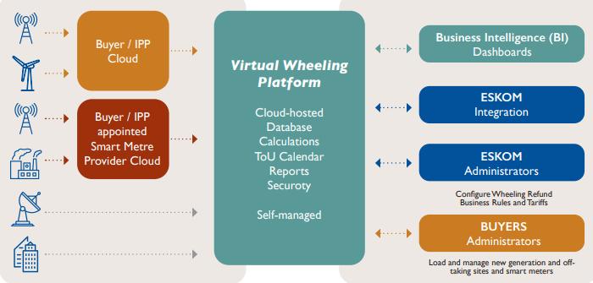
System Solution – Final View

Slide 11

Wheeling One-stop-shop – Client Office
The Wheeling One stop Shop (Client office) will provide the following services:
Internal Deliverables
  To provide guidance / training to Customer Execs when requested
    Traditional Wheeling - will remain with the Cluster to manage, advisory services provided by the One – stop - Shop
    Portfolio Wheeling – To co-ordinate agreements (involving 1 or multiple Generators / Offtakers across Provincial Boundaries), billing, governance in collaboration with Cluster Customer Executives and GAU.
    Virtual Wheeling - To develop the agreements (CUoSA and ESA) for virtual wheeling..
  Develop and test processes, systems, contracts, rules, tariffs, governance - To provide wheeling transaction validations, reporting, resolving queries and propose operational and technical remedies.
    Functional Specification Document for Energy Trading (including Virtual Wheeling) completed. RFP issued to market in April 2025..
    Portfolio Wheeling - Billing System development (Phase 1) completed. Ready for Billing
  Marketing materials, messaging, Website (external), coordinate Campaigns..
External Deliverables
  To serve as a coordination desk for wheeling enquiries and requests.
    5 to 6 requests from Traders, Companies already responded on since September
  To co-ordinate multi-provincial agreements - Provide 1 singular point of contact.
  Update all communication platforms regarding Wheeling
  Advisory Services - to guide on which products and services are suitable for specific scenarios
Clientservices@eskom.co.za

Slide 12


Thank you

